Slide 1
Science and Magical Thinking
English 110

Slide 2
Believe nothing, no matter where you read it, or who said it, no matter if I have said it, unless it agrees with your own reason and your own common sense.
Buddha

Slide 3
What is Magical thinking?
In anthropology, psychology, and cognitive science, the term magical thinking is used to describe causal reasoning that looks for correlation between acts or utterances and certain events. In religion, folk religion and superstition, the correlation posited is between religious ritual, such as prayer, sacrifice or the observance of a taboo, and an expected benefit or recompense.
Huh?
How about some examples?
Magical thinking - Wiki
YouTube - The Seven Principles of Magical Thinking
http://www.csicop.org/si/show/belief_engine/

Slide 4
What is Magical thinking?
Give some specific examples of your own…

Slide 5
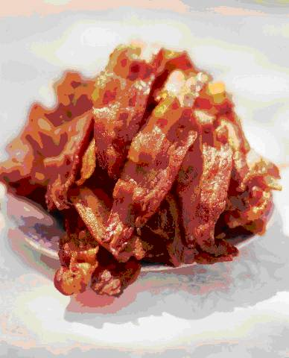
Scientific thinking
Timeline of the historyof the scientific method-Highlights
Bacon’s (Roger then Francis) famous cycle: observation, hypothesis, experimentation
Authors write many things and the people cling to them through arguments which they make without experiment, that are utterly false. It is commonly believed among all classes that one can break adamant only with the blood of a goat, and philosophers and theologians strengthen this myth. But it is not yet proved by adamant being broken by blood of this kind, as much as it is argued to this conclusion. And yet, even without the blood it can be broken with ease. I have seen this with my eyes; and this must needs be because gems cannot be cut out save by the breaking of the stone. Similarly it is commonly believed that the secretions of the beaver that the doctors use are the testicles of the male, but this is not so, as the beaver has this secretion beneath its breast and even the male as well as the female produces a secretion of this kind. In addition also to this secretion the male has its testicles in the natural place and thus again it is a horrible lie that, since hunters chase the beaver for this secretion, the beaver knowing what they are after, tears out his testicles with his teeth and throws them away. Roger Bacon-1268 A.D.
Having laid down the main points of the wisdom of the Latins as regards language, mathematics and optics, I wish now to review the principles of wisdom from the point of view of experimental science, because without experiment it is impossible to know anything thoroughly.
Roger Bacon-1268 A.D.

Slide 6
Scientific thinking
Is scientific investigation always “non-magical?”
ASK ME…

Slide 7
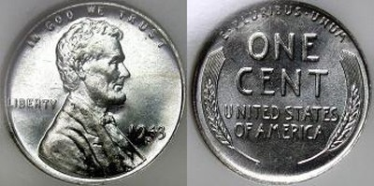
Scientific thinking: “minute” Paper
Try to explain what just happened. Is it alchemy (magical) or should we think critically about it first ?
1) Ask the overarching question raised by your observations
2) Come up with an explanation (hypothesis). More than one is OK. Your experiments can eliminate some of them.
3) Describe at least 3 experiments you could do (maybe now!) or three questions about the system you could ask me to answer to support your hypothesis…

Slide 8
Modern Magical thinking
Sympathetic magic- the doctrine of signatures
Modern version? Homeopathic medicine “magic”
Like cures like
YouTube - HeadOn!
YouTube – Headon parody
YouTube - James Randi
Penn and Teller (ill-logic of correlation)
YouTube - Ben Goldacre
YouTube – Homeopathy-Pro-Introduction
YouTube – Pro-Making Homeopathic Medicines

Slide 9
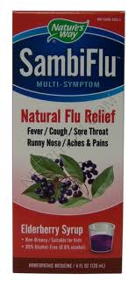
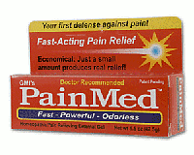
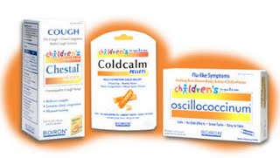
Modern Magical thinking: more homeopathic products

