Slide 1
CHEM 304 - 2/17/12
I.B. Stratospheric chemistry: Ozone
Catalytic Ozone Depletion
- Catalyst “Families” (HO_{x}, NO_{x}, ClO_{x})
- Reservoirs and Sinks
QUIZ #2: M

Slide 2
3 Main (1 + additional) Catalytic Families:
“HO_{x}”: H, OH, HO₂
“NO_{x}”: NO, NO₂, (NO₃ - technically not included)
“ClO_{x}”: Cl, ClO, (ClO₂)
“BrO_{x}”: Br, BrO, (BrO₂ - ? May not exist ?)

Slide 3
Some lingo regarding “Trace species” (e.g. pollutants, reactive substances, etc.)
Source: reaction or process that release trace compound.
Sink: Reaction or process that “permanently” removes trace compound.
Reservoir: An entity (process, substance, physical feature) that temporarily holds a trace substance

Slide 4
Catalyst Sources: Substance must be resilient to these key (tropospheric) loss processes.
Wet Deposition or “rain out”: Is it H₂O Soluble?
Reaction w/ OH: Does it have an H?
Photochemistry: Does it absorb λ>300nm?

Slide 5
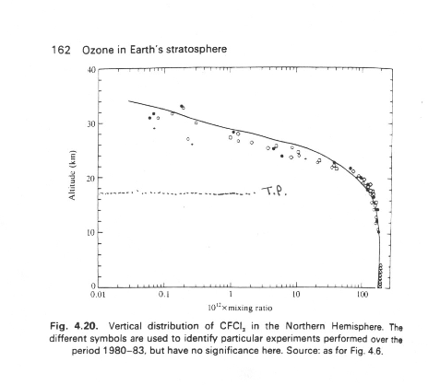
Vertical Distribution of CFC’s…

Slide 6
A real world question: How might you modify the structure of a CFC to yet reduce its contribution to stratospheric ClOx, yet retain, as much as possible, its physical properties?
(Hint: How would you keep it out of the stratosphere …)

Slide 7
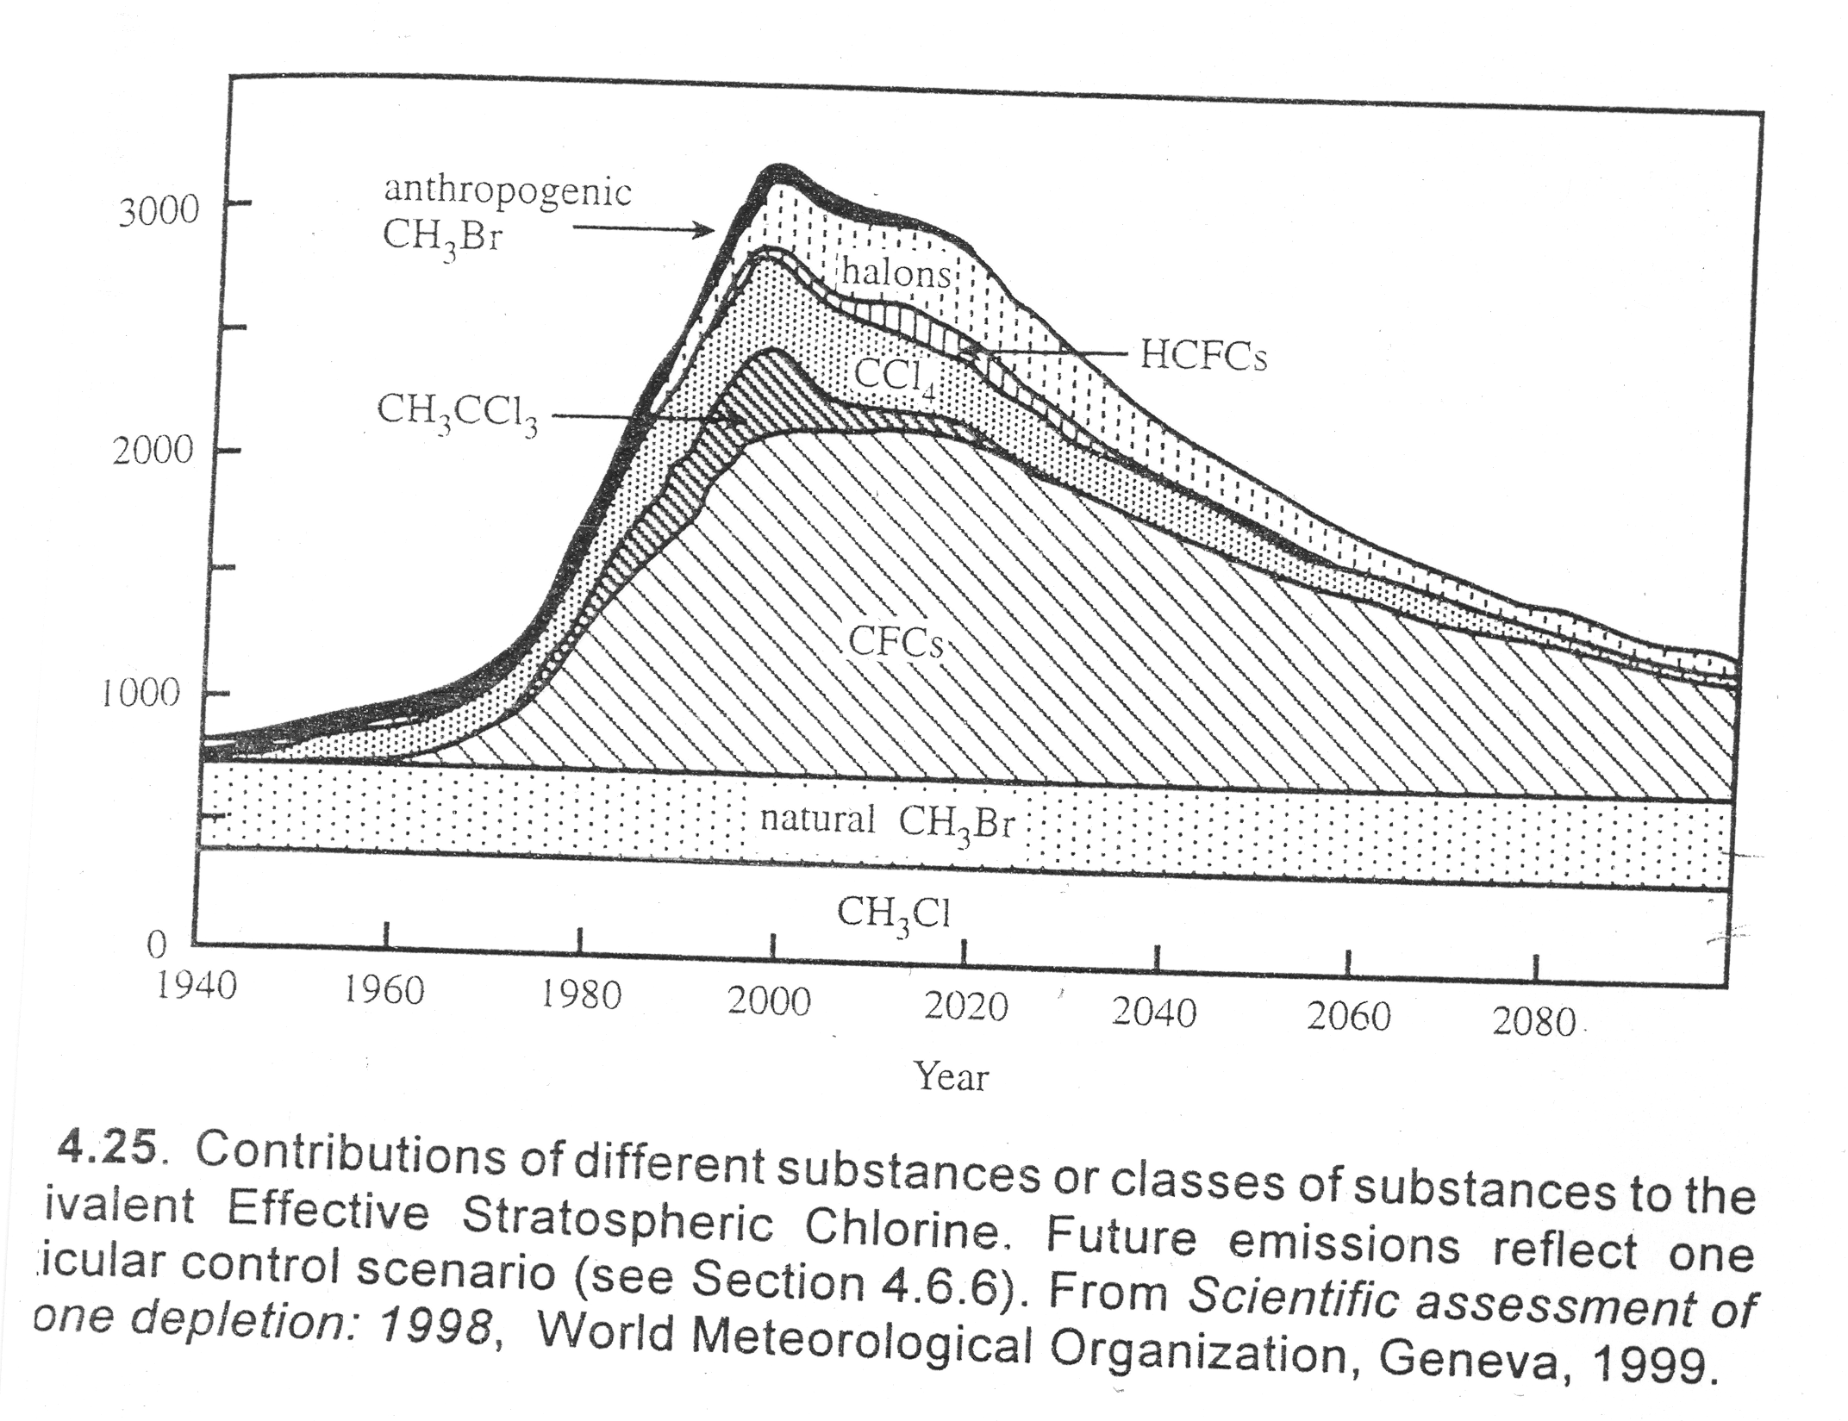
Contributions to stratospheric Chlorine “load” – this graphic does not work

Slide 8
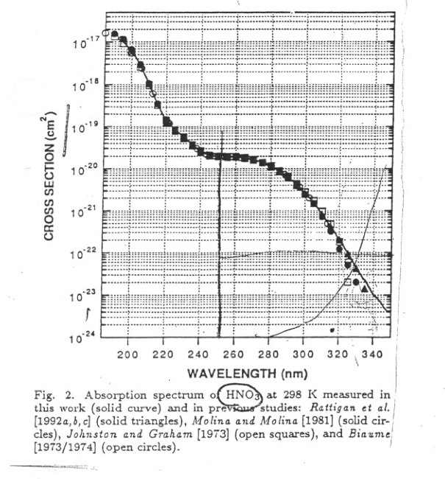
UV/VIS Spectrum of HO-NO₂ (i.e. HNO₃)
τ = 1.2 x10⁶ sec.
= ~ 14 days

Slide 9
UV/VIS Spectrum of ClO-NO₂
τ = 1.7 x10⁴ sec.
= ~ 4.7 hours

Slide 10
UV/VIS Spectrum of BrO-NO₂
τ = 2 x10³ sec.
= ~ 0.55 hours!

Slide 11
UV/VIS Spectrum of HO-NO₂ (i.e. HNO₃)
τ = 1.2 x10⁶ sec.
= ~ 14 days
(altitude average … shorter in stratosphere)
Notes:
11

Slide 12
UV/VIS Spectrum of ClO-NO₂
τ = 1.7 x10⁴ sec.
= ~ 4.7 hours
Notes:
12

Slide 13
UV/VIS Spectrum of BrO-NO₂
τ = 2 x10³ sec.
= ~ 0.55 hours!
Notes:
13

Slide 14
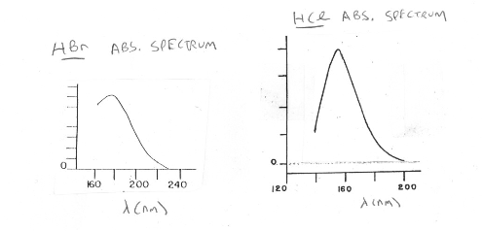
Why BrOx is so much more destructive than ClOx:
UV Spectra of HCl and HBr

