Slide 1
CHEM 304 - 2/15/12
I.C Strat. Chemistry: Catalytic Ozone Depletion
- Catalyst “Families” (HO_{x}, NO_{x}, ClO_{x})
- Reaction Paths/Cycles (#1, #2, #3)
- Sources of HO_{x}, NO_{x}, ClO_{x}
Web updated today (HW #3, #4, and O₃ key)
QUIZ M on see – email/web for scope.

Slide 2
3 Main (1 + additional) Catalytic Families:
“HO_{x}”: H, OH, HO₂
“NO_{x}”: NO, NO₂, (NO₃ - technically not included)
“ClO_{x}”: Cl, ClO, (ClO₂)
“BrO_{x}”: Br, BrO, (BrO₂ - ? May not exist ? )

Slide 3
Write a 2-reaction path 1 cycle w/ X=NO.
NO + O₃ —> NO₂ + O₂
NO₂ + O₃ —> NO + O₂

Slide 4
Write a 2-reaction path 2 “null” cycle w/ X=NO.
NO + O₃ —> NO₂ + O₂
NO₂ + hν —> NO + O

Slide 5
Write a 2-reaction path 3 cycle w/ X=OH.
HO + O₃ —> HO₂ + O₂
HO₂ + O₃ —> HO + O₂

Slide 6
Some lingo regarding “Trace species” (e.g. pollutants, reactive substances, etc.)
Source: reaction or process that release trace compound.
Sink: Reaction or process that “permanently” removes trace compound.
Reservoir: An entity (process, substance, physical feature) that temporarily holds a trace substance

Slide 7
Catalyst Sources: Substance must be resilient to these key (tropospheric) loss processes.
Wet Deposition or “rain out”: Is it H₂O Soluble?
Reaction w/ OH: Does it have an H?
Photochemistry: Does it absorb λ>300nm?

Slide 8
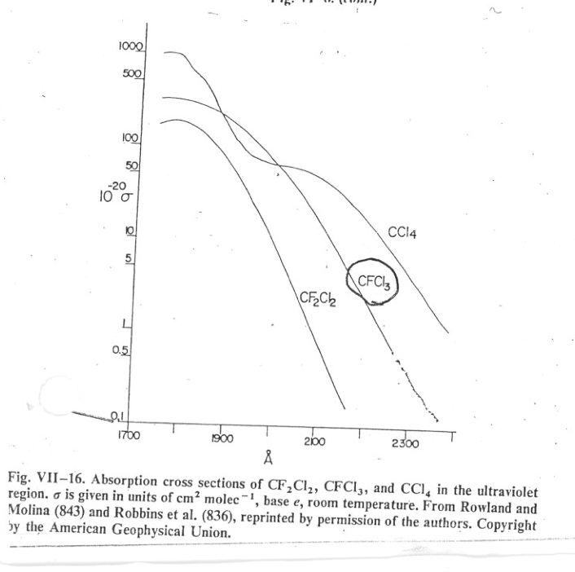
Absorption spectra of CFC’s

Slide 9
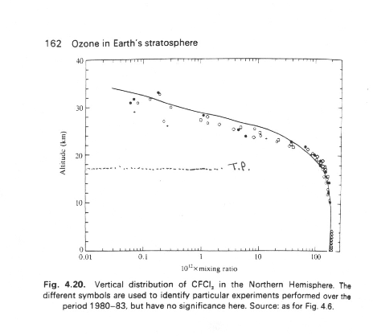
Vertical Distribution of CFC’s…

Slide 10
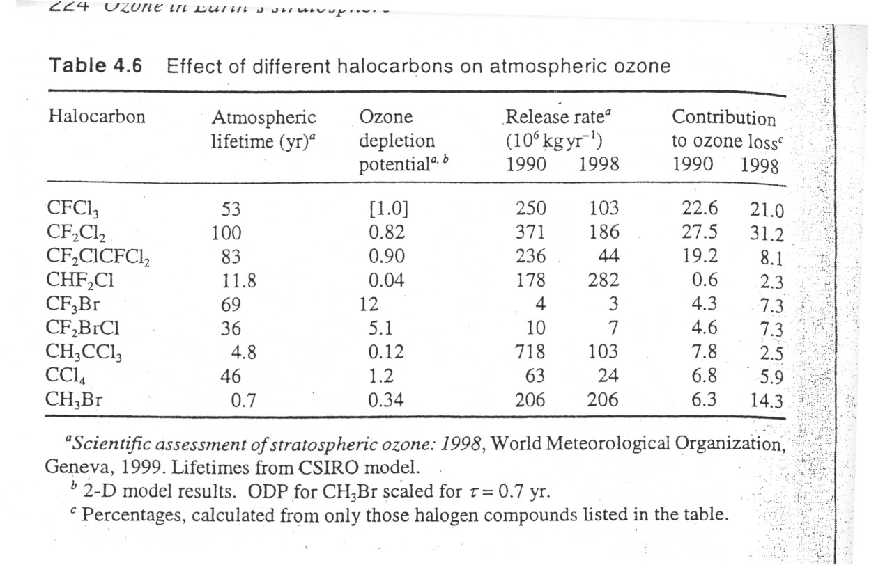
Lifetimes of CFC’s and related compounds this graphic does not work

Slide 11
A real world question: How might you modify the structure of a CFC to yet reduce its contribution to stratospheric ClOx, yet retain, as much as possible, its physical properties?
(Hint: How would you keep it out of the stratosphere …)

