Slide 1
CHEM 304 - 2/13/12
I.B Stratospheric chemistry: Ozone
- Fundamentals: Photochemistry
- Rationalizing O₃ “layer” via Chapman
I.C Stratospheric Chemistry: Catalytic Ozone Depletion
- Catalyst “Families” (HO_{x}, NO_{x}, ClO_{x})
FINISH CH 1 – O₃ handout W.
HW #3 via e-mail today (for real...) key on web soon

Slide 2
Photochemical Reactivity: 3 KEY questions
1) What wavelength does molecule absorb?
2) What altitudes are they available at?
3) Does the radiation carry enough E to break a bond ? (almost always YES!)

Slide 3
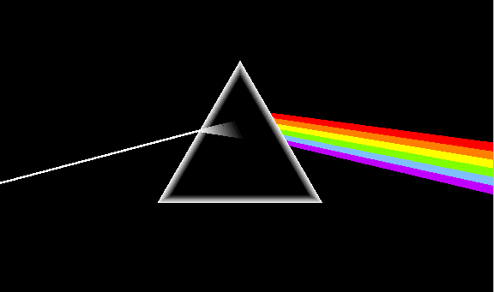
A spectroscopy measurement …
I_{o} = MT
SAMPLE
D
I = sample
l
σ = “absorption cross-section” units of cm² (or cm²/molec.)

Slide 4
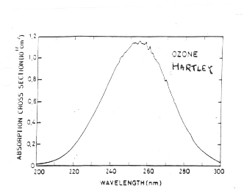
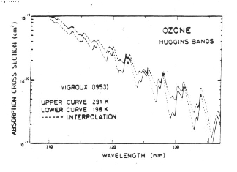
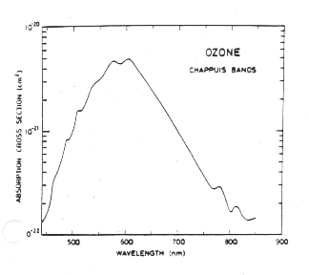
Absorption bands of O3…

Slide 5
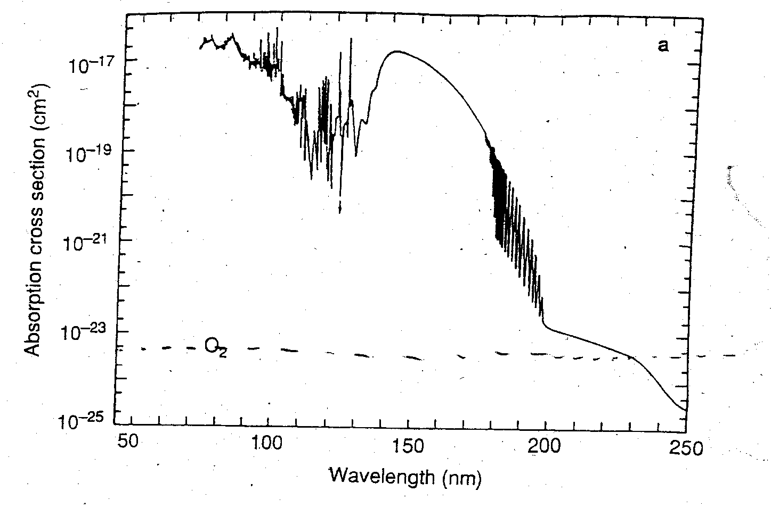
Absorption bands of O2…

Slide 6
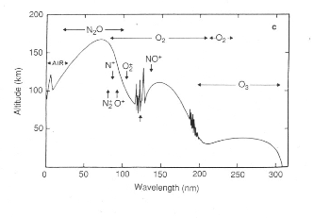
Light Penetration…
< 200 nm only HI stratosphere & above
200-300nm —> filtered in stratosphere VARIABLE w/ ALT.
(200-230 O₂ & O₃ absorption, 230-300 O₃ absorption)
> 300 nm —> penetrates to surface!

Slide 7
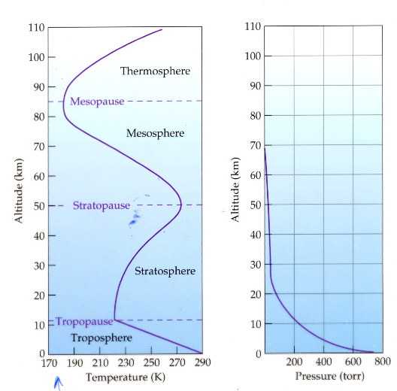
Vertical distribution of [M] …
<— not enough M for O₃ production up high
<— no λ<242 down here!

