Slide 1
CHEM 304 - 2/10/12
I.B. Stratospheric chemistry: Ozone
- The Chapman Mechanism - cont.
Embedded Fundamentals
- Photochemistry
KEEP READING CH 1
HW#3 is out… and you should be working on it!

Slide 2
Photochemical Reactivity: 3 KEY questions
1) What wavelength does molecule absorb?
2) What altitudes are they available at?
3) Does the radiation carry enough E to break a bond ? (almost always YES!)
(We’ll take these in 3 —> 1 —> 2 order …)

Slide 3
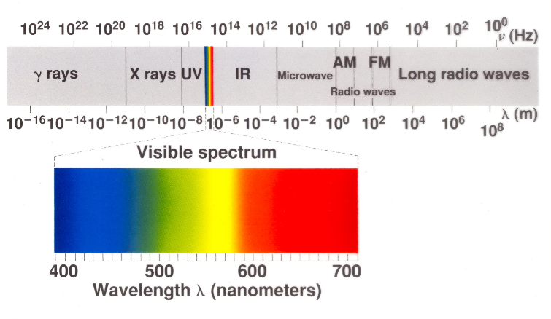
The Electromagnetic Spectrum

Slide 4
How much energy does a 400 nm “photon” carry?
h= 6.63 x 10⁻³⁴ J sec
c=3.0 x 10⁸ m/sec
E_{photon} = 5.0 x 10⁻¹⁹ J

Slide 5
What is the wavelength (λ)of a photon with E = 6.0 x10⁻¹⁹ J?
h = 6.63 x 10⁻³⁴ J sec
c = 3.0 x 10⁸ m/sec
λ = 3.32 x 10⁻⁷ m = 332 nm

Slide 6
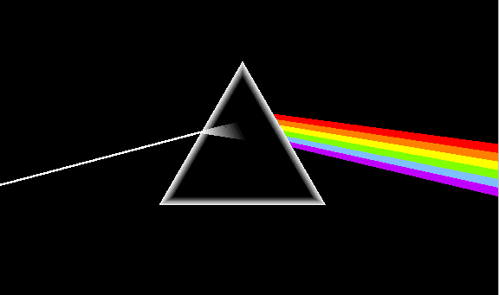
A spectroscopy measurement …
I_{o} = MT
SAMPLE
D
I = sample
l
σ = “absorption cross-section” units of cm² (or cm²/molec.)

Slide 7
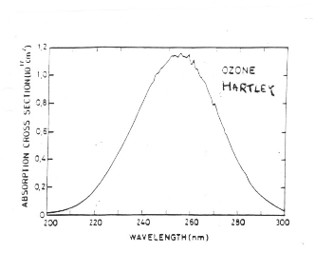
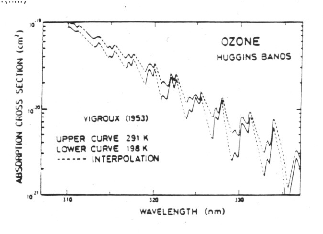
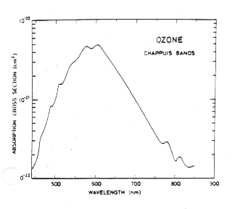
Absorption bands of O3…

Slide 8
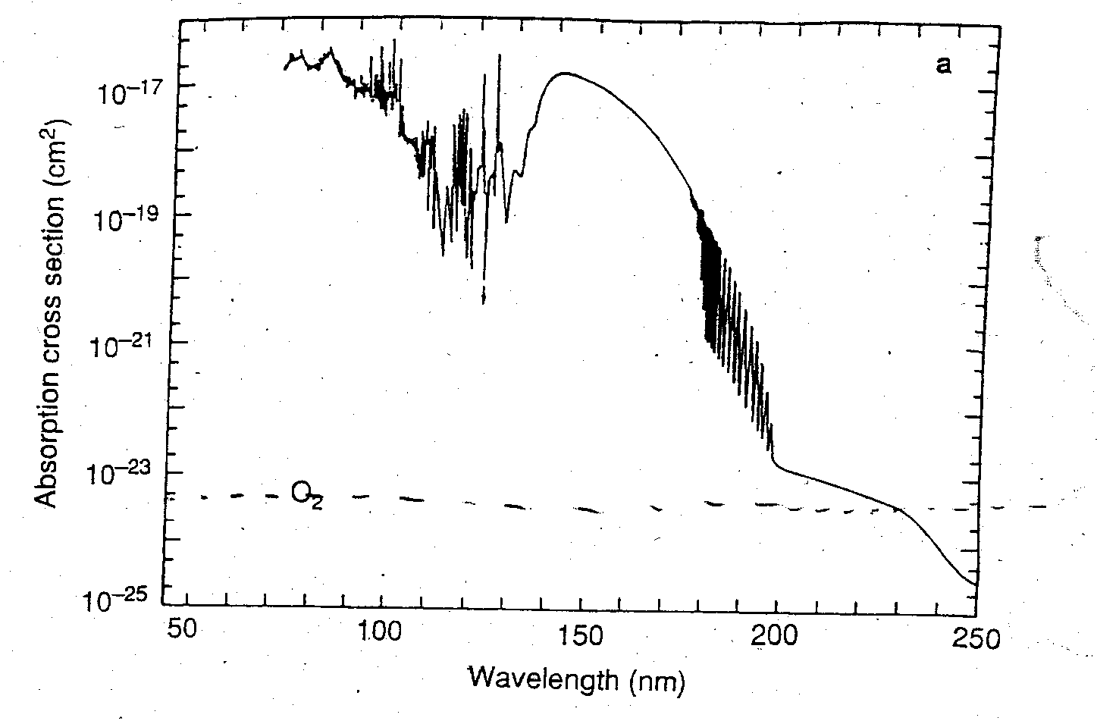
Absorption bands of O2…

Slide 9
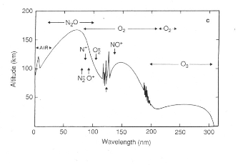
Light Penetration…
< 200 nm only HI stratosphere & above
200-300nm —> filtered in stratosphere VARIABLE w/ ALT.
(200-230 O₂ & O₃ absorption, 230-300 O₃ absorption)
> 300 nm —> penetrates to surface!

Slide 10
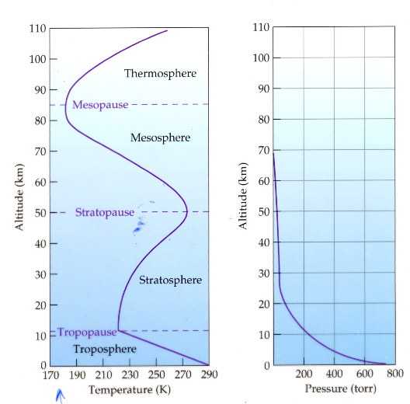
Vertical distribution of [M] …
<— not enough M for O₃ production up high
<— no λ<242 down here!

