Slide 1
CHEM 304 – 2/8/12
I.B. Stratospheric chemistry: Ozone
- The Chapman Mechanism - cont.
(w/ Embedded Fundamentals)
-> Chemical Kinetics
- Rates of Chapman reactions
- Lifetimes
- Start Photochemistry ?
KEEP READING READ CH 1
QUIZ AVE = 19/20 (!)

Slide 2
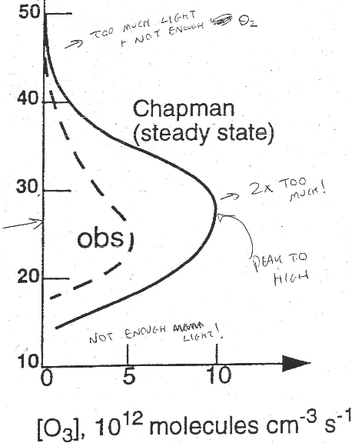
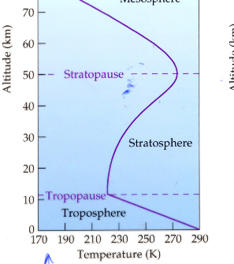
The Ozone “Layer” - it is not a “layer”

Slide 3
Photochemical Reactivity: 3 KEY questions
What wavelength does molecule absorb?
2) What altitudes are they available at?
3) Does the radiation carry enough E to break a bond ? (almost always YES!)

Slide 4
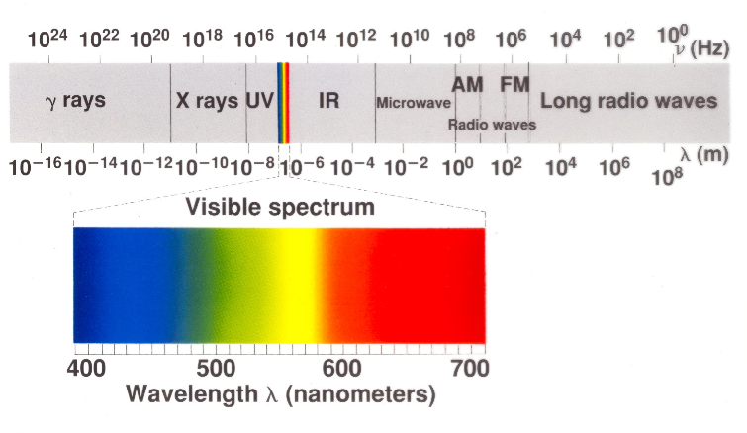
The Electromagnetic Spectrum

