Slide 1
CHEM 304 – 2/3/12
I.B. Stratospheric chemistry: Ozone
- History and observations
- The Chapman Mechanism
(Embedded Fundamentals)
- Chemical Kinetics
- Rate Laws & Rates
> READ CH 1
> Quiz 1 TODAY!!!

Slide 2
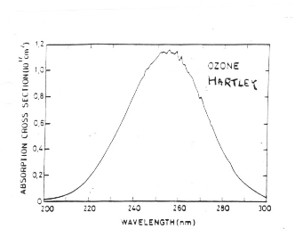
Stratospheric Chemistry: O₃ is the point here…
There are three ATM functions of O₃:
1) UV filter, 2) Heats the stratosphere, 3) tropospheric pollutant

Slide 3
Brief Ozone History
1840 - Discovered by Schönbein - (Oziene = “to smell”)
1881 - Hartley - main UV Band
1930 - Chapman - “layer chemistry”
1931 - Dobson - measured column thickness (1 D.U. = 0.01 mm)

Slide 4
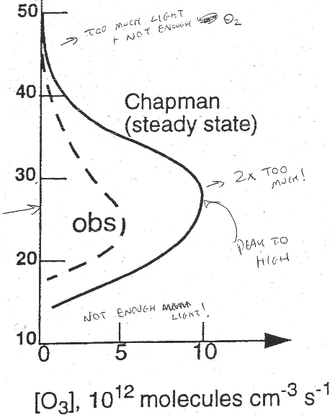
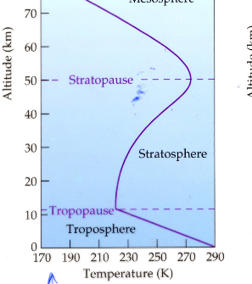
The Ozone “Layer” - it is not a “layer”

Slide 5
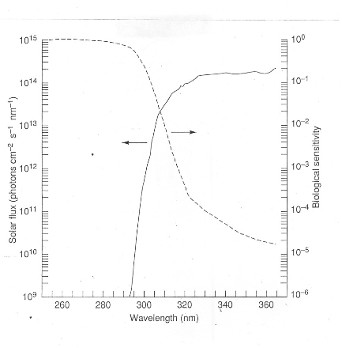
O₃ is a UV Filter: Hartley band protects biological organisms
Threshold
wavelength

Slide 6
O₃ Heats the Stratosphere
O₃ + hν —> O₂ + O
O₂ + O —> O₃ + heat

