Slide 1
CHEM 304 – 5/4/12
IV: Toxic Substances
- Metals: Hg, Pb, (Cd, As)
Read Chapter 15
EXAM F ?
REV SESSION W ?
QUIZ 5 TODAY

Slide 2
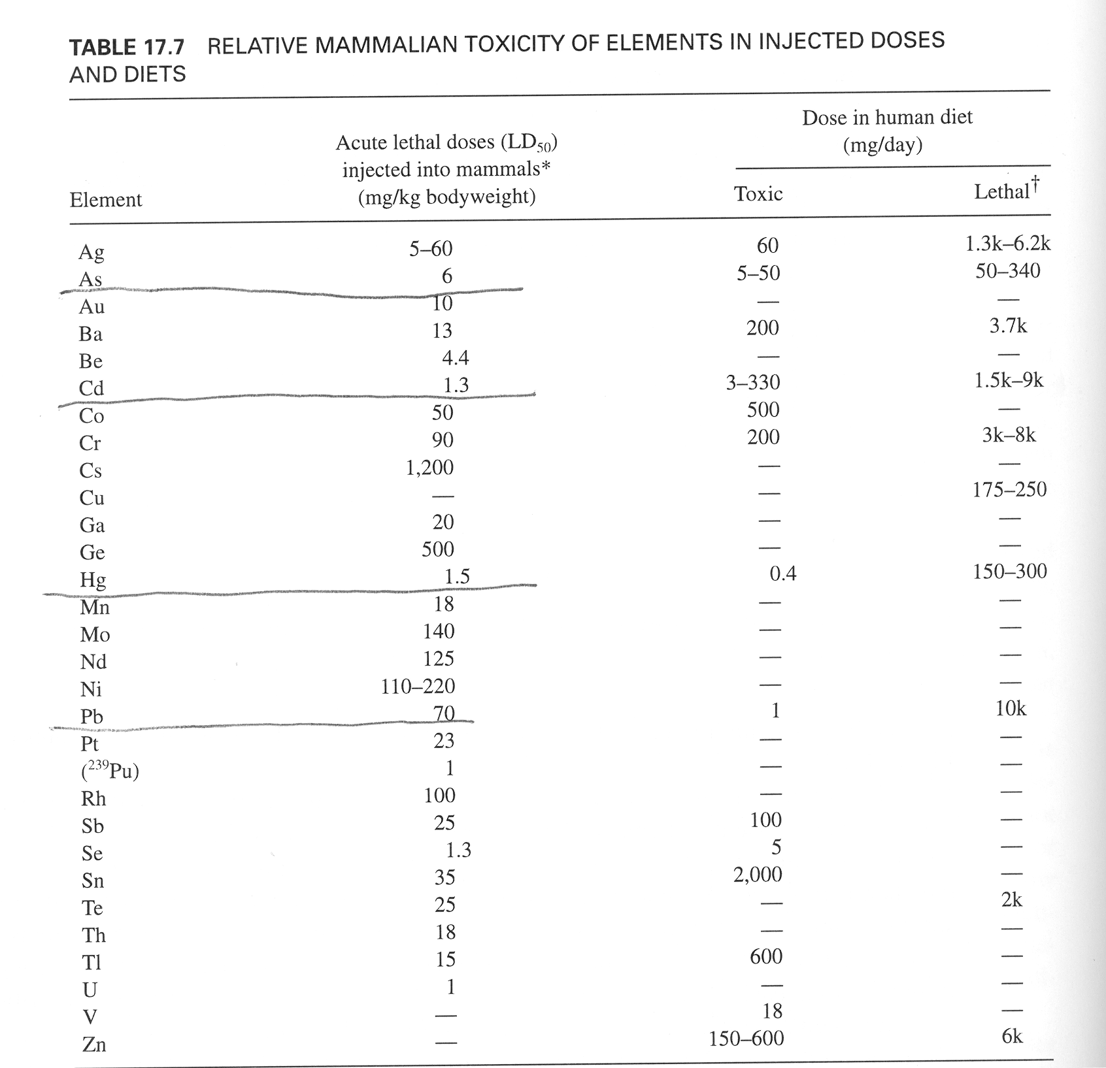
LD50:
Dose that kills 50% of those exposed

Slide 3
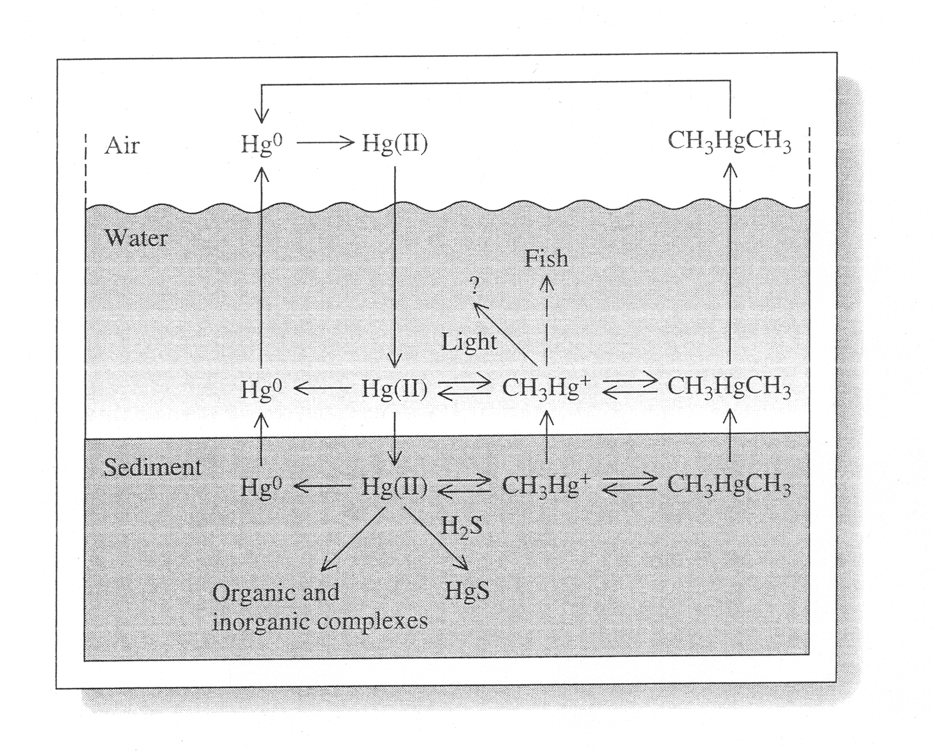

Slide 4
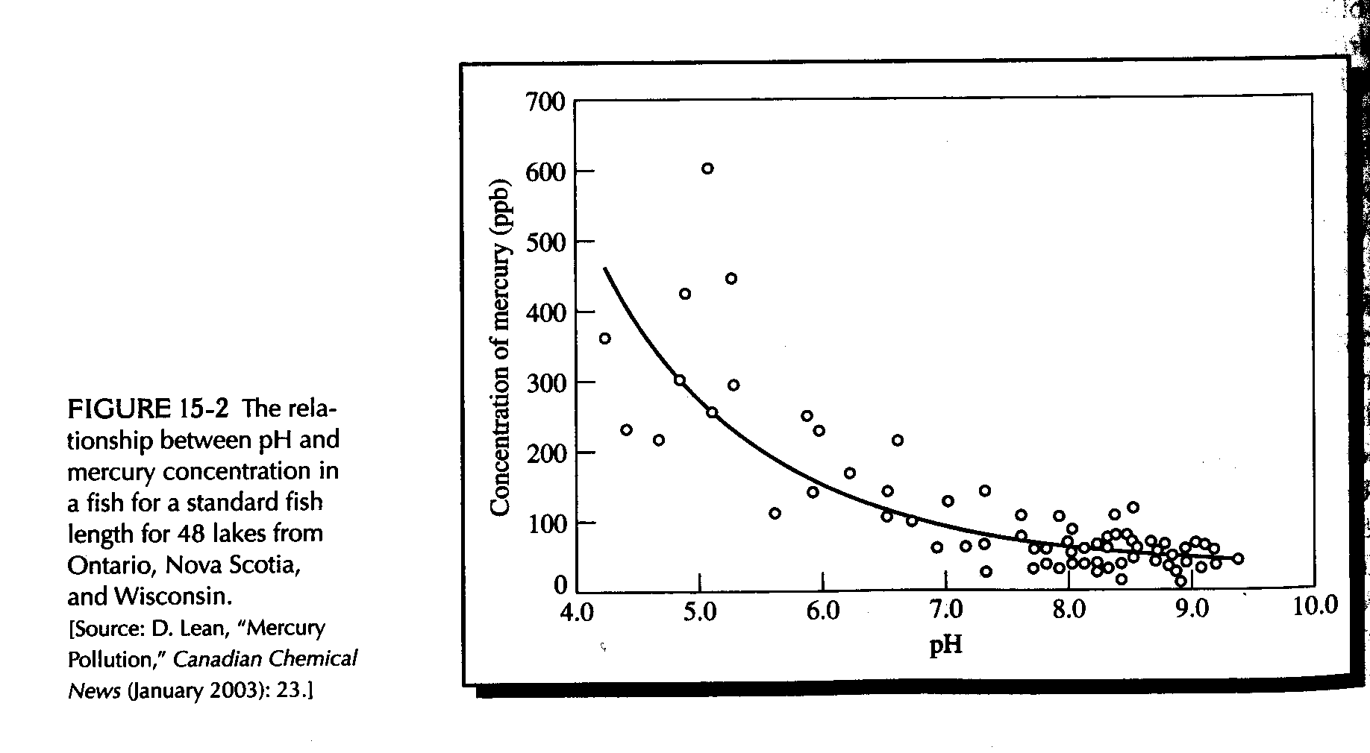
Why does acidity increase Hg concentration in fish ?

Slide 5
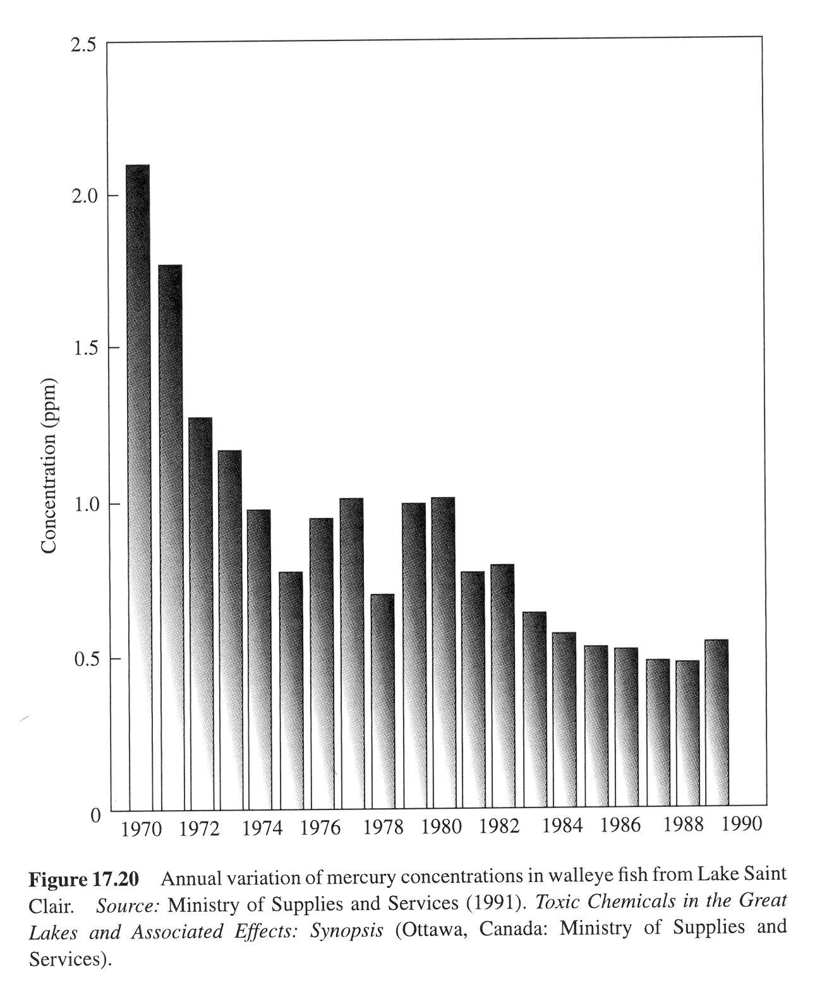
Due to:
1)controls on waste incinerators and
2) removal of batteries from solid waste stream

