Slide 1
CHEM 304 – 2/1/12
I.A. Fundamentals of Atmospheric Chemistry
- Concentration Units
- Final word on Stability and Trace Species: “Disequilibrium”
> READ CH 1: Review DG and K cal;cs from gen chem book if necessary.
> Quiz M on HW #1 (& #2, Q1) – covers thru today lecture.

Slide 2
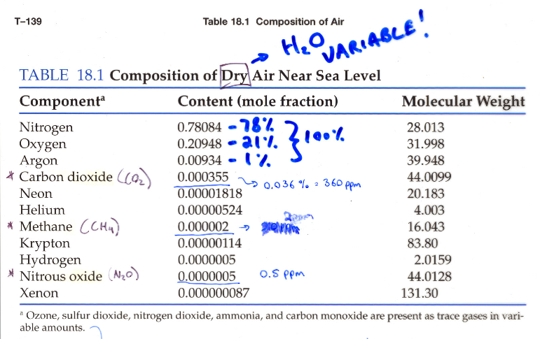

Slide 3
Quantifying Concentrations:
Express the following as X’s (i.e. pure numbers).
a) H₂O (10km) = 36 ppm
b) CH₄ (40 km) = 300ppb
a) 36 ppm = 36 x 10⁻⁶ = 3.6 x 10⁻⁵
b) 300 ppb = 300 x 10⁻⁹ = 3.0 x 10⁻⁷

Slide 4
Partial pressures:
Calculate the Partial Pressure of CO₂ (X_{CO2}= 360 ppm) at:
a) 0 km (P_{TOT}=1 atm)
b) 15 km (P_{TOT}=122 mbar)
a) P_{CO2} = 3.6x10⁻⁴ x 1.0 atm = 3.6 x 10⁻⁴ atm
b) P_{CO2} = 3.6 x 10⁻⁴ x 122 mbar = 4.4 x 10⁻⁵ bar

Slide 5
Number Densities: molec/cm³
For OH, X = 6 x 10⁻¹⁴, what is C in molec/cm³ at 0 km (p=1.0atm)?
Calc p first, then multiply by:
C_{L} = 2.7x10¹⁹ molec/cm³atm
C_{OH} = 1.6 x 10⁶

Slide 6
Consider the following Reaction:
N₂ + ½ O₂ —> N₂O
a) Does it “go”? How do you know?
b) Is “a” really a yes/no question - what quantity gives the subtle answer?
c) Can we use “b” to predict the partial pressure of N₂O?
d) Does it work? (P_{N2O}(obs) = 3.3 x10⁻⁷ atm)

Slide 7
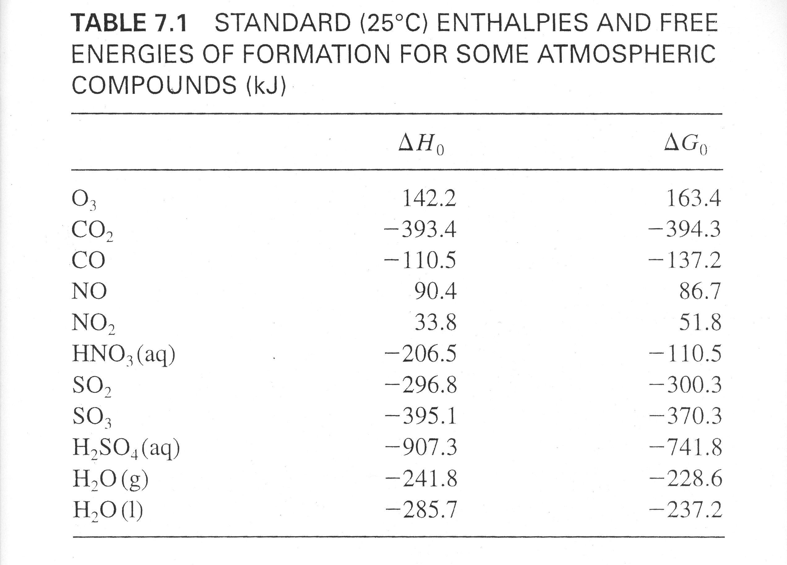
ΔH_{f} - Energy relative to Elements ( “–” means lower E)
ΔG_{f} - Overall Chemical Stability relative to Elements
(“–” means more stable (or less reactive)).

Slide 8
Disequilibrium
The planet is not an equilibrium system. An active state of Disequilibrium is maintained by:
Sunlight
Biology (Microbes, Humans, Livestock)
Geological factors (volcanoes)
Meteorological factors (lightning)

Slide 9
Summarizing logical questions regarding “trace species”
How much is out there? how do we quantify? (Concentration Units)
- What do they do ? (free radical reaction types)
Why are they out there ? Why disequilibrium?
(Photochemistry, biology…)
- (Still forthcoming) How long do they last ? How to we account for their concentrations?
(Chemical Kinetics)

