Slide 1
CHEM 304 – 4/30/12
III. Water Chemistry - Case Studies:
- Lakes:
- Stratification
- Euthrophication (CH14, p.640)
- Acid Mine Drainage
- Toxicity of Acid Rain: Al (CH4, p.153)
- CO₂ and Ocean pH
> Read Chapter 13 and ^ stuff
> Quiz 5 (last one) F

Slide 3
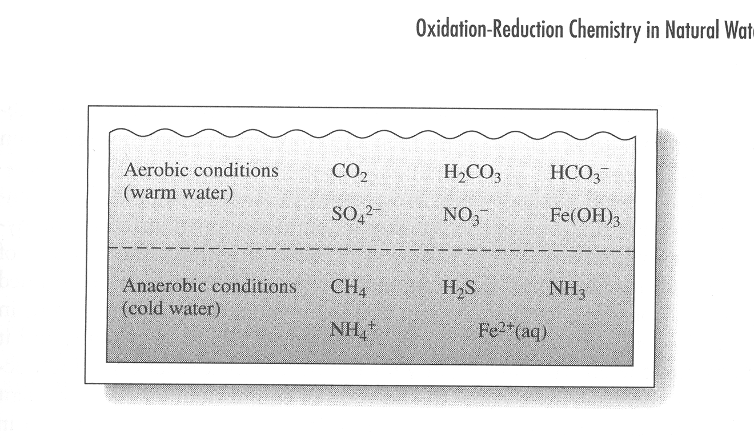

Slide 4
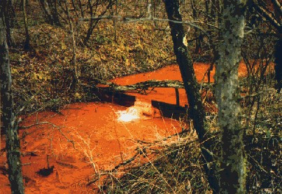
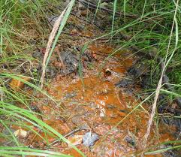
Pennsylvania
Minnesota

Slide 5
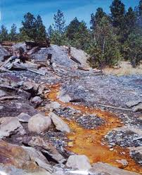
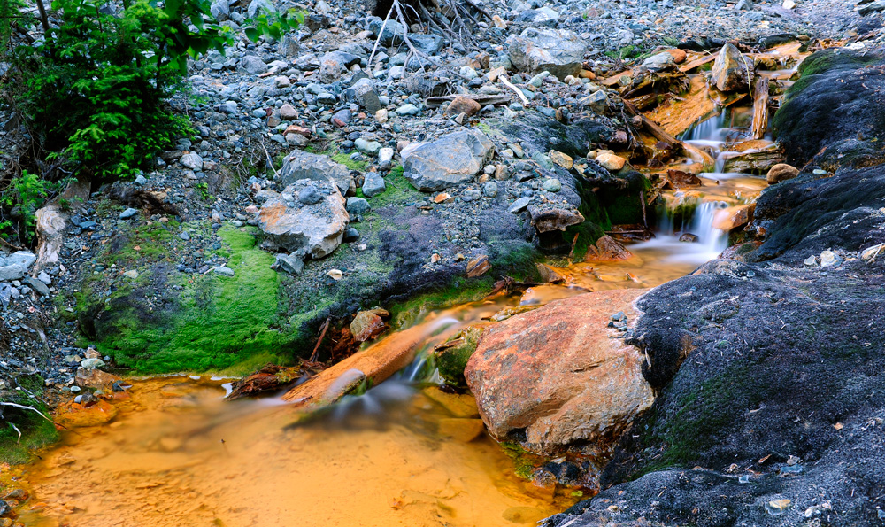
British Columbia
South Dakota

Slide 6
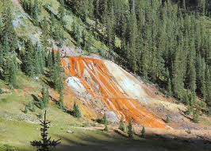
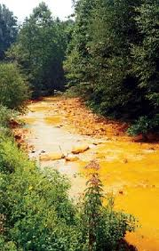
Colorado
West VA

Slide 7
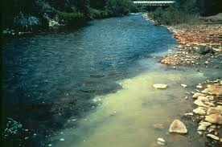
Alaska

Slide 8
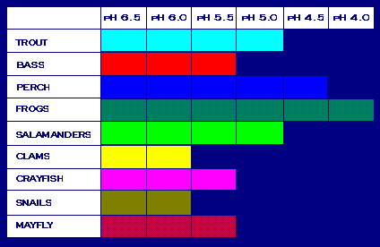

Slide 9
