Slide 1
CHEM 304 - 4/20/12
II. Water Chemistry
• Redox Chemistry
- Dissolved O₂
- Reducing agents
- pE
> Read Chapter 13
Water HW sent out today – quiz 5 (?)
Video Editing M & W – have video to edit!

Slide 2
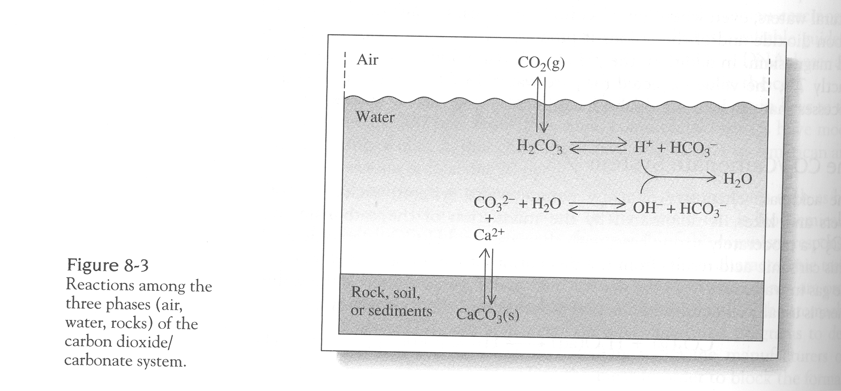

Slide 3
What is [O₂] at saturation in:
Moles/L?
ppm (=mg/L)?
P_{O2} = 0.21 atm, K_{H} = 1.3 x 10⁻³

Slide 4
