Slide 1
CHEM 304 – 4/16/12
II. Water Chemistry
• Finish up solubility …
• Acid/Base Chem and solubility:
“Inorganic Carbon”
- CO₃⁻²
- CO₂ & CO₃⁻² together …
READ: Chapter 13
Script Meetings this week …T/Th (?)
Dr. J (the sequel) on W.

Slide 2
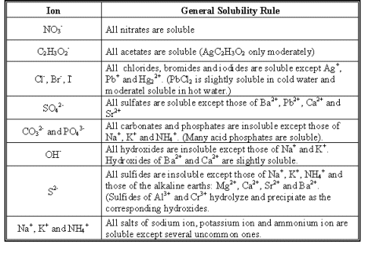
Solubility of solids – Qualitative …

Slide 3
The Ksp’s of a few Lead Salts are:
Pb(CO₃): 7.4 x 10⁻¹⁴
Pb(OH)₂: 1.2 x 10⁻¹⁵
Pb(SO₄): 1.6 x 10⁻⁸
Pb(S)*: 3.0 x 10⁻²⁸
Which of these is most likely to persist, and thus be the comprise a main component of a lead ore?

Slide 4
Ksp’s of Fe(OH)₃ is 4.0 x 10^{-38.} what is the concentration of Fe (i.e. [Fe⁺³]) at saturation?
Ignore acid base chem.
Noting that [OH-] = 10⁻⁶

Slide 6
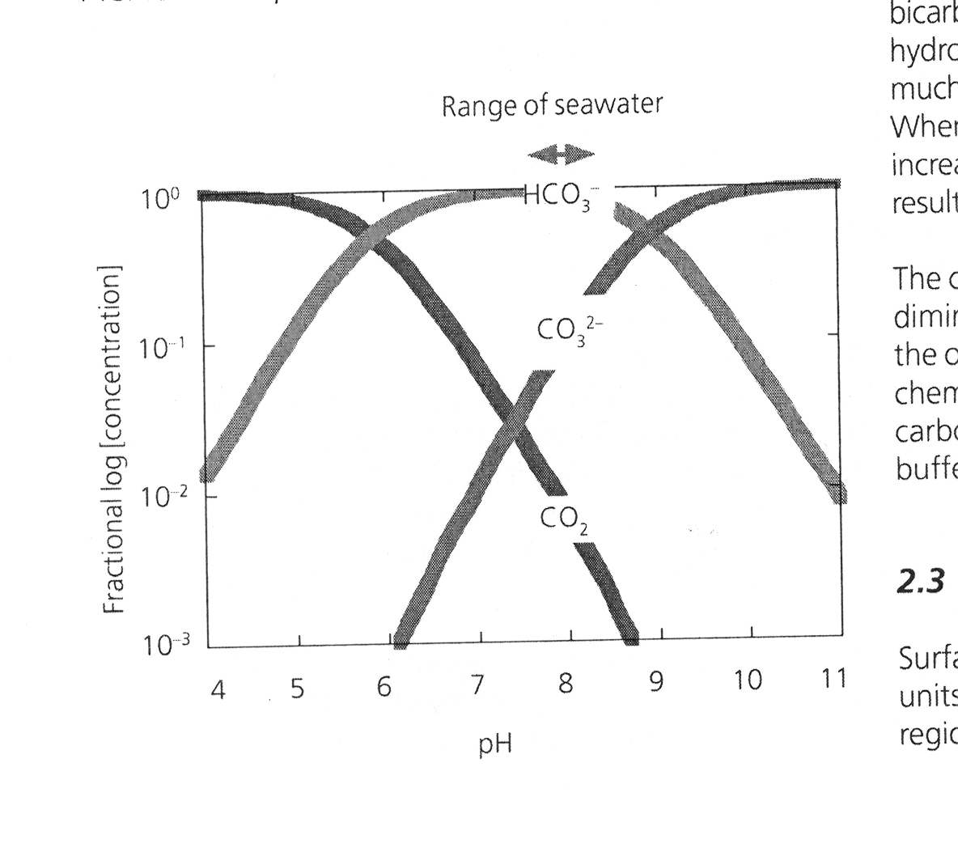

Slide 7
