Slide 1
CHEM 304 – 4/11/12
III. Water Chemistry
• Introductory Points
• Physical processes: Water Cycle, etc.
• Overview of Chemical Processes
• Solubility Calcs.
READ: Chapter 13 (I am following this).
Quiz #5 Average = 27/30 (Nice Job!)
EARTH DAY FESTIVAL In Owen Park Tomorrow (Fine Arts = Rain Site)

Slide 2
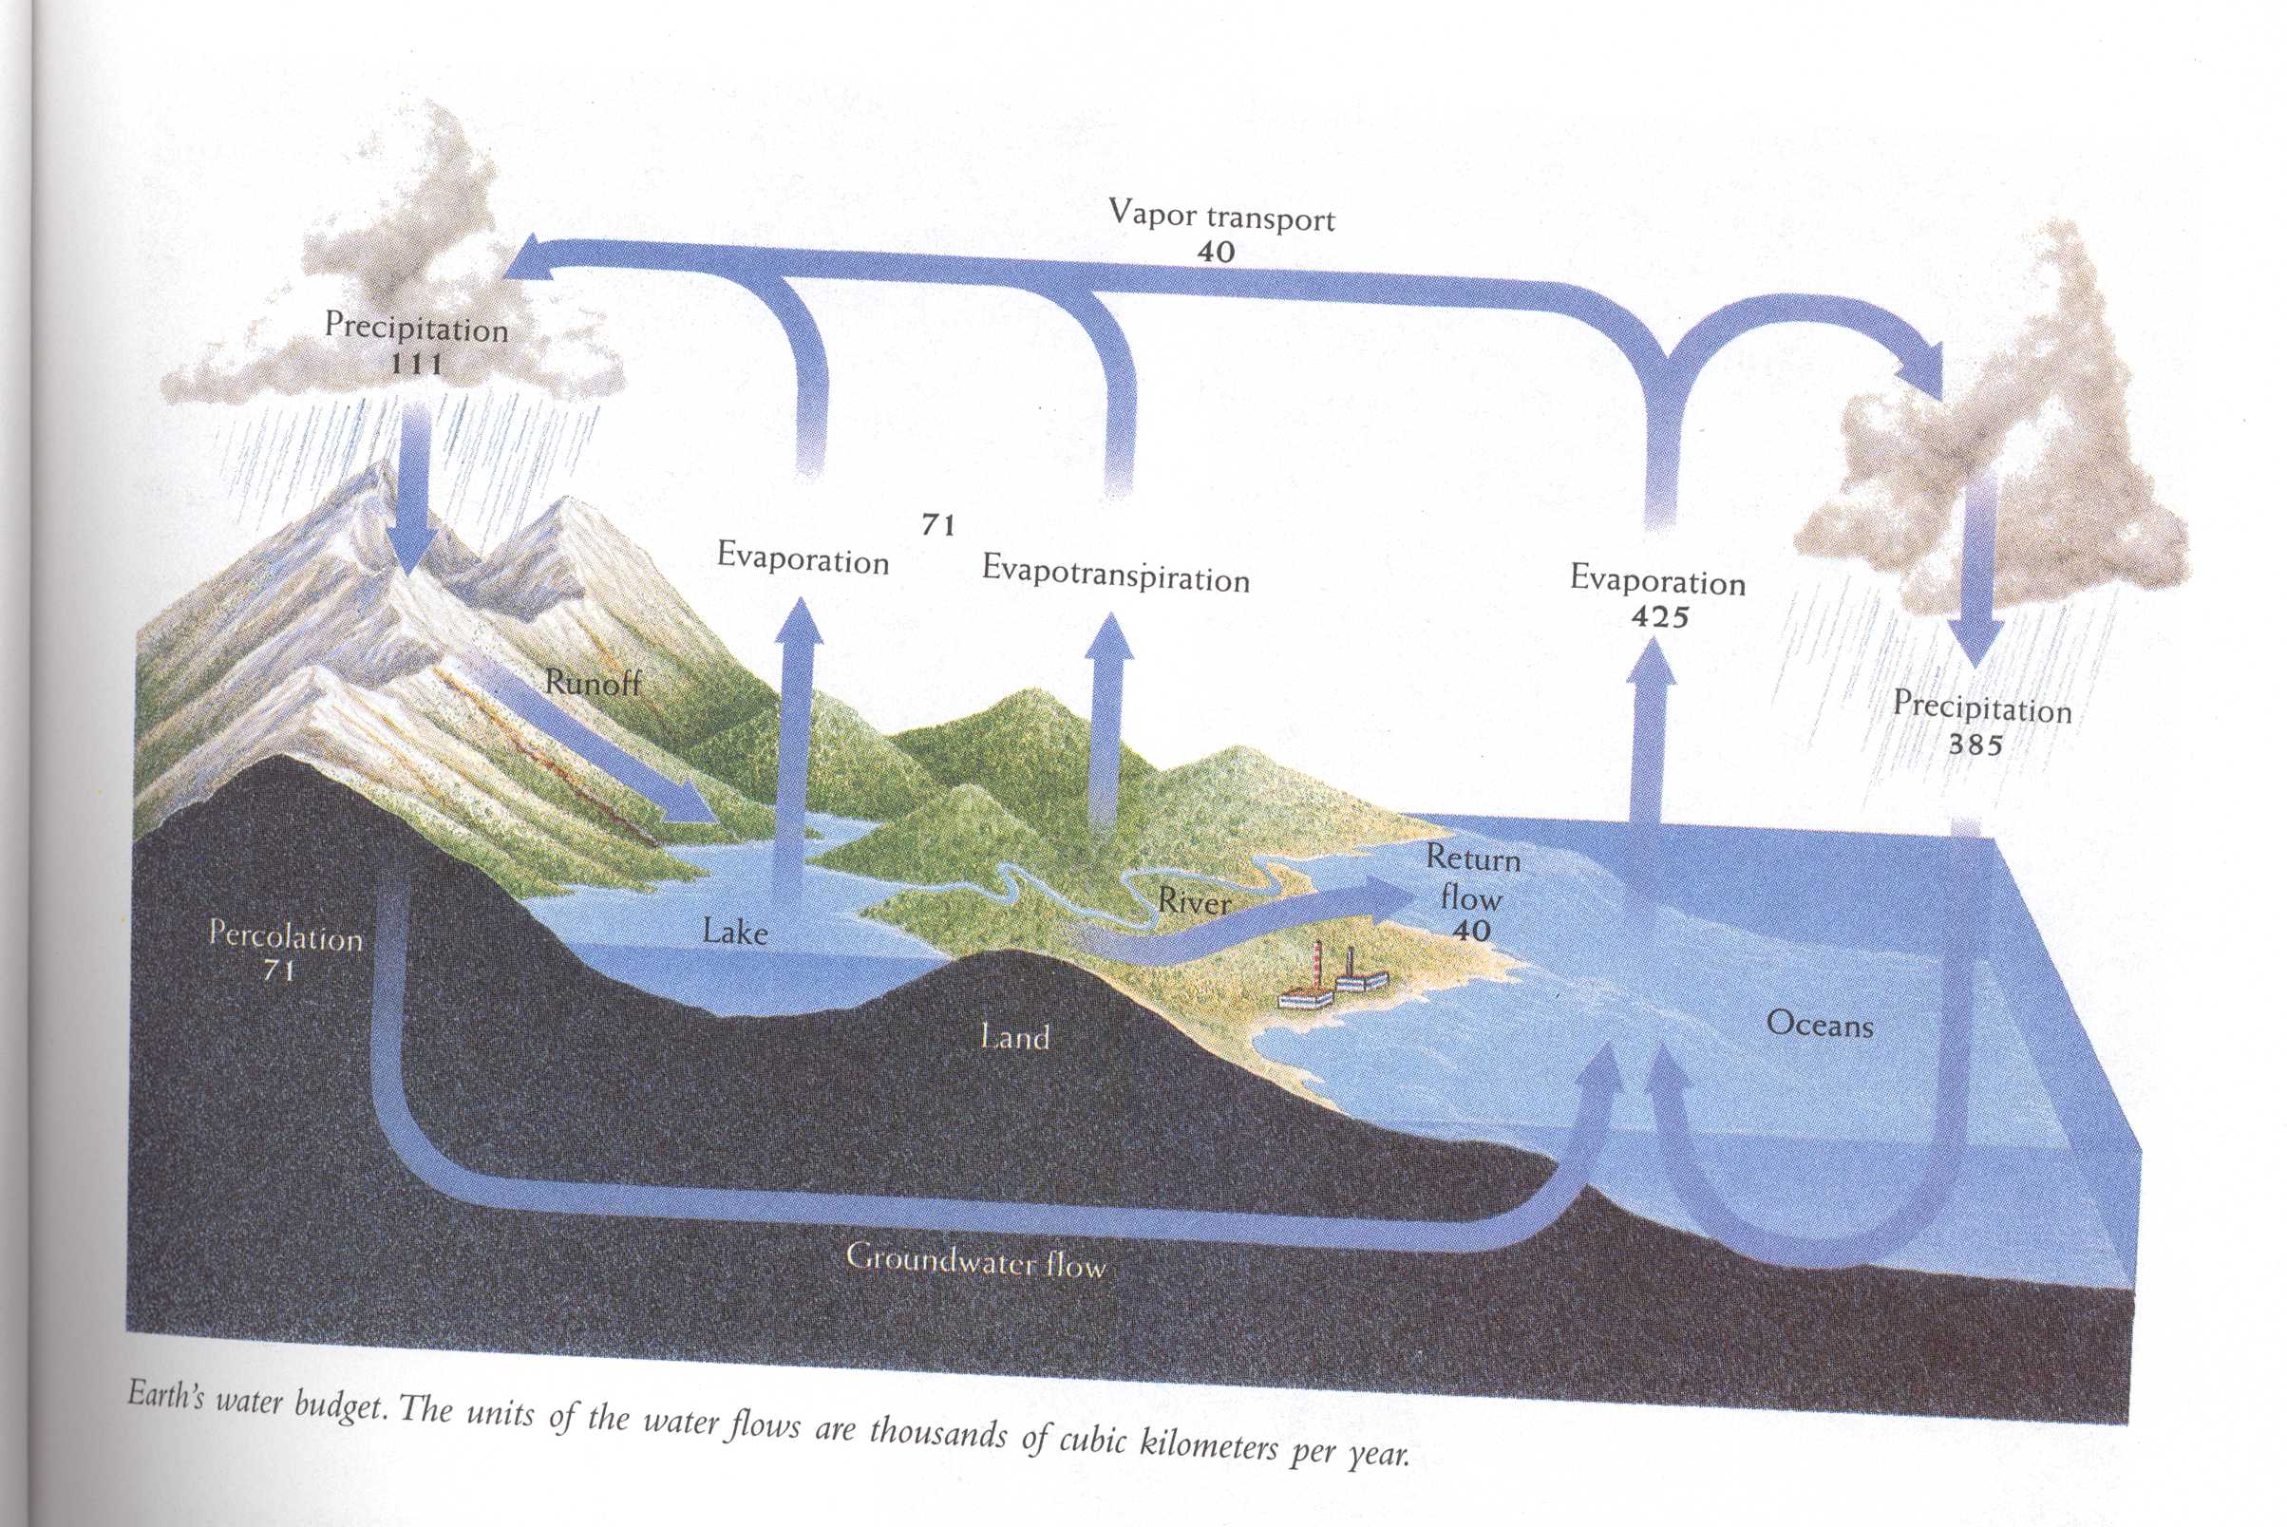

Slide 3
Key questions for Environmental Chemistry
What is out there? (i.e. what is the chemical composition of some Earth system, e.g. a lake, clean air, dirty air, etc.)
How, Why, and is it changing? (i.e. what factors led to current composition?, what be be driving changes? Local? Global?)
Is human activity a factor? (i.e. are we causing #3?)

Slide 4
Gas Solubility: The Henry’s Law Constants for Ar and N₂ (at 298K) are 1.4 x 10⁻³ and 6.1 x 10⁻⁴.
Which has the greater solubility?
Which would have the greatest ambient/saturated concentration?

Slide 5
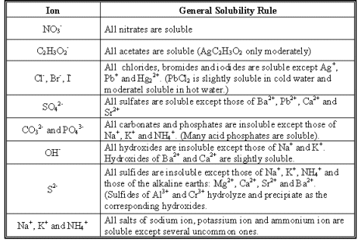
Solubility of solids – Qualitative …

Slide 6
The Ksp’s of a few Lead Salts are:
Pb(CO₃): 7.4 x 10⁻¹⁴
Pb(OH)₂: 1.2 x 10⁻¹⁵
Pb(SO₄): 1.6 x 10⁻⁸
Pb(S)*: 3.0 x 10⁻²⁸
Which of these is most likely to persist, and thus be the comprise a main component of a lead ore?

Slide 7
Ksp’s of Fe(OH)₃ is 4.0 x 10^{-38.} what is the concentration of Fe (i.e. [Fe⁺³]) at saturation?
Ignore acid base chem.
Noting that [OH-] = 10⁻⁶ (at pH=8)

