Slide 1
CHEM 304 – 4/9/12
I.D Synopsis of Climate
Highlights of the 2007, IPCC Working Group I “AR4” report.
Quiz #4 (on climate change) Friday – see web page.
“Lisa B” – communications consultant will be visiting on WEDNESDAY.

Slide 2
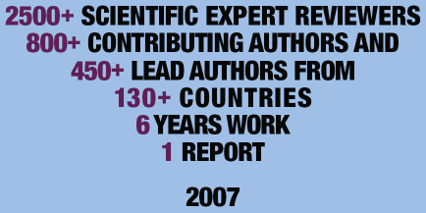
Figure: Courtesy of IPCC
Notes:
After assessing decades of climate data recorded everywhere from the depths of the oceans to tens of miles above Earth’s surface, leading scientists from around the world have reported major advances in our understanding of climate change. Government representatives participate in the line-by-line review and revision of the much shorter summary for policymakers, or SPM, for each technical report. The SPM is written by the working group’s lead authors, reviewed in two stages by technical experts, and finally by government representatives before being accepted at the working group’s plenary session. The SPM released February 2, 2007 was approved by the United States Government. IPCC Climate Change 2007:The Physical Science Basis available at www.ipcc.ch.

Slide 3
1) Human-caused changes in climate “forcing agents” (e.g. GHG’s)?
Not only GHG’s, but Ozone too, as well as Aerosols, and land use …
Changes in the atmospheric abundance of greenhouse
gases and aerosols, in solar radiation and in land surface
properties alter the energy balance of the climate system.
These changes are expressed in terms of radiative
forcing,² which is used to compare how a range of human
and natural factors drive warming or cooling influences
on global climate. Since the TAR, new observations and
related modeling of greenhouse gases, solar activity, land
surface properties and some aspects of aerosols have led
to improvements in the quantitative estimates of radiative
forcing.

Slide 4
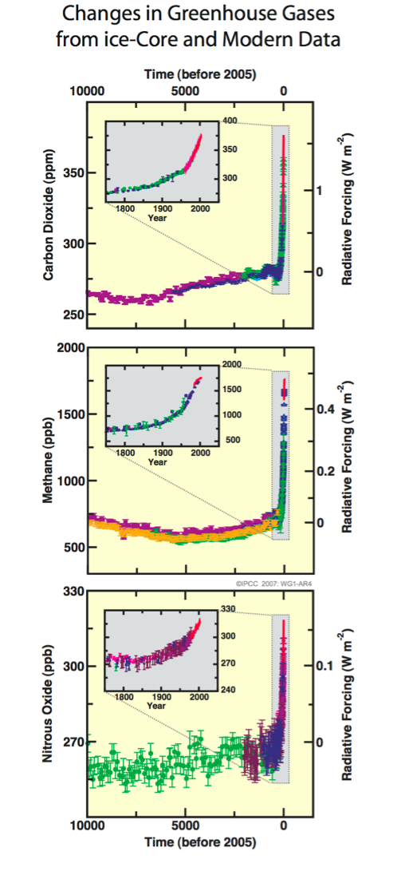
Greenhouse gas concentrations:
the last 10,000 years
—> CO₂ - ~35% increase
Global atmospheric concentrations of carbon
dioxide, methane and nitrous oxide have increased
markedly as a result of human activities since 1750
and now far exceed pre-industrial values determined
from ice cores spanning many thousands of years
(see Figure SPM.1). The global increases in carbon
dioxide concentration are due primarily to fossil fuel
use and land use change, while those of methane
and nitrous oxide are primarily due to agriculture.
—> CH₄ - more than 2x!
—> N₂O - ~20% increase
BTW: “Sustainability means these lines are flat!
Halocarbons —> ∞ increase

Slide 5
Do human CO₂ sources rival nature ?
Natural CO₂ emissions:
Terrestrial Biosphere: 60.0 Pg/year
Marine Biosphere: 90.0 Pg/year
Anthropogenic CO₂ emissions:
Fossil Fuels: 7.2 Pg/yr (~25% US)
Deforestation: 1.5 Pg/yr

Slide 6
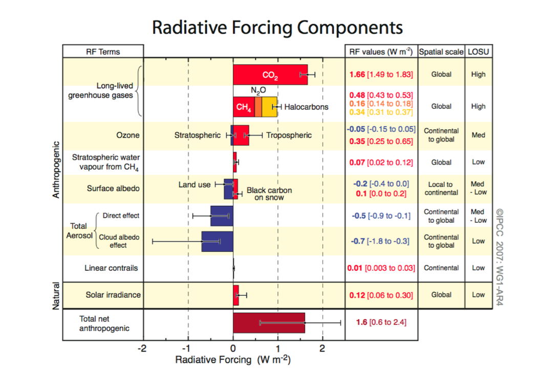
The understanding of anthropogenic warming and
cooling influences on climate has improved since
the TAR, leading to very high confidence7 that the
global average net effect of human activities since
1750 has been one of warming, with a radiative
forcing of +1.6 [+0.6 to +2.4] W m^{–2} (see Figure SPM.2). {2.3., 6.5, 2.9}
Anthropogenic contributions to aerosols (primarily
sulphate, organic carbon, black carbon, nitrate and
dust) together produce a cooling effect, with a total
direct radiative forcing of –0.5 [–0.9 to –0.1] W m^{–2}
and an indirect cloud albedo forcing of –0.7 [–1.8 to
–0.3] W m^{–2}. These forcings are now better understood
than at the time of the TAR due to improved in situ,
satellite and ground-based measurements and more
comprehensive modeling, but remain the dominant
uncertainty in radiative forcing. Aerosols also influence
cloud lifetime and precipitation. {2.4, 2.9, 7.5}
Changes in solar irradiance since 1750 are estimated
to cause a radiative forcing of +0.12 [+0.06 to +0.30]
W m^{–2}, which is less than half the estimate given in the
TAR. {2.7}
Long form: The direct RF due to increase in solar irradiance is reduced from
the TAR. The best estimate is +0.12 W m^{–2} (90% confidence interval: +0.06
to +0.30 W m^{–2}). While there have been advances in the direct solar irradiance
variation, there remain large uncertainties. The level of scientific understanding
is elevated to low relative to TAR for solar forcing due to direct irradiance
change, while declared as very low for cosmic ray influences
(Section 2.9, Table 2.11).
Significant anthropogenic contributions to radiative forcing come from several other sources. Tropospheric ozone changes due to emissions of ozone-forming chemicals (nitrogen oxides, carbon monoxide, and hydrocarbons) contribute +0.35 [+0.25 to +0.65] W m^{–2}. The direct radiative forcing due to changes in halocarbons
is +0.34 [+0.31 to +0.37] W m^{–2}. Changes in surface albedo, due to land cover changes
and deposition of black carbon aerosols on snow, exert respective forcings of –0.2 [–0.4 to 0.0] and +0.1 [0.0 to +0.2] W m^{–2}.

Slide 7
2) Direct Observations of Climate Change
Ya think ?
Evidence = T measurements (direct and indirect; land, air, and ocean) , AND changes in:
ice cover, snow cover, water vapor content, ocean salinity, sea level, precipitaiton patterns, extreme weather events…
• Observations since 1961 show that the average
temperature of the global ocean has increased to depths
of at least 3000 m and that the ocean has been absorbing
more than 80% of the heat added to the climate system.
• Mountain glaciers and snow cover have declined on
average in both hemispheres.
• Global average sea level rose at an average rate of 1.8
[1.3 to 2.3] mm per year over 1961 to 2003
• 11 of “last 12 years (1995-2006) among 12 warmest on record.
(2010 and 2005 tied w/ warmest - 1998 still a close 3rd). Urban heat island effects are real but local, and have a negligible influence.
• New analyses of balloon-borne and satellite measurements of
lower- and mid-tropospheric temperature show warming rates that are
Similar to those of the surface temperature record and are consistent
within their respective uncertainties, largely reconciling a discrepancy
noted in the TAR. {3.2, 3.4}
• The average atmospheric water vapour content has
increased since at least the 1980s over land and ocean
as well as in the upper troposphere. The increase is
broadly consistent with the extra water vapour that
warmer air can hold
Warming of the climate system is unequivocal, as is
now evident from observations of increases in global
average air and ocean temperatures, widespread
melting of snow and ice, and rising global average
sea level (see Figure SPM.3). {3.2, 4.2, 5.5}

Slide 8
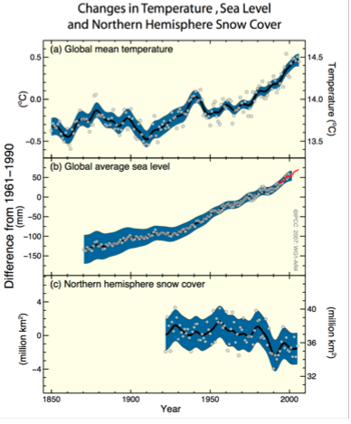
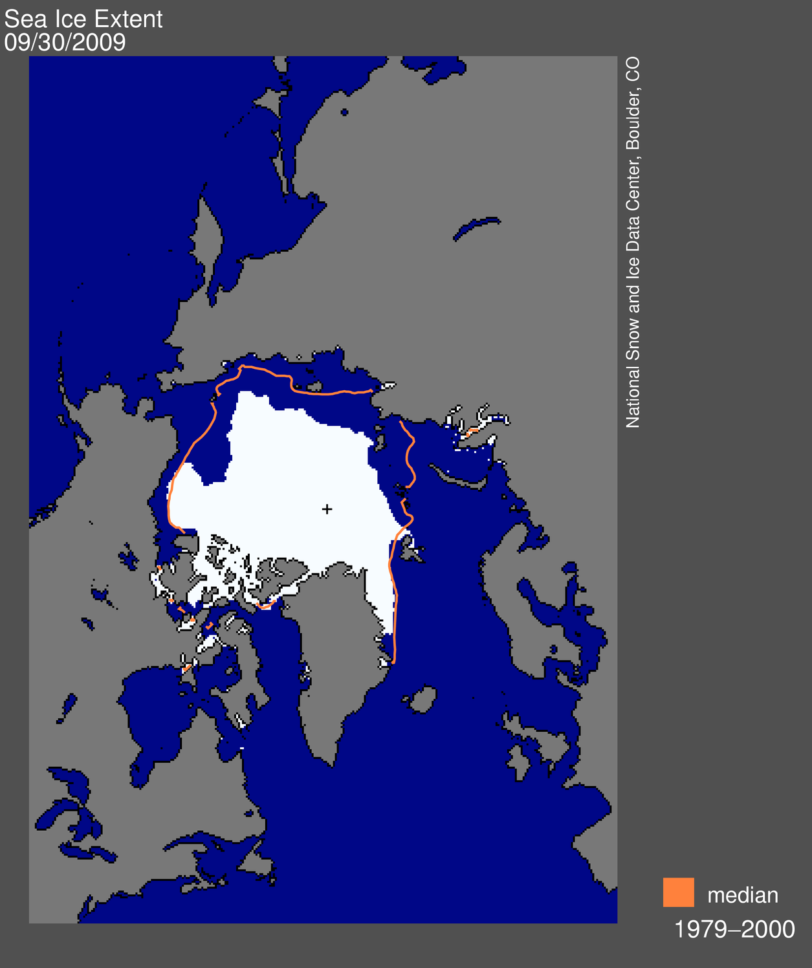
Sea level up - snow & ice melting…
IPCC, AR4, WG1, 2007
NOAA, CMDL, 2009

Slide 9
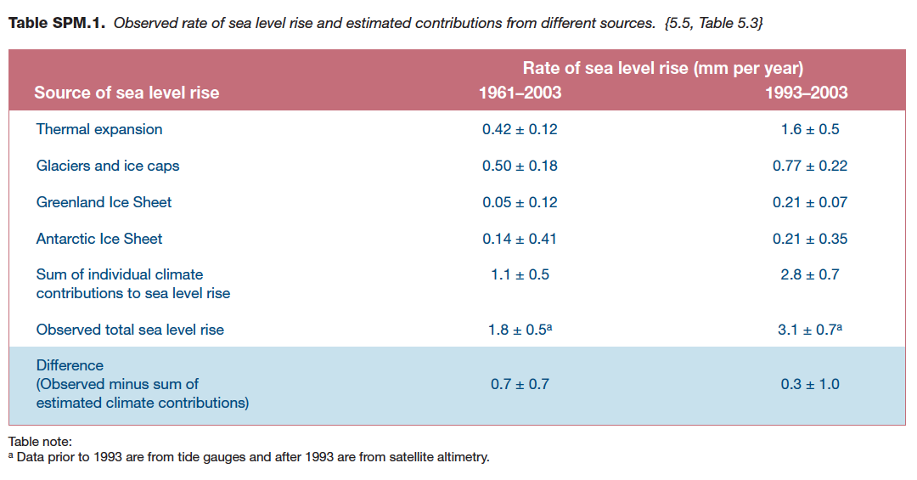

Slide 10
And there is more:
• Long-term trends from 1900 to 2005 have been observed
in precipitation amount over many large regions.11
Significantly increased precipitation has been observed
in eastern parts of North and South America, northern
Europe and northern and central Asia. Drying has been
observed in the Sahel, the Mediterranean, southern
Africa and parts of southern Asia.
• … increased salinity in low latitude waters.
• Mid-latitude westerly winds have strengthened in both
hemispheres since the 1960s
• More intense and longer droughts have been observed
over wider areas since the 1970s, particularly in the
tropics and subtropics…
• The frequency of heavy precipitation events has
increased over most land areas
At continental, regional and ocean basin scales,
numerous long-term changes in climate have
been observed. These include changes in arctic
temperatures and ice, widespread changes in
precipitation amounts, ocean salinity, wind patterns
and aspects of extreme weather including droughts,
heavy precipitation, heat waves and the intensity of
tropical cyclones.10 {3.2, 3.3, 3.4, 3.5, 3.6, 5.2}
• Average arctic temperatures increased at almost twice
the global average rate in the past 100 years.
• Satellite data since 1978 show that annual average
arctic sea ice extent has shrunk by 2.7 [2.1 to 3.3]%
per decade, with larger decreases in summer of 7.4 [5.0
to 9.8]% per decade
• Temperatures at the top of the permafrost layer have
generally increased since the 1980s in the Arctic (by
up to 3°C). The maximum area covered by seasonally
frozen ground has decreased by about 7% in the
Northern Hemisphere since 1900, with a decrease in
spring of up to 15%.

Slide 11
3) A Palaeoclimactic perspective
Palaeoclimatic information supports the interpretation
that the warmth of the last half century
is unusual in at least the previous 1,300 years.
The last time the polar regions were significantly
warmer than present for an extended period (about
125,000 years ago), reductions in polar ice volume
led to 4 to 6 m of sea level rise. {6.4, 6.6}

Slide 12
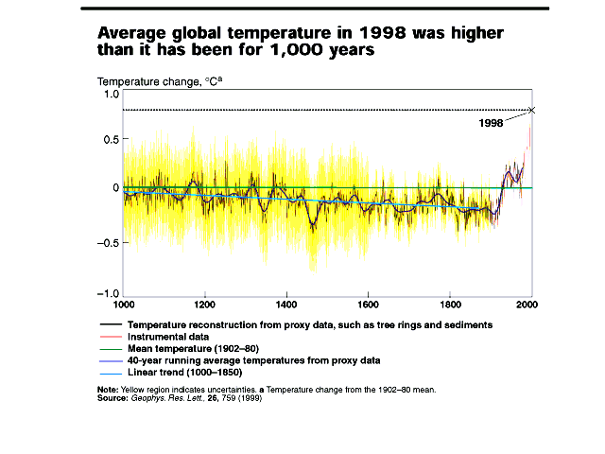
The notorious “Hockey Stick” Graph

Slide 13
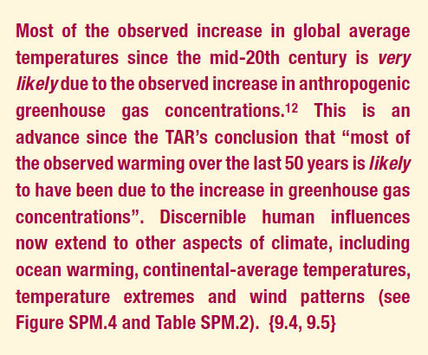
3) Understanding and Attributing Climate Change:

Slide 14
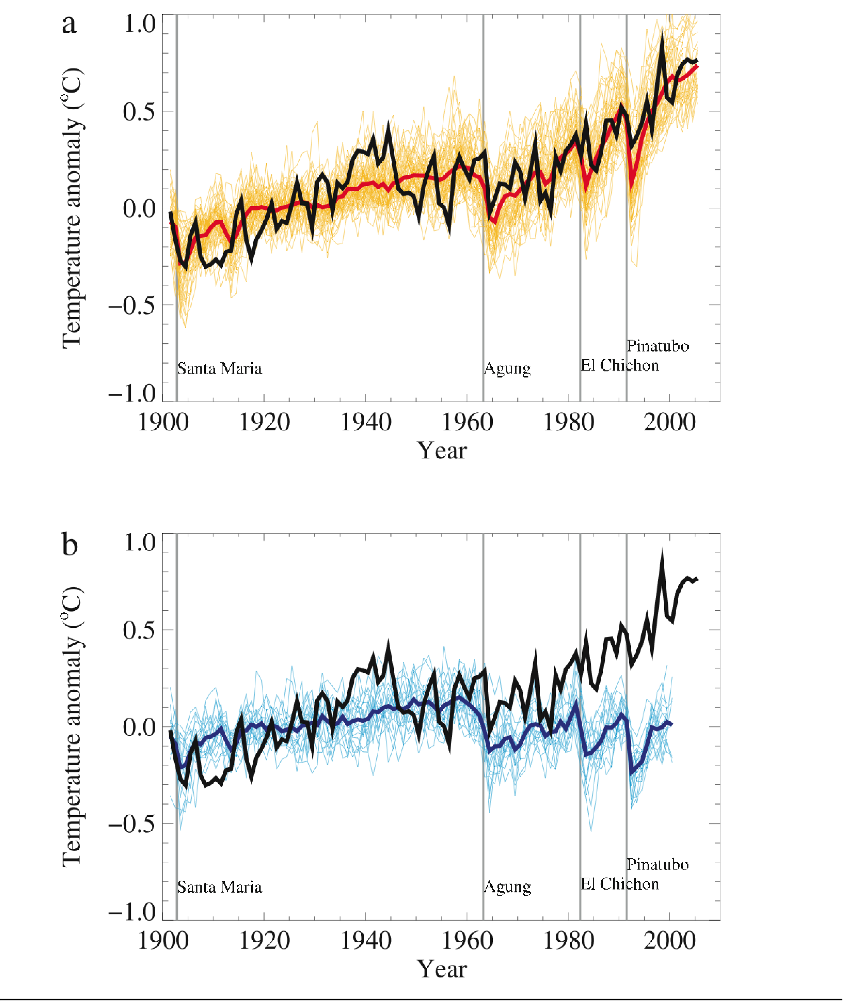
IPCC 2001: Models can reproduce Global T trends - ONLY if human effects are included.
<— Global Temperature as modeled WITH Anthropogenic Factors
<— Global Temperature as modeled WITHOUT Anthropogenic Factors

Slide 15
2007 – much more sophistication … SAME ANSWER
Pink is WITH Anthropogenic Factors
Blue is WITHOUT Anthropogenic Factors

Slide 16
Models + Observations = Causes
Key Points:
CO₂ and other GHG’s are by far the dominant factor
No existing model can reproduce the recent global temperature trends using strictly natural factors
This is how we know …

Slide 17
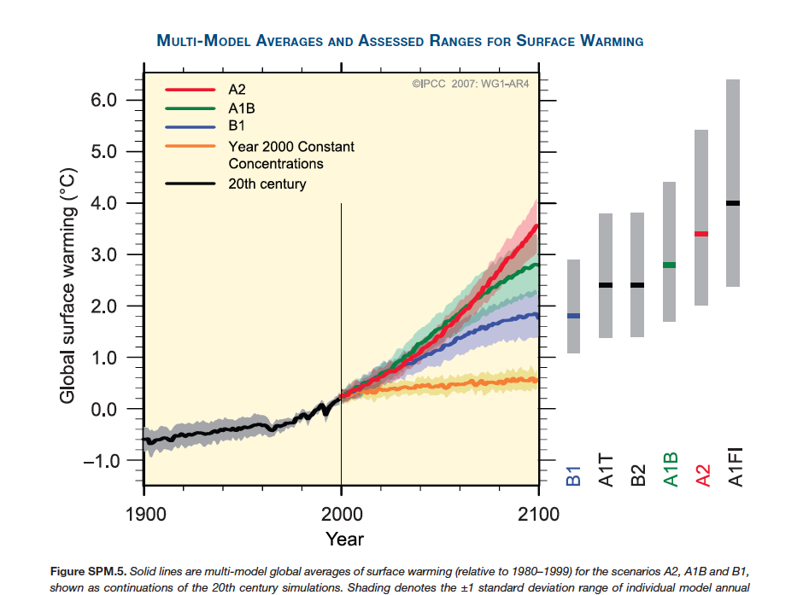
Future T predictions
About the “Scenarios”:
A1 – rapid global economic growth – converging per capita incomes (F = fossil fuel, T= renewable, B = balanced)
A2 – rapid growth, but more regionalized, less homogenized.
B1: Convergent world with more emphasis on global solutions to economic inequality and environmental substantiality…
B2: regionalized/localized version of B1
BTW: “Sustainability means this line is flat!

Slide 18
For anthropogenic climate change to be “plausible”:
1) T must be increasing.
2) Humans must be causing changes in climate “forcing agents” (e.g. GHG’s).
3) Must be some evidence for a “mechanistic relationship.

Slide 19
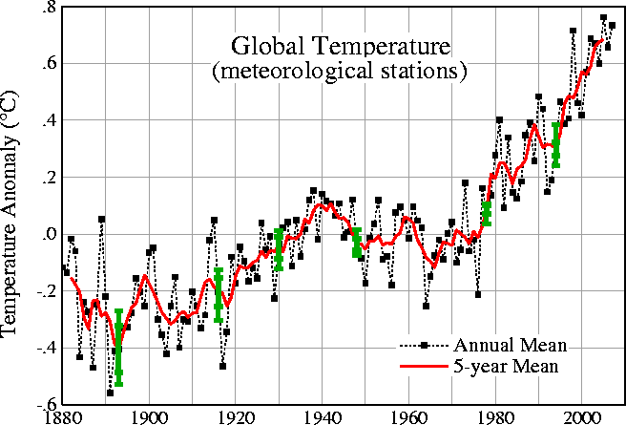

Slide 20
Greenhouse gas concentrations:
the last 10,000 years
—> CO₂ - ~35% increase
—> CH₄ - more than 2x!
—> N₂O - ~20% increase
Halocarbons —> ∞ increase

Slide 21
2007 – much more sophistication … SAME ANSWER
Pink is WITH Anthropogenic Factors
Blue is WITHOUT Anthropogenic Factors

