Slide 1
CHEM 304 – 4/6/12
II. Climate Change:
- Quick Comment about GHG’s & Albedo
- Solar Effects
- Temperature Histories
- The Vostock Ice Core
- Feedbacks
Read IPCC WG I “AR4” (2007) Report (by M!!!)
QUIZ: F 4/13 (HW 7 & 8, & IPCC Report)
(Dr. Jim will be off campus …)

Slide 2
A Quick review re: GHG’s:
Amounts of all GHG’s are increasing, but:
CO₂ (~30% Increase) is already 380 ppm
CH₄ ~2 ppm, but a 2.5-fold inc, but more effective GHG than CO₂ (GWP ~ 25-50)
Halocarbons - ~ all anthro, ppt levels, but powerful (GWP’s 100’s to 1000’s)

Slide 3
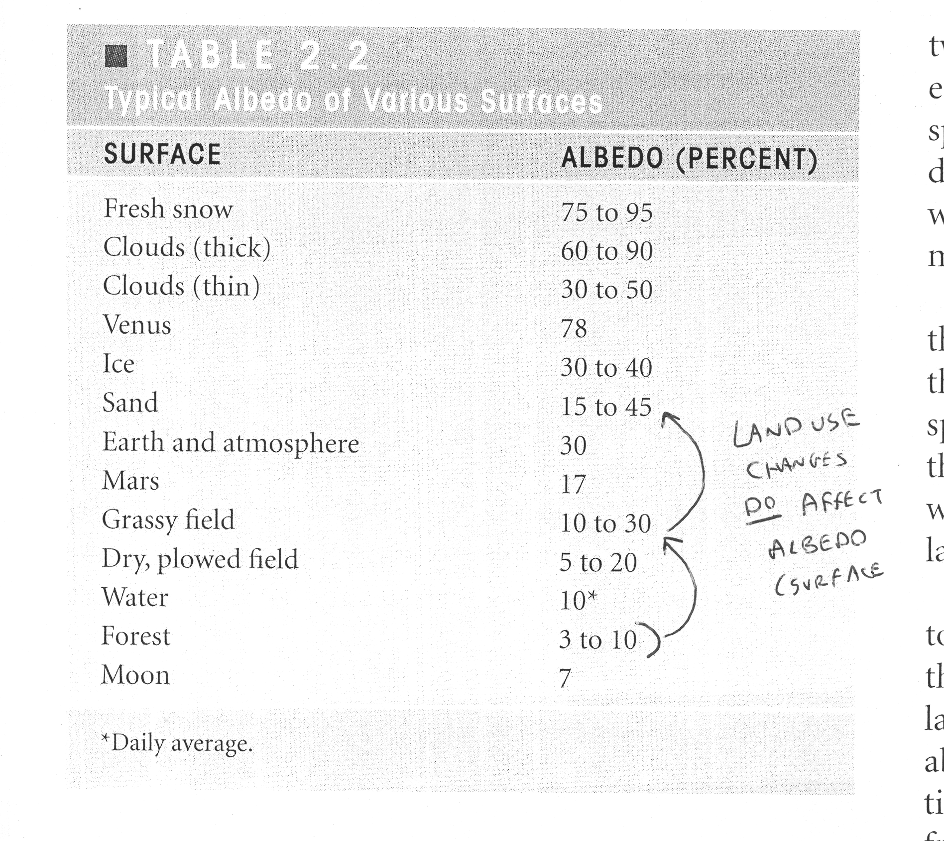
Albedo Effects - surface/land use

Slide 4
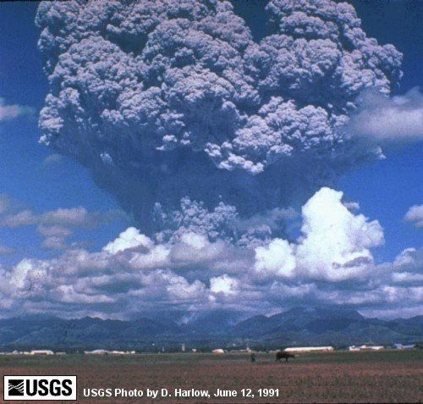
Mt. Pinatubo Eruption - Philippines 1991

Slide 5
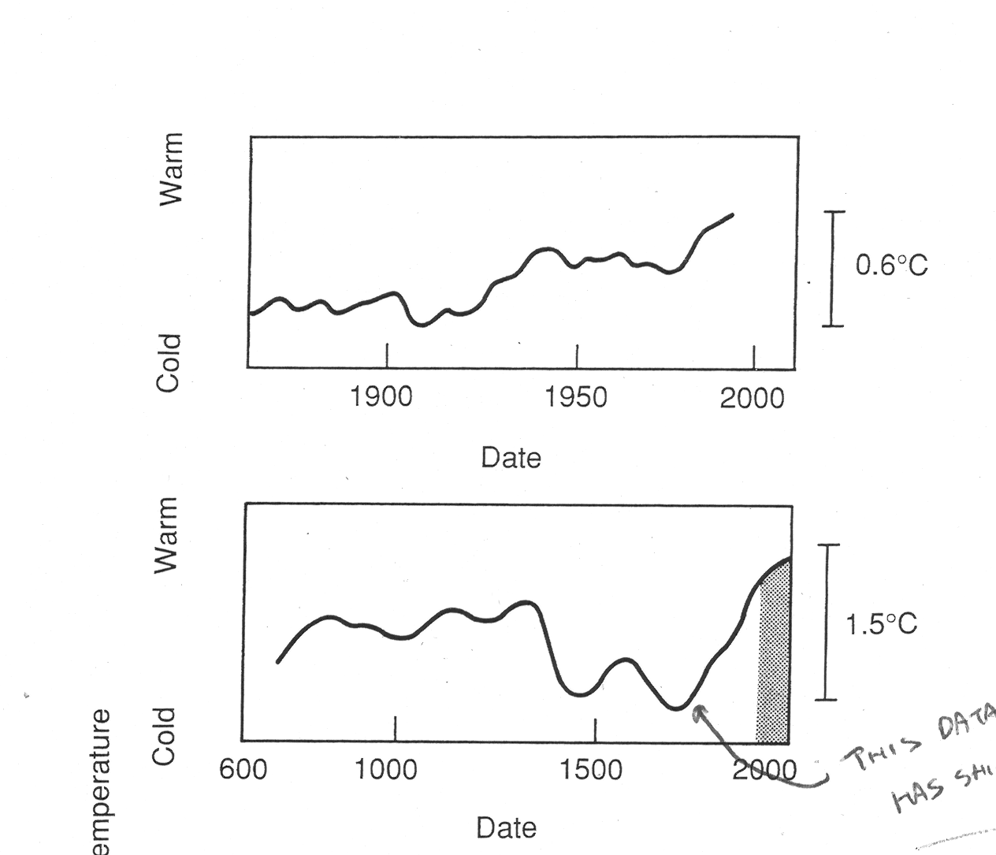
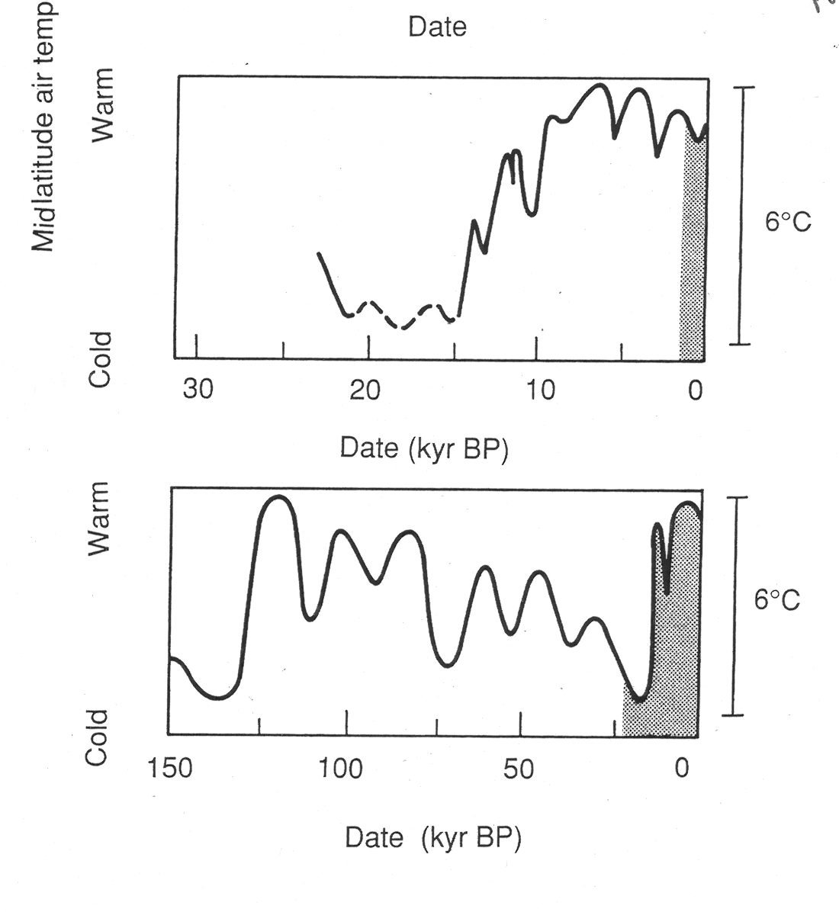
Temperature History over 4 different “timescales”

Slide 6
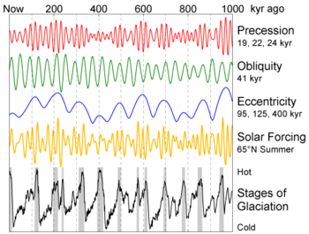
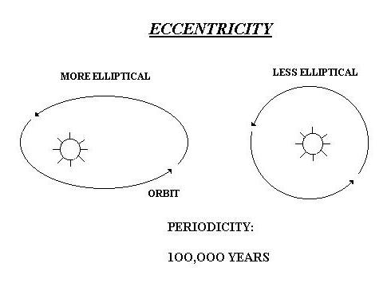
Long Term Solar Effects: Milankovich Cycles
http://www.youtube.com/watch?v=wLAYRdSnRSI

Slide 7
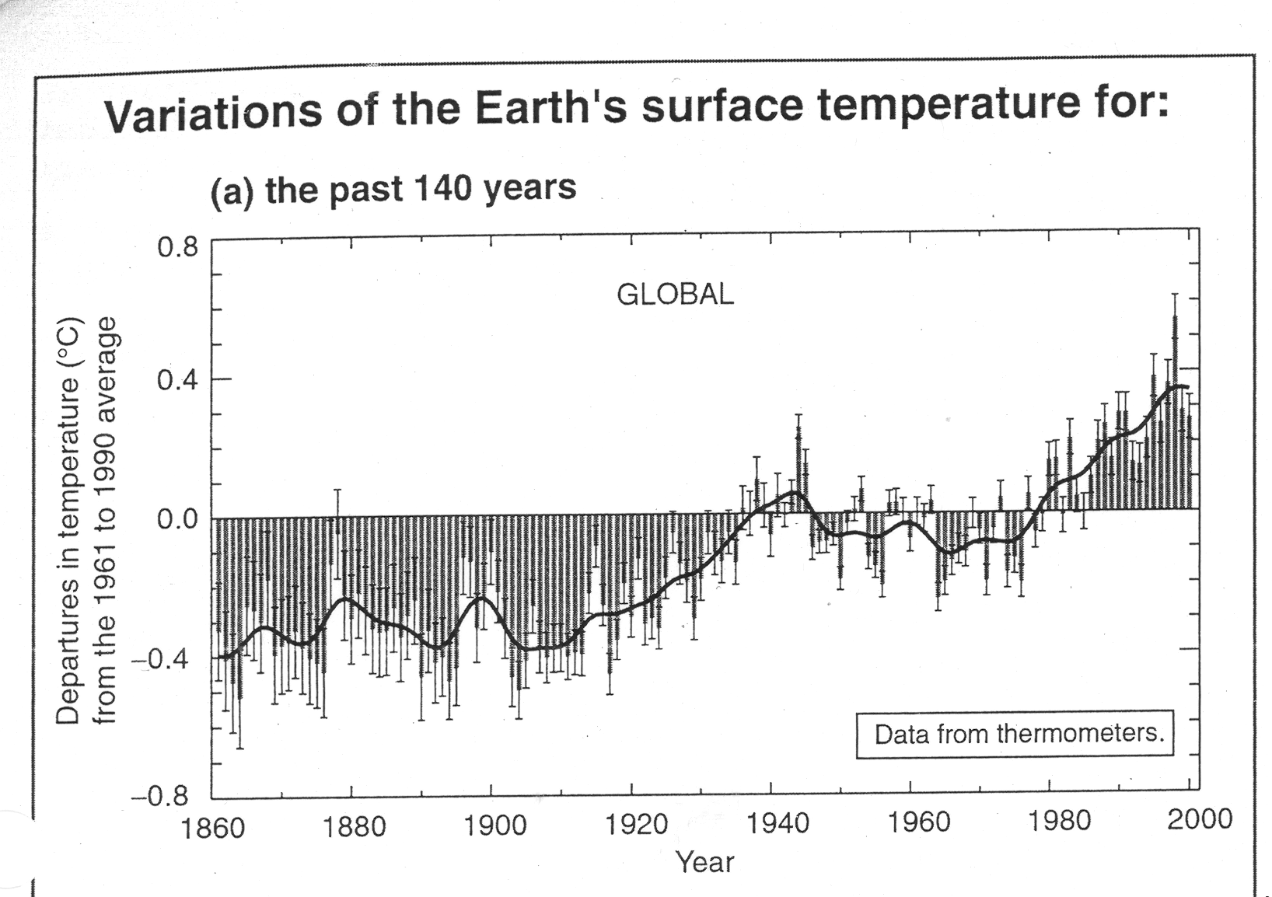

Slide 8
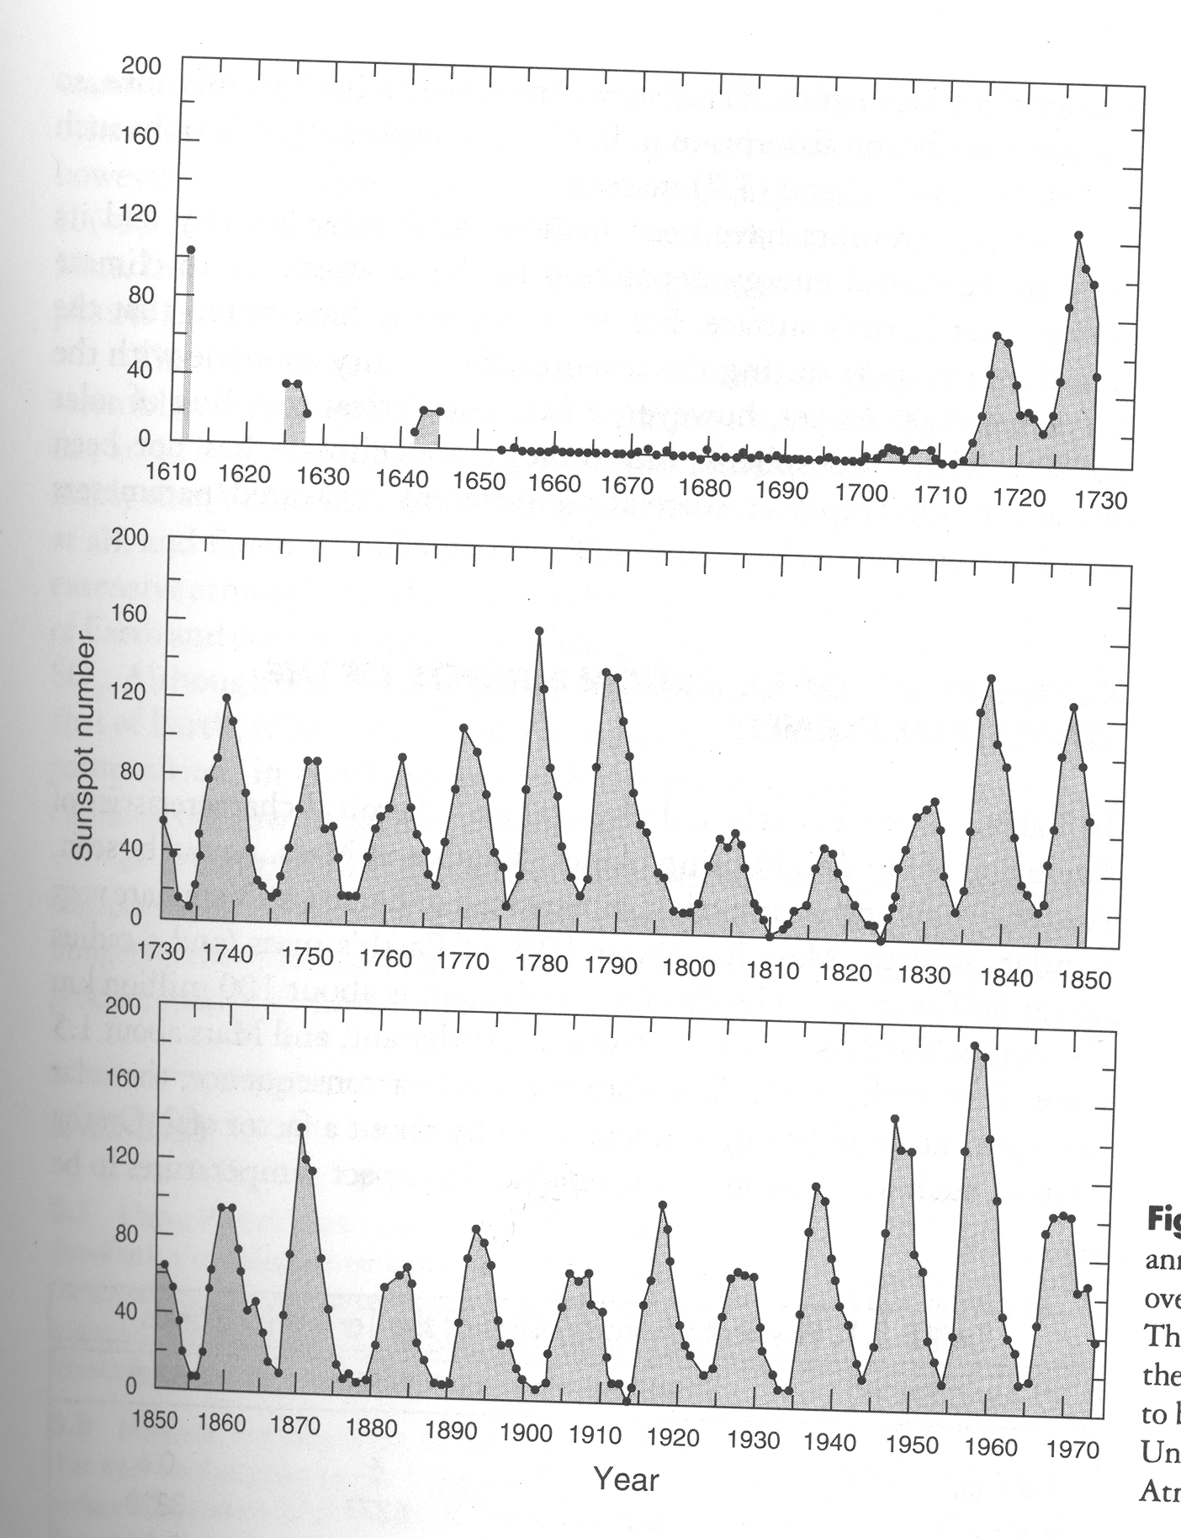
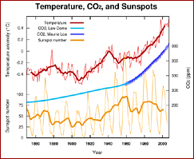
Short/Med. term Solar Effects: ~10-12 yr. sunspot cycle

Slide 9
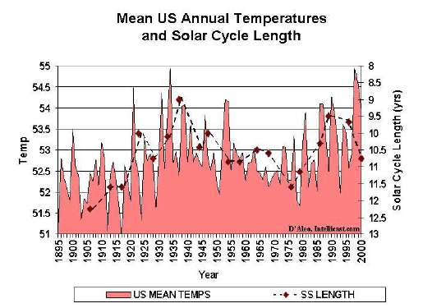
Solar Cycle Frequency and T

Slide 10
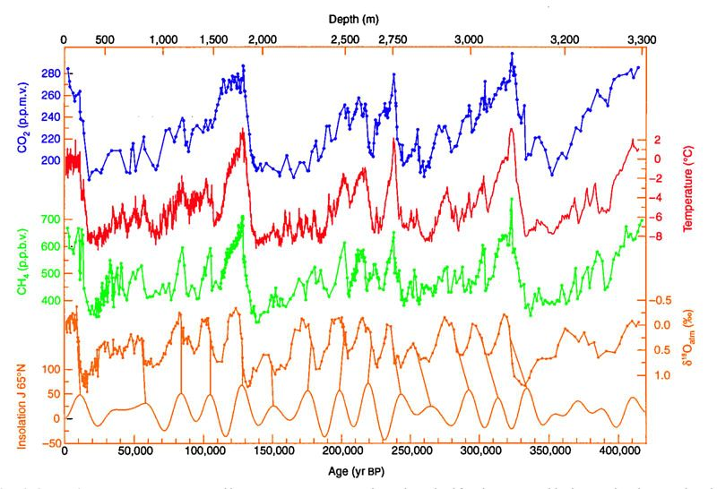
The Vostock Ice Core …

Slide 11
Are these Feedbacks + or – ?
Temperature increase melts permafrost, releasing trapped methane…
Temperature Increase melts Sea Ice…
Increased CO₂ fertilizes plants…
Increased T lengthens and extends growing season…

