Slide 1
CHEM 304 – 4/4/12
II. Climate Change:
- Greenhouse gases (GHG’s):
- Sources/Sinks
- GWP’s
- Albedo effects
Read IPCC Working Group I “AR4” Report
> HW #7 just went out – not sure abut next quiz.

Slide 2
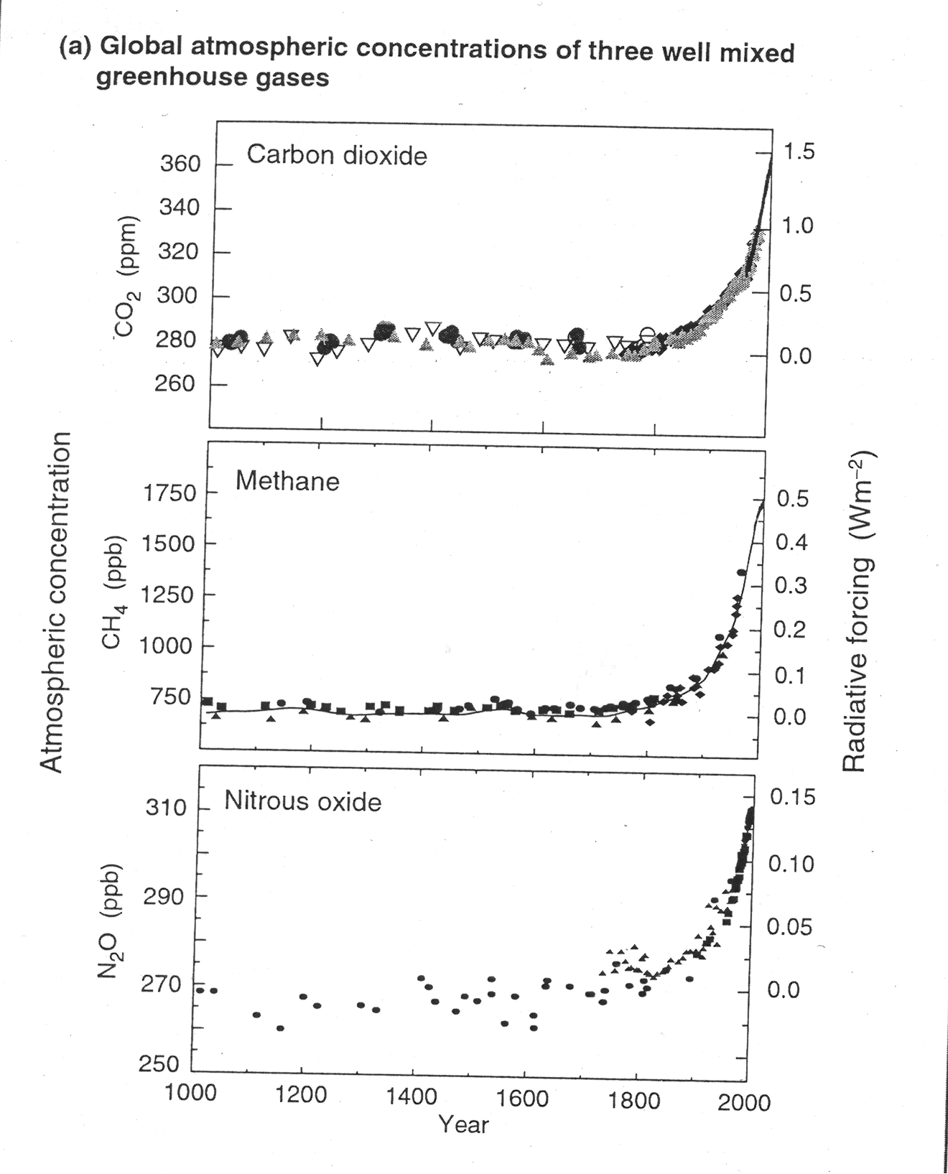

Slide 3
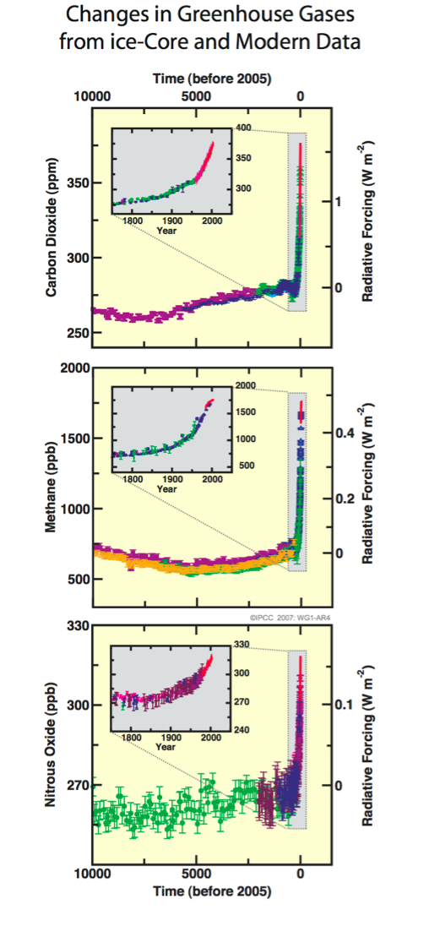
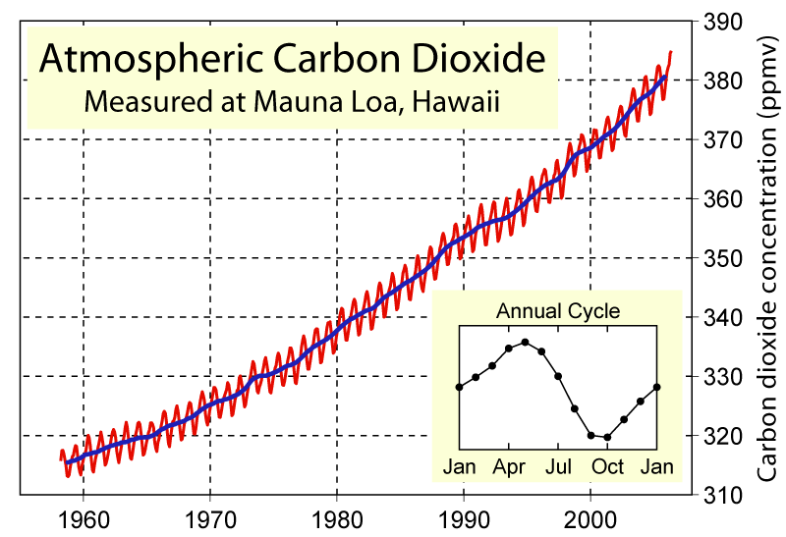
Greenhouse Gases ?

Slide 4
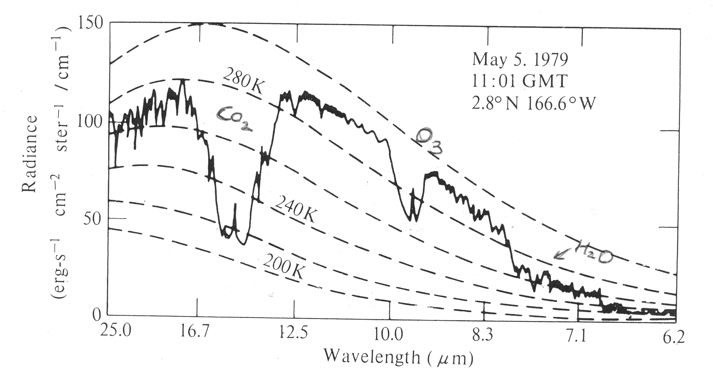

Slide 5
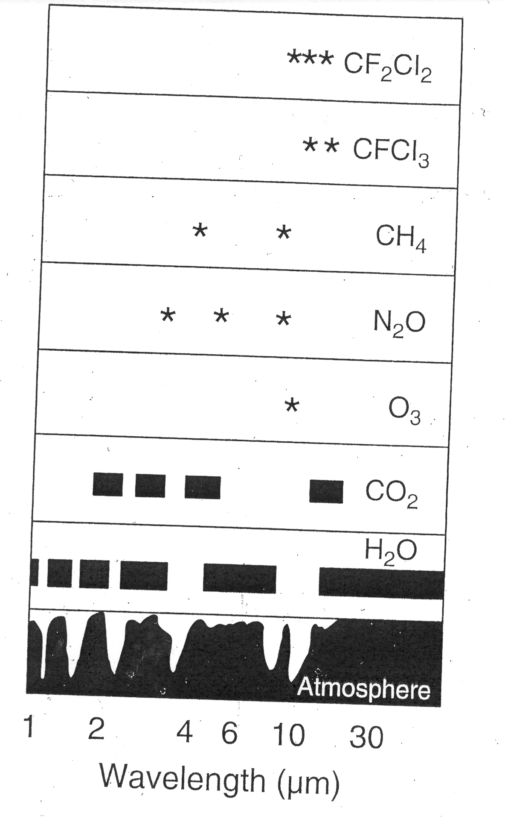
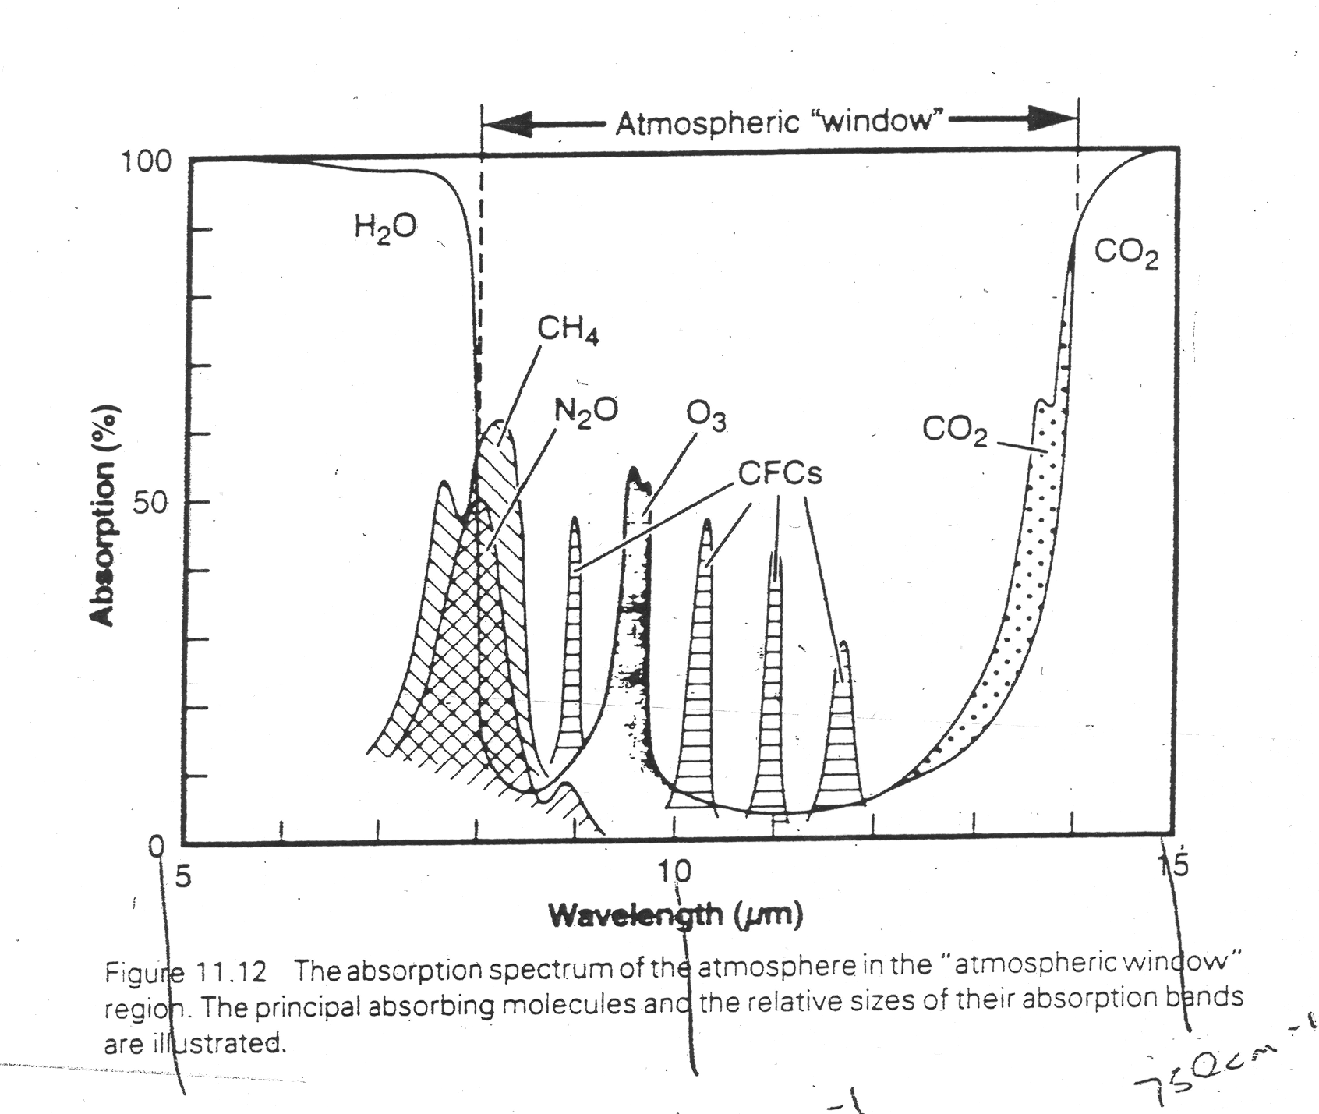

Slide 6
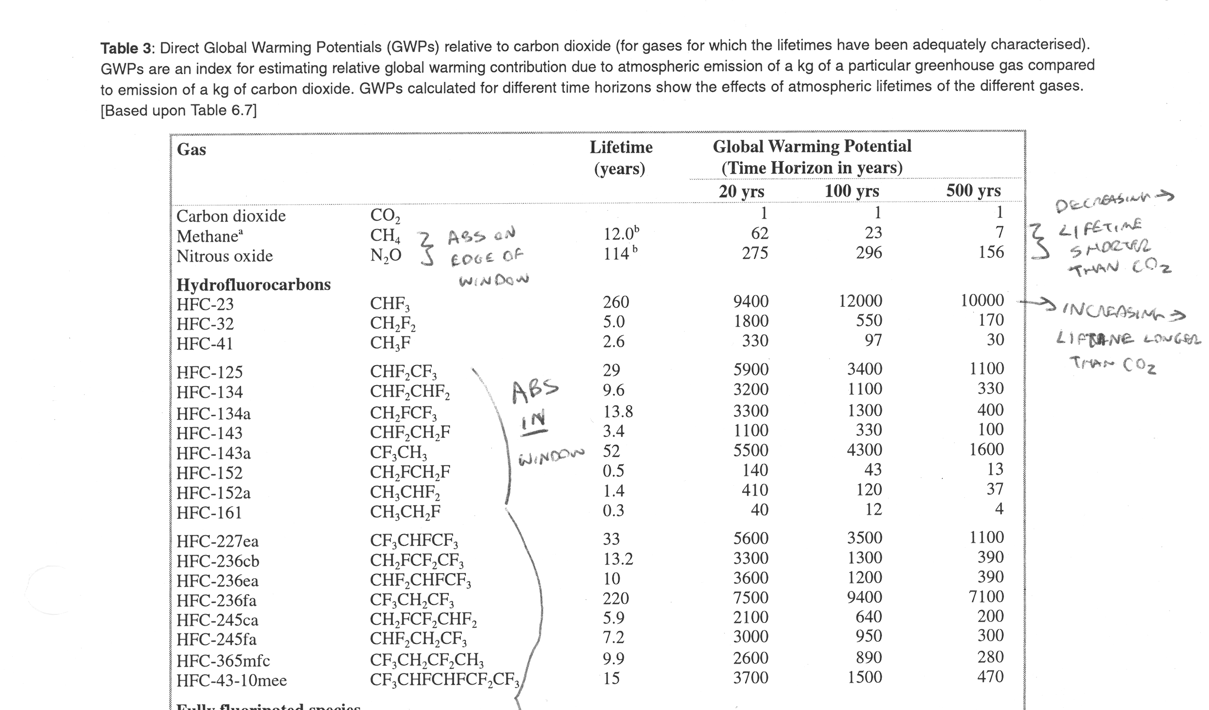

Slide 7
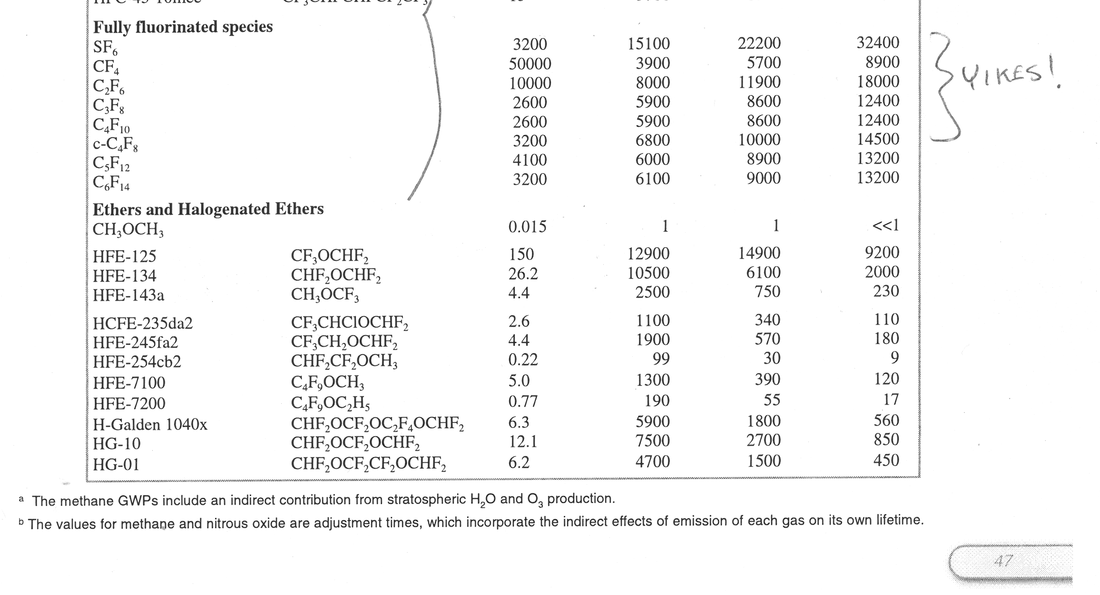

Slide 8
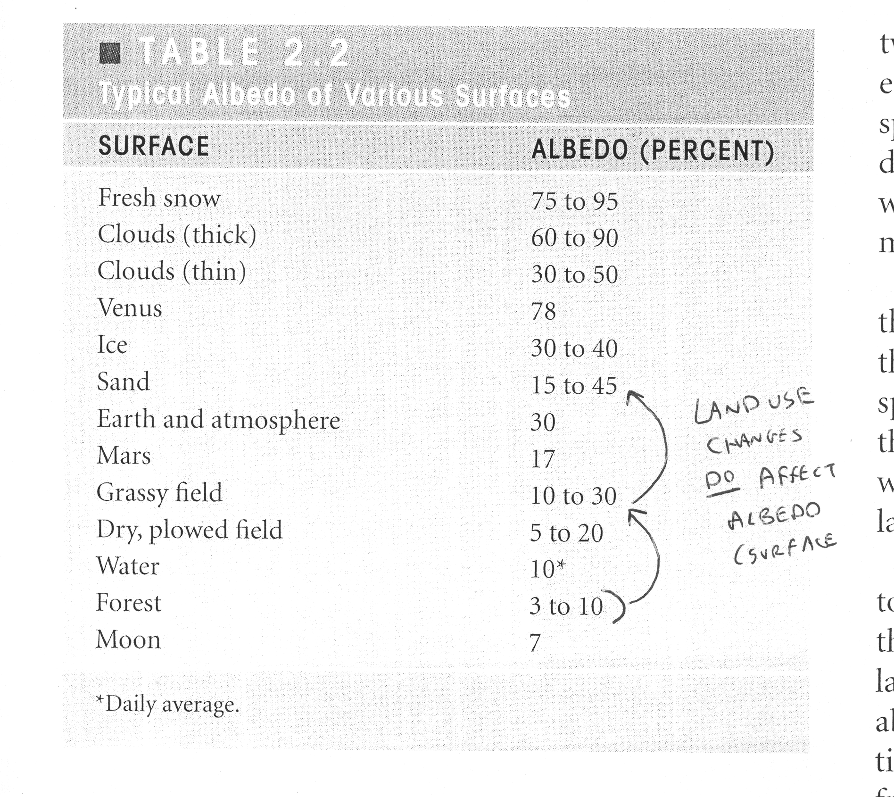
Albedo Effects - surface/land use

Slide 9
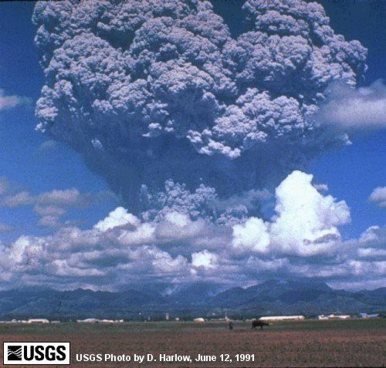
Mt. Pinatubo Eruption - Philippines 1991

Slide 10
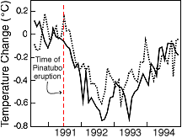
Pinatbo has observable cooing effect - and this is well understood and “model-able” - Tobs = (dashed), T(model) = (solid)

