Slide 1
CHEM 304 - 4/2/12
I.D. Climate Change:
- Quick Review
- Greenhouse gases (GHG’s):
- Structural features
- Identification - Sources / Sinks
- Effectiveness: GWP
Read Chapter 6 & 7

Slide 2
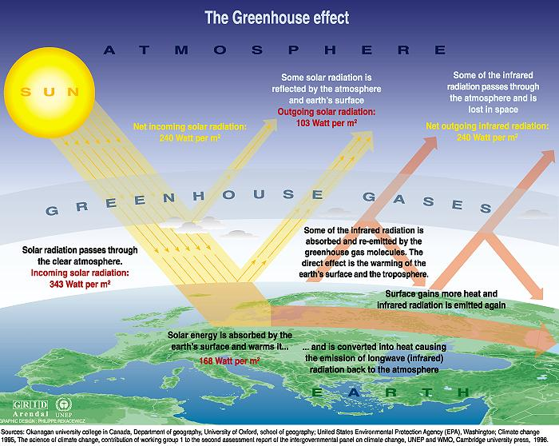
The global radiation balance —>
3 Main climate Influences

Slide 3
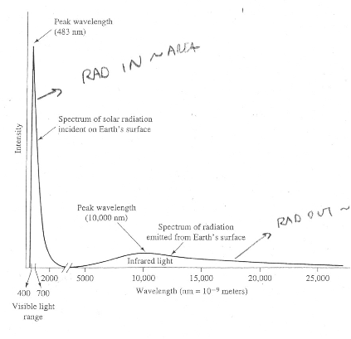

Slide 4
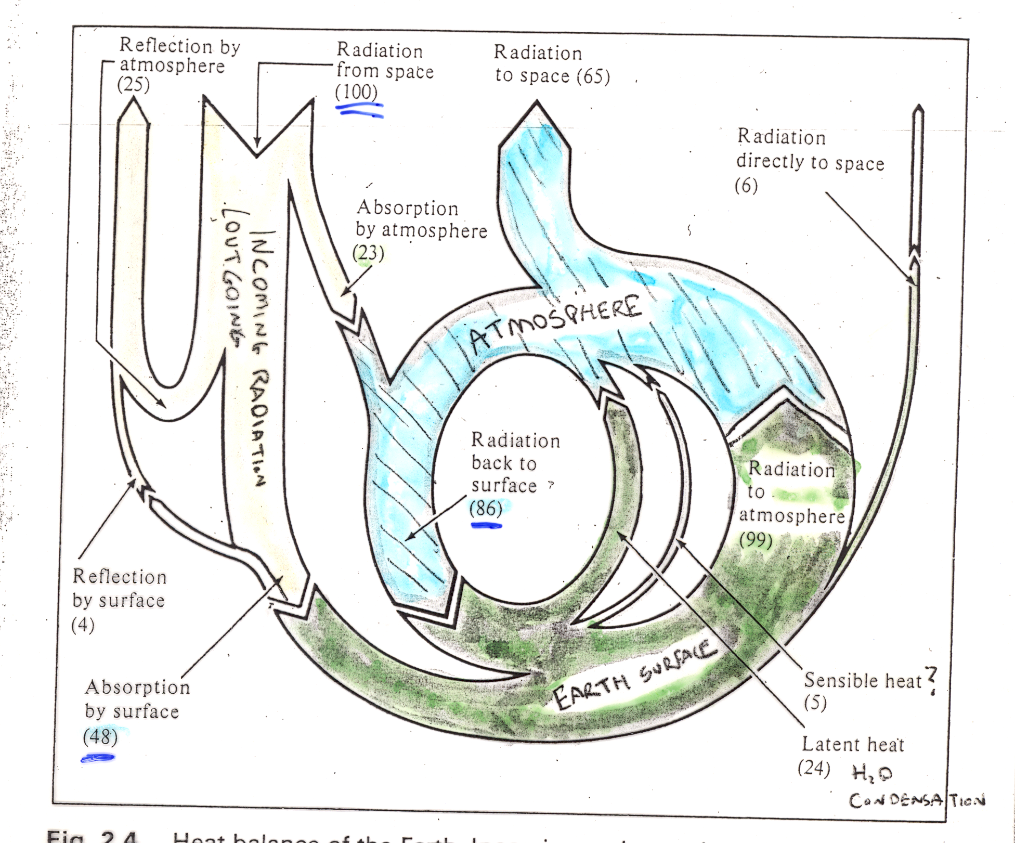

Slide 5
Does a substance absorb/emit IR?
Atoms or Molecules?
No
Diatomic or Polyatomic?
Yes
Homonuclear or Heteronuclear?
Yes
No

Slide 6
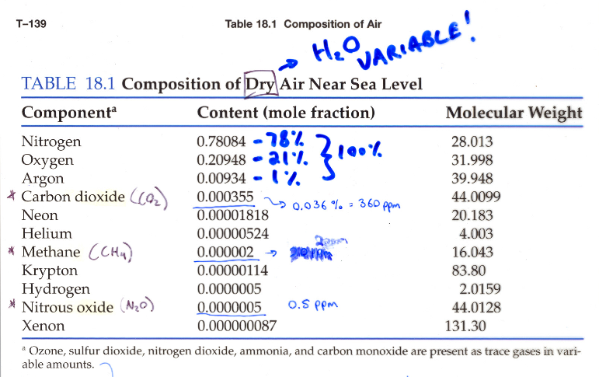

Slide 7
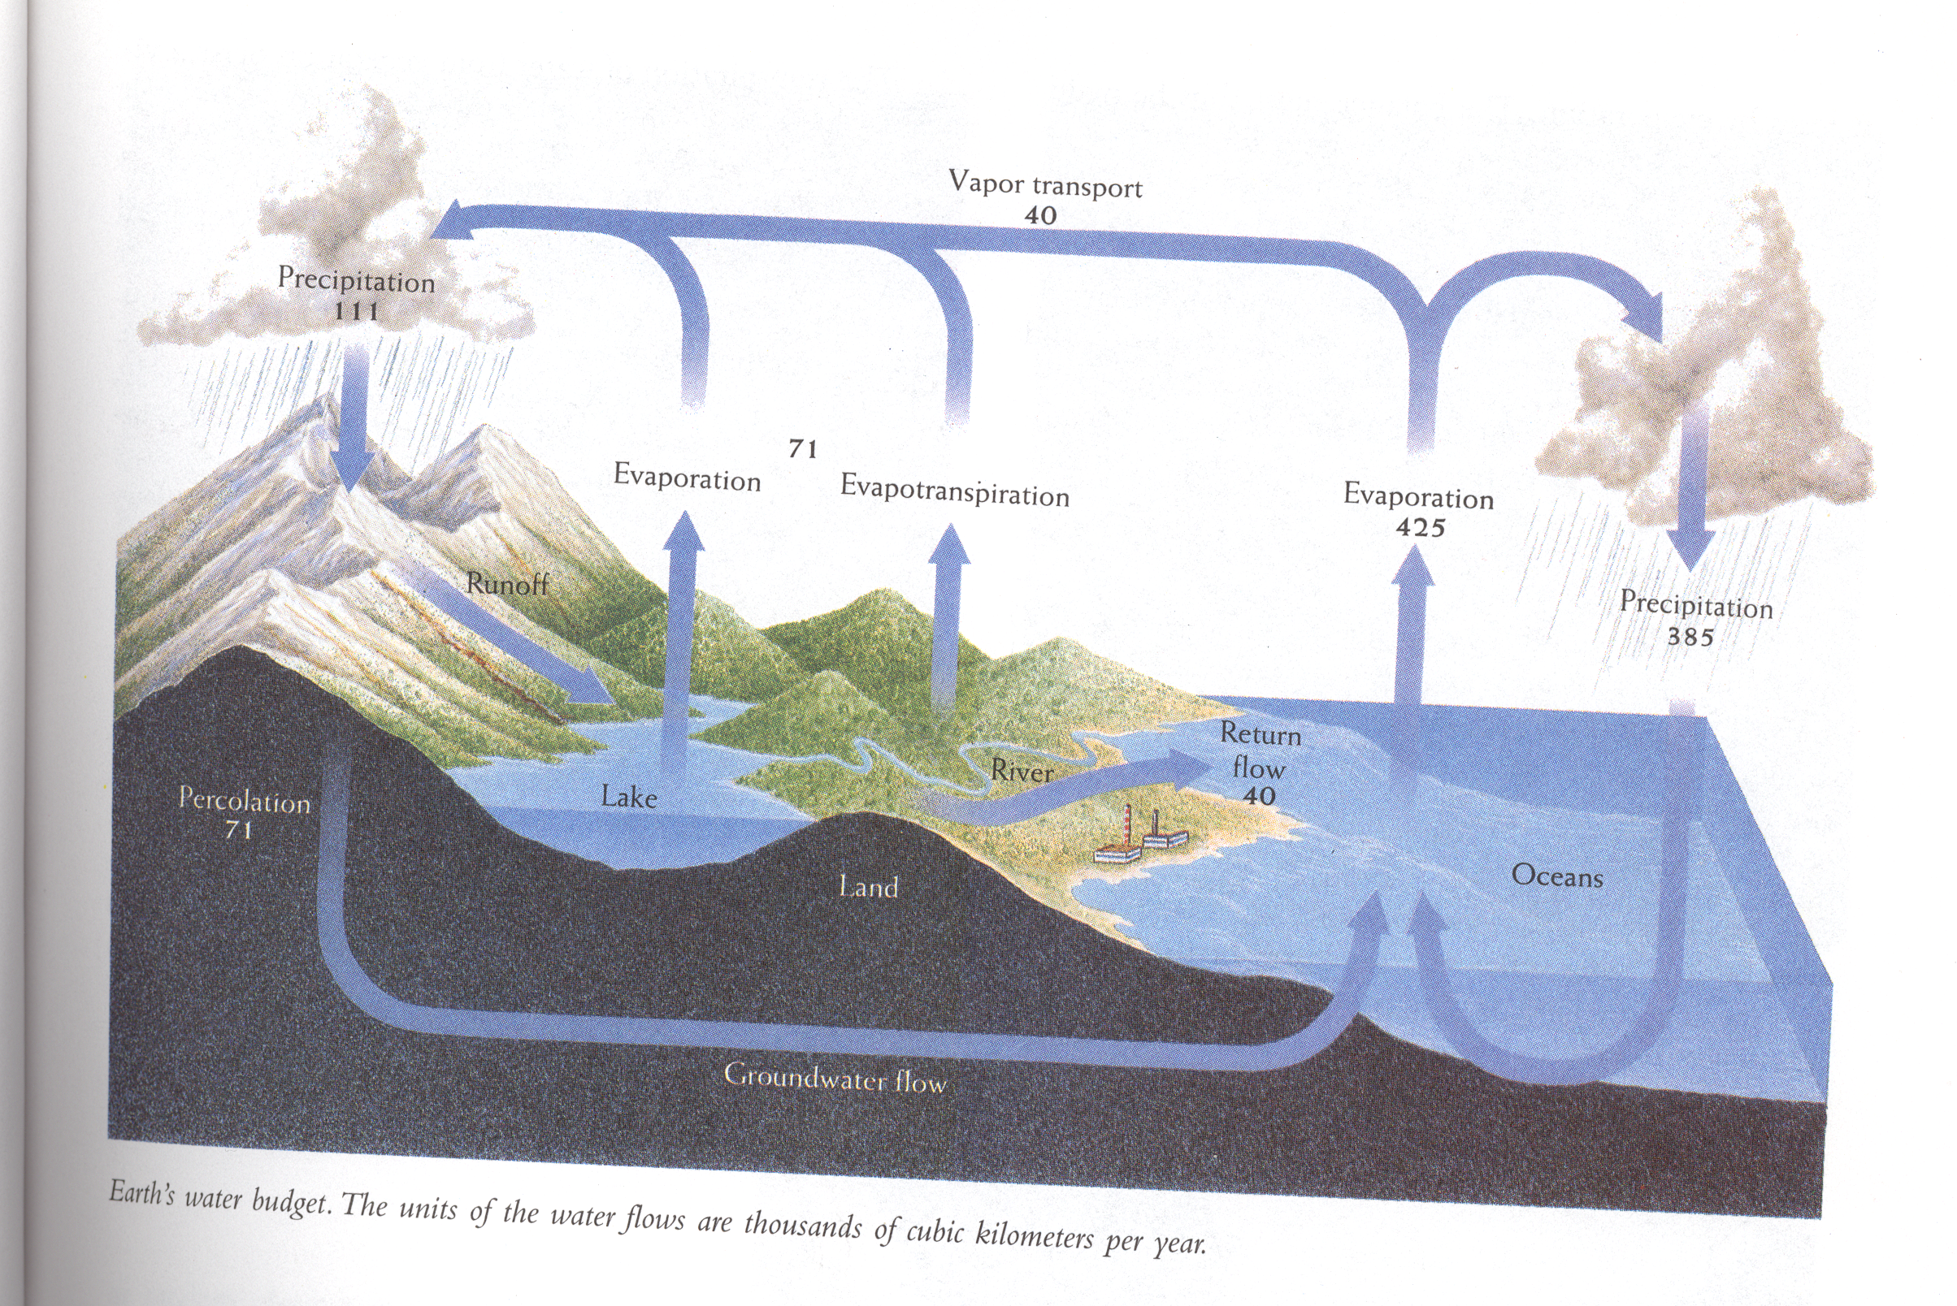

Slide 8
Deforestation = either “B” (burning) or “A-”
Atmosphere
(CO₂ mainly…750Pg)
C
B’
B
A
A
B
Biosphere (terrestrial)
(C₆H₁₂O₆ - carbohydrates)
Biosphere (marine)
(C₆H₁₂O₆ - carbohydrates)
D’
B
Pedosphere (rocks)
(CaCO₃ - “Carbonates”)
D
Hydrosphere
(H₂CO₃ - “Carbonic acid”)
Fossil Fuels
(Coal mainly…5000Pg)

Slide 9
Photosynthesis: C₆H₁₂O₆ + 6 O₂ —> 6 CO₂ + 6 H₂O
Respiration: 6 CO₂ + 6 H₂O —> C₆H₁₂O₆ + 6 O₂
Uptake: CO₂ + H₂O —> *H₂CO₃
Note: upper layer of ocean is “saturated”..
(*Carbonic Acid —> leads to Ocean Acidification …)
D) Deposition (or mineralization): (SLOW!!!)
Land: CO₂ + CaO —> CaCO₃ (s) (aka limestone …)
Water: (*H₂CO₃ <—> 2 H⁺ + CO₃⁻²)
CO₃⁻² + Ca⁺² —> CaCO₃ (s)

Slide 10
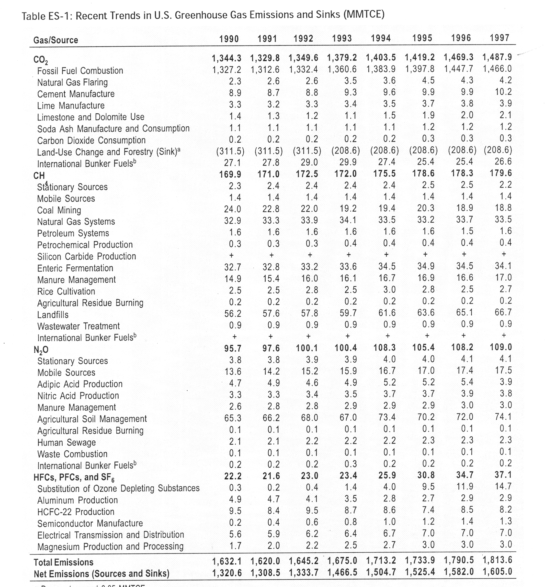
http://www.epa.gov/climatechange/emissions/usinventoryreport.html

Slide 11
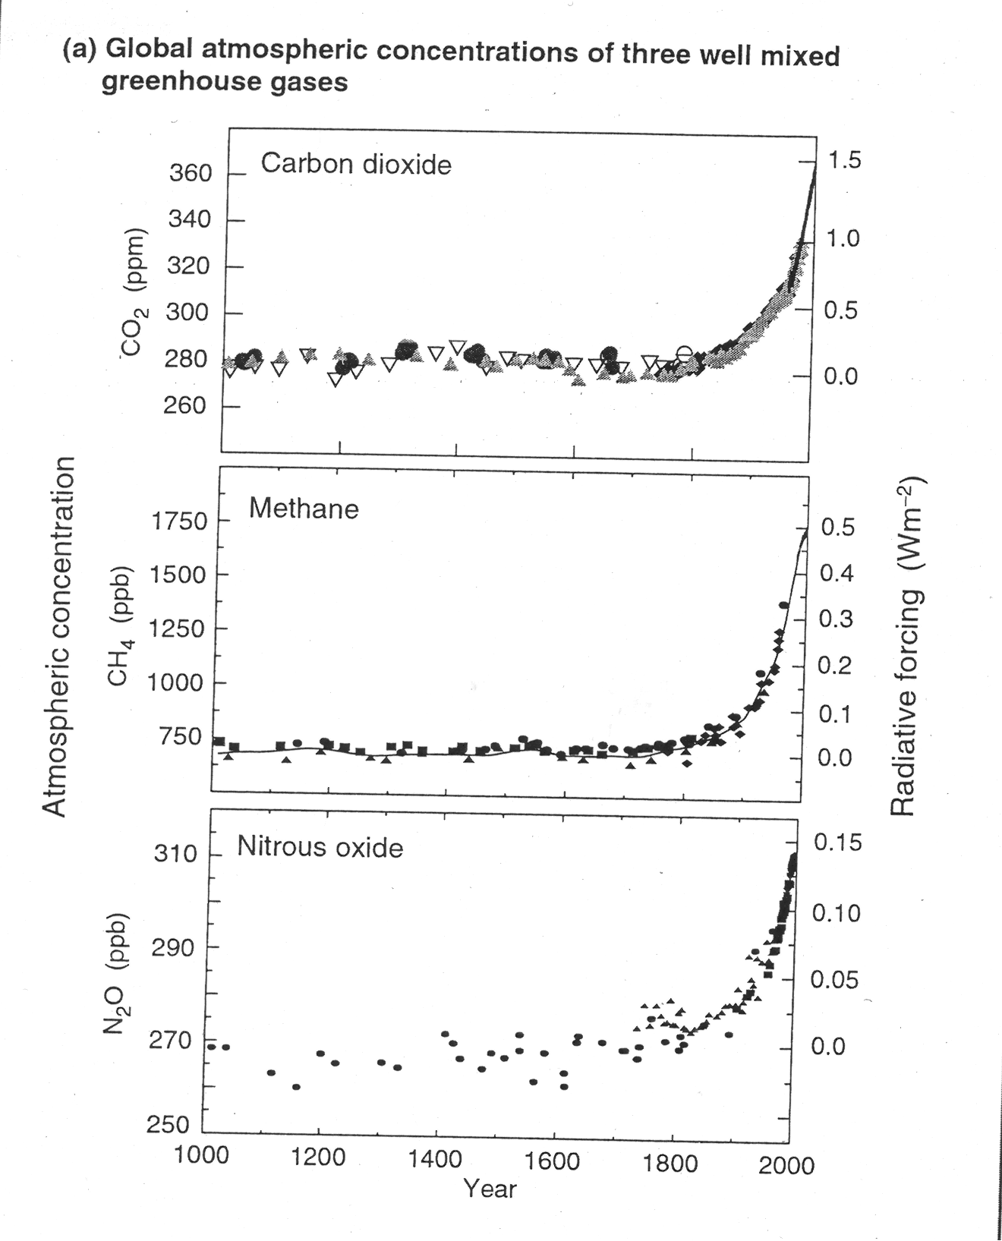

Slide 12
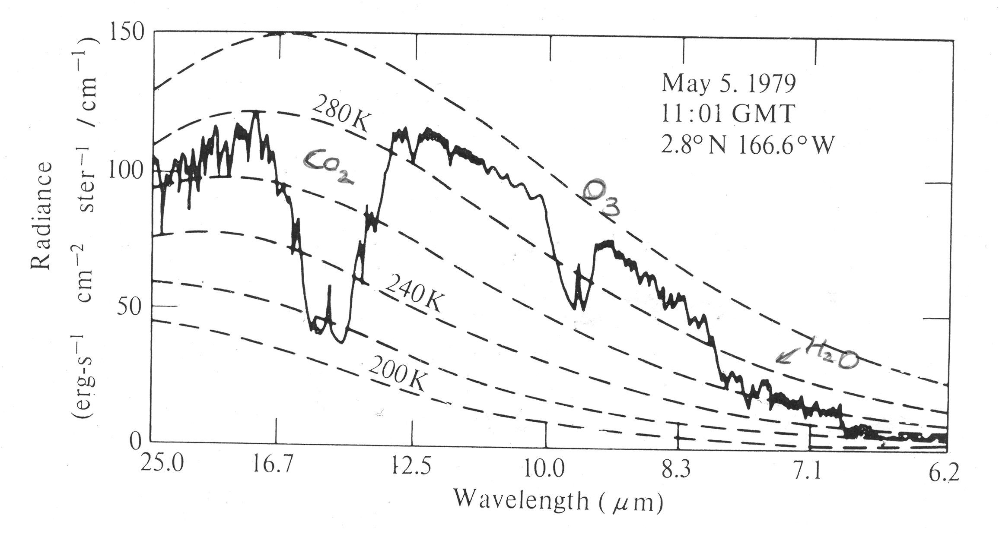

Slide 13
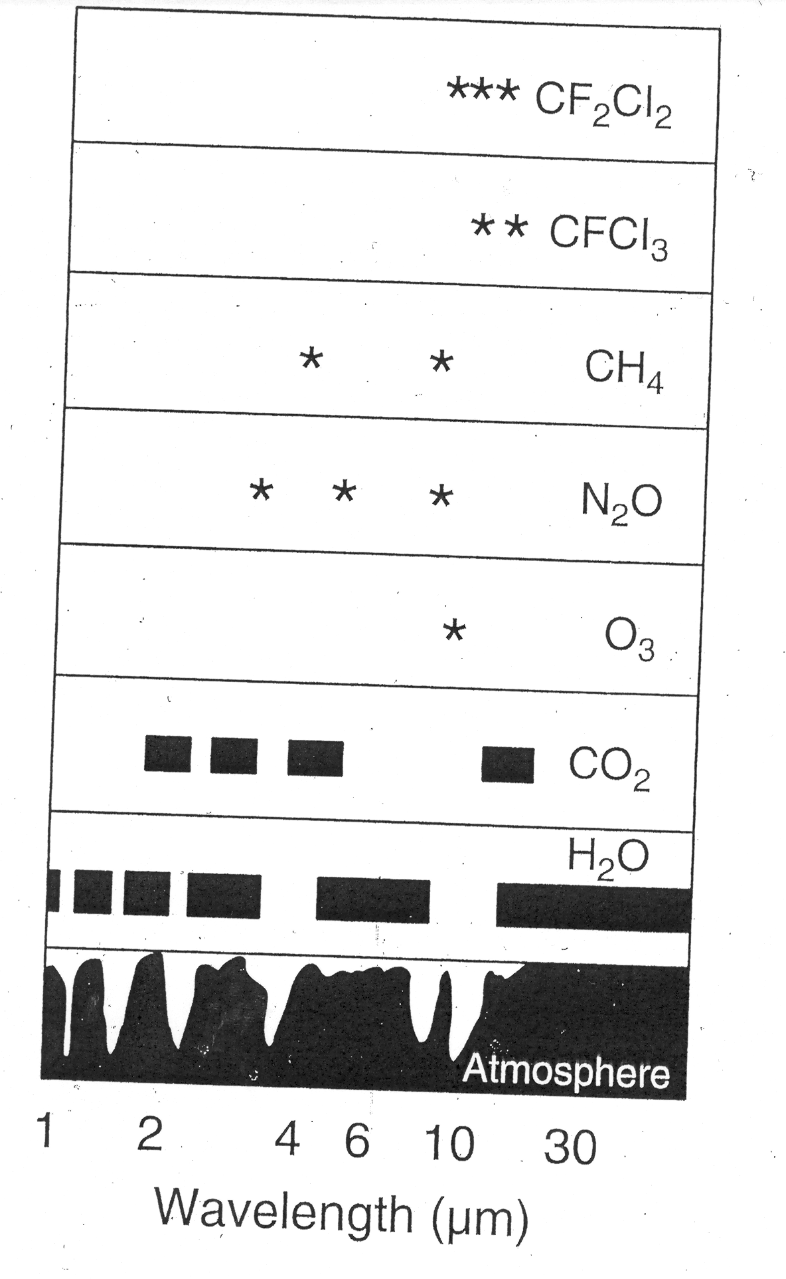
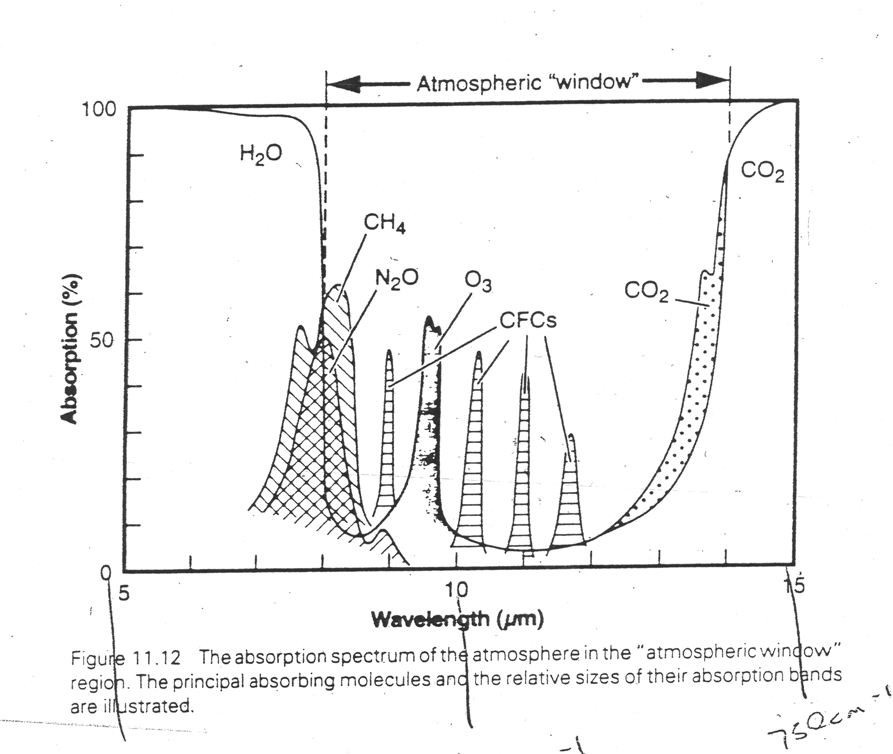

Slide 14
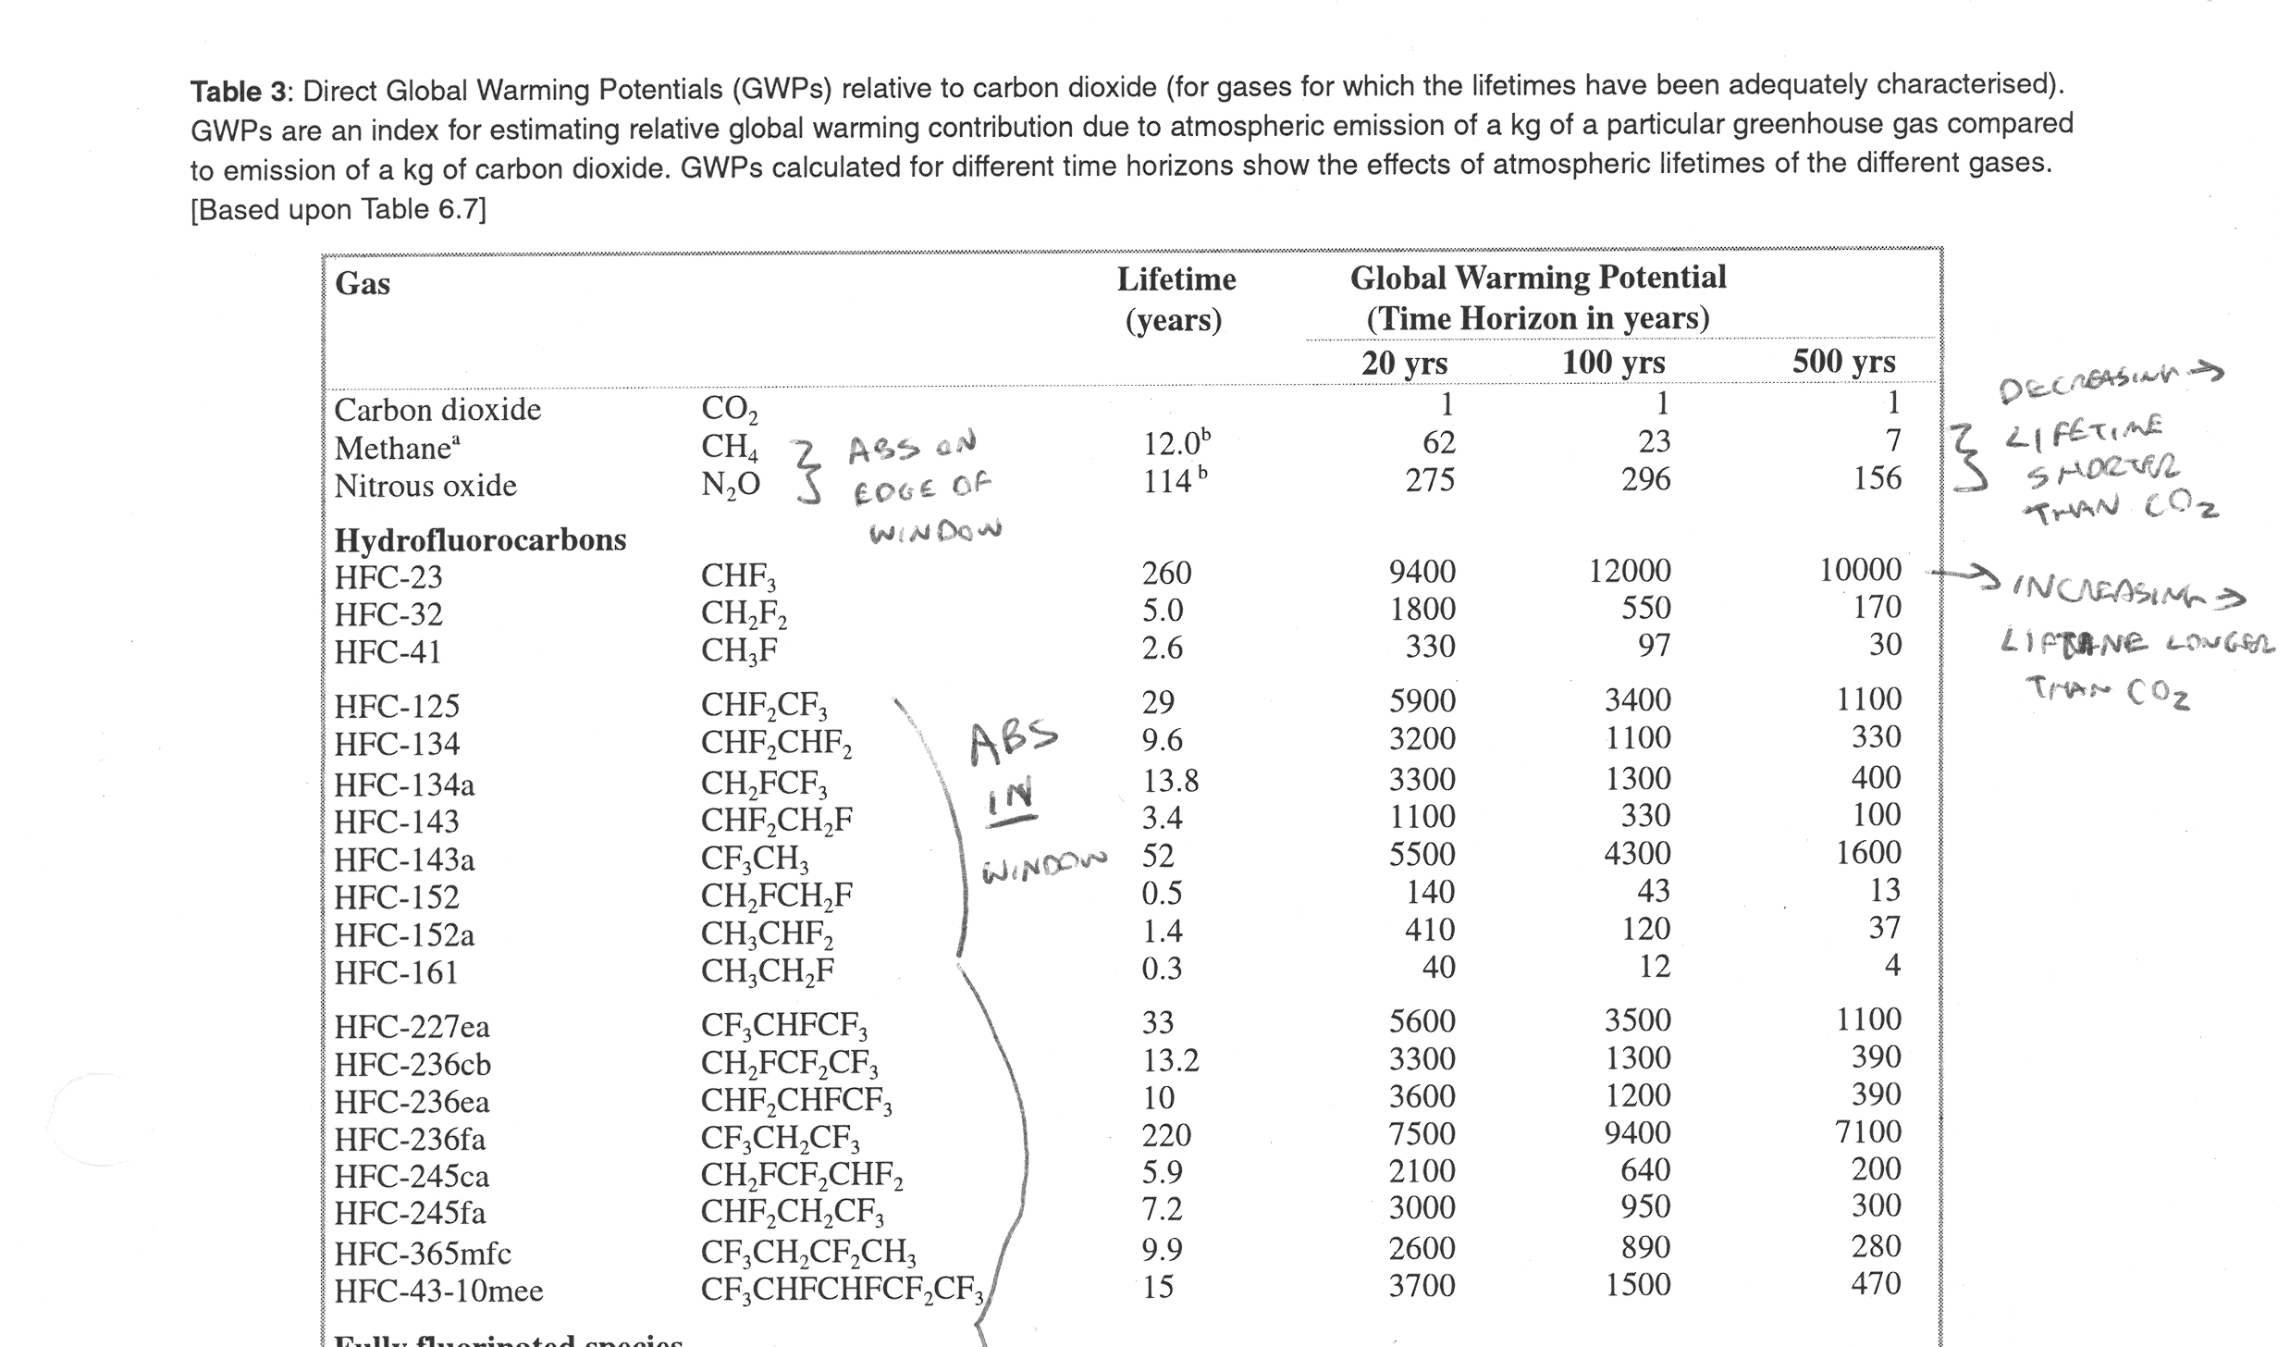

Slide 15
