Slide 1
CHEM 304 – 1/27/12
I.A. Fundamentals of Atmospheric Chemistry
• More on “Trace” Species
- Free Radical Chemistry
- Concentration units (p. 28-29)
FIELD TRIP MONDAY !
HW #1 e-mailed W
Reading: Baird Intro, Ch. 3 (p. 91-95), and start chapter 1

Slide 2
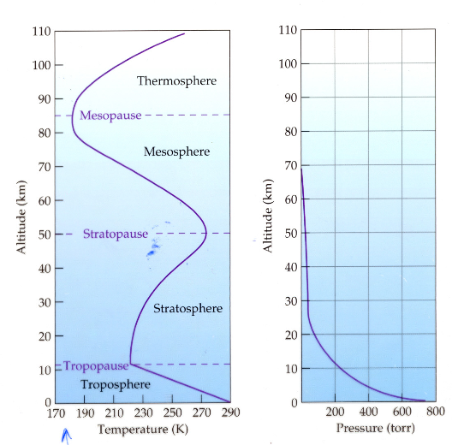

Slide 3
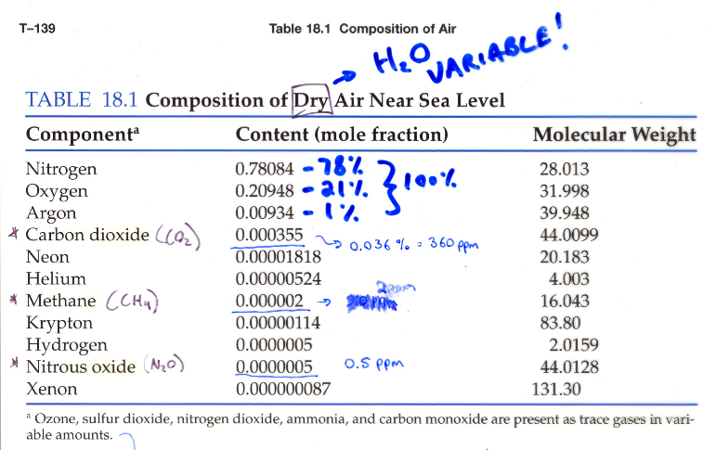

Slide 4
Some lingo regarding “Trace species” (e.g. pollutants, reactive substances, etc.)
Source: reaction or process that release trace compound.
Sink: Reaction or process that “permanently” removes trace compound.
Reservoir: An entity (process, substance, physical feature) that temporarily holds a trace substance

Slide 5
Which of the following are “free radicals”?
(all are neutral …)
CH₃, ClONO₂, NO₃, SO₃, HOSO₂, Cl₂O₂
CH₃, NO₃, & HOSO₂

Slide 6
A summary for free radical reaction types:
Initiation: X-Y —> X° + Y ° (often light-driven)
Propagation: X° + Y-Z —> XY + Z° or
X° + W —> XW°
Initiation: X° + Y ° —> X-Y

Slide 7
Quantifying Concentrations:
Express the Following as ppm and ppb
a) X_{CH4} = 0.000002
b) X_{O3}(10 km) = 5.1 x 10⁻⁸
a) 2.0 x10⁻⁶ = 2.0 ppm = 2000 ppb
b) 0.051 x10⁻⁶ = 0.051 ppm = 51 ppb

Slide 8
Quantifying Concentrations:
Express the following as X’s (i.e. pure numbers).
a) H₂O (10km) = 36 ppm
b) CH₄ (40 km) = 300ppb
a) 36 ppm = 36 x 10⁻⁶ = 3.6 x 10⁻⁵
b) 300 ppb = 300 x 10⁻⁹ = 3.0 x 10⁻⁷

Slide 9
Partial pressures:
Calculate the Partial Pressure of CO₂
(X_{CO2}= 360 ppm) at:
a) 0 km (P_{TOT}=1 atm)
b) 15 km (P_{TOT}=122 mbar)
a) P_{CO2} = 3.6x10⁻⁴ x 1.0 atm = 3.6 x 10⁻⁴ atm
b) P_{CO2} = 3.6 x 10⁻⁴ x 122 mbar = 4.4 x 10⁻⁵ bar

Slide 10
Number Densities: molec/cm³
For OH, X = 6 x 10⁻¹⁴, what is C in molec/cm³ at 0 km (P=1.0atm)?
Calc p first, then multiply by 2.7x10¹⁹ molec/cm³atm
1.6 x 10⁶

