Slide 1
CHEM 304 – 3/16/12
Your “Personal Carbon Footprint” Assignment
- Chemical Mass & Energy Balance
- Some specifics
Exam #1 Average =

Slide 2
For methane combustion:
CH₄ + 2 O₂ —> 2 H₂O + CO₂
If 1000 g of CH₄ are burned:
i) How many grams of H₂O are produced? ii) How many grams of CO₂ are produced?

Slide 3
For methane combustion:
CH₄ + 2 O₂ —> 2 H₂O + CO₂ + 890 kJ
If 1000 kg (1 metric ton) of CH₄ is burned, how much heat (energy) is produced?
How many grams of CH₄ is burned if 105 megajoules (105 x 10⁶ J)* of energy are produced? How much CO₂?
*(this is 1 “THERM” – the unit on a utility bill!)

Slide 4
Converting to kJ (per day) or g (per day)

Slide 6
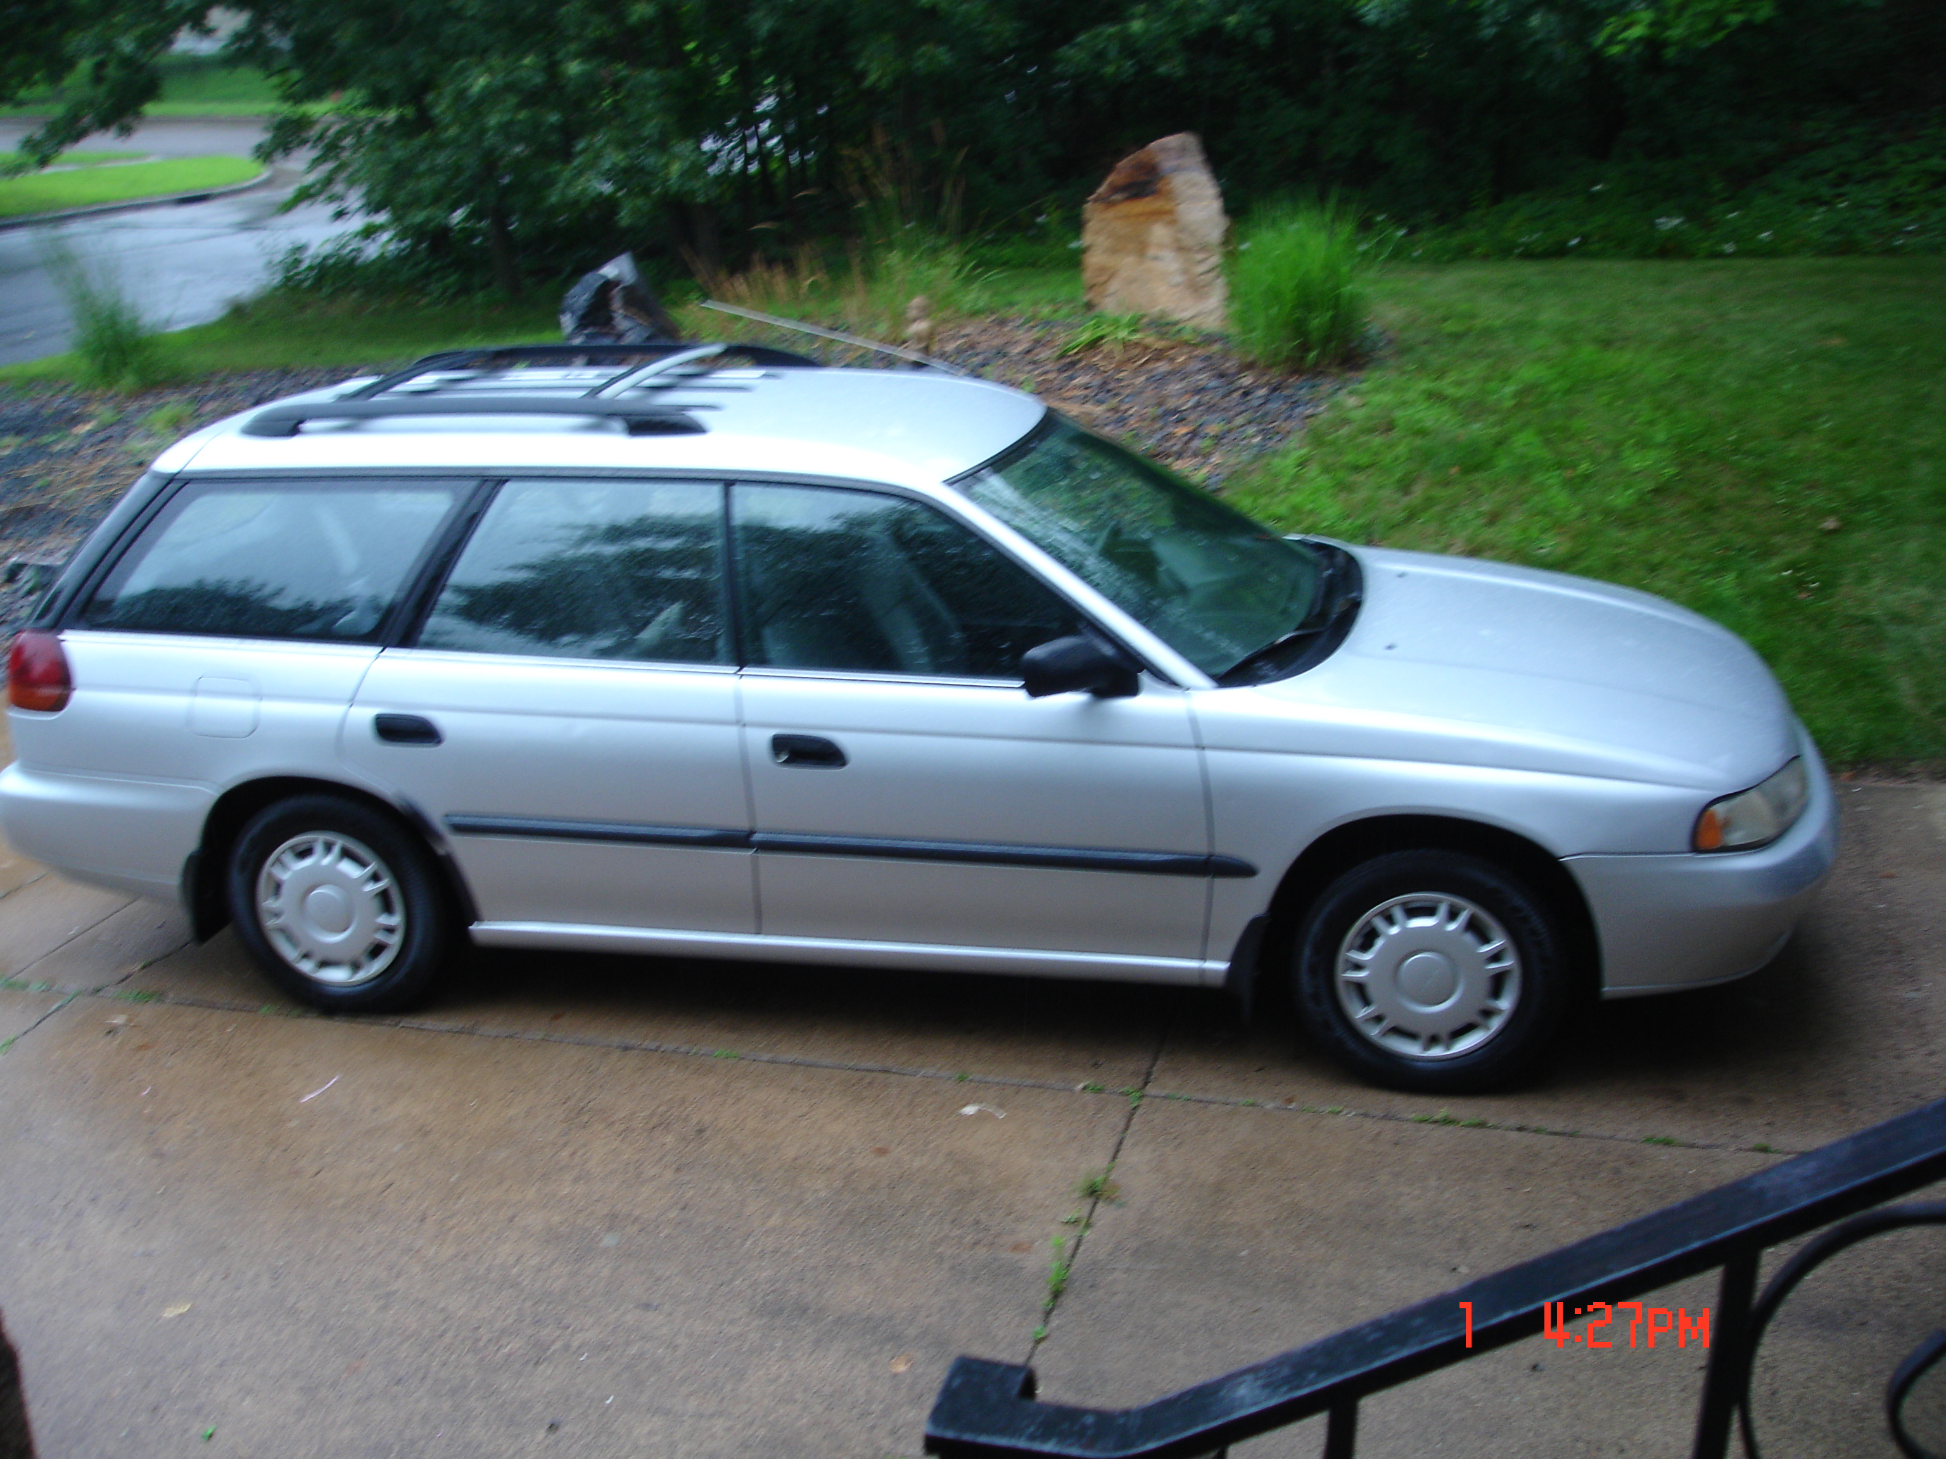
http://www.fueleconomy.gov/
Dr Jim drives ~ 150 miles per week
(100 w/out kids, 200 w/ kids …)
• 1997 Subaru legacy wagon:

