Slide 1
CHEM 304 - 3/9/12
I.D. Climate Change:
- Final comments of T_{eff}
- Mechanism for a Greenhouse effect
- Radiation budget: Accounting
- Greenhouse gases (GHG’s):
Structural features
READ: Chapter 6 & 7

Slide 2
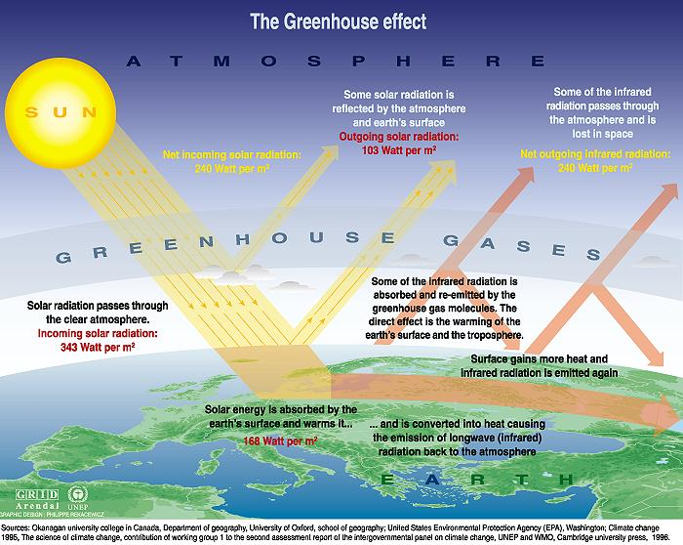
The global radiation balance —>
3 Main climate Influences

Slide 3
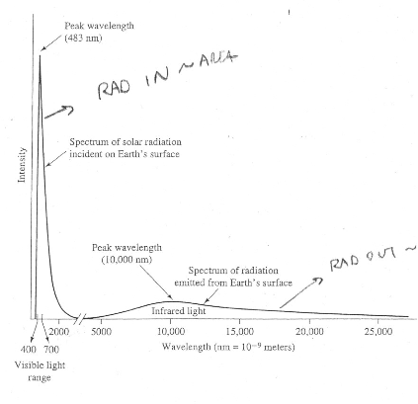

Slide 4
True or False:
Venus is hotter than Earth because it is closer to the sun?

Slide 5
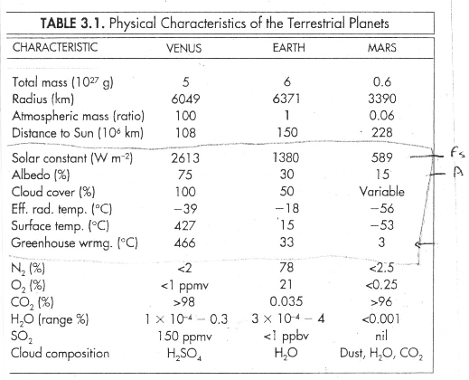

Slide 6
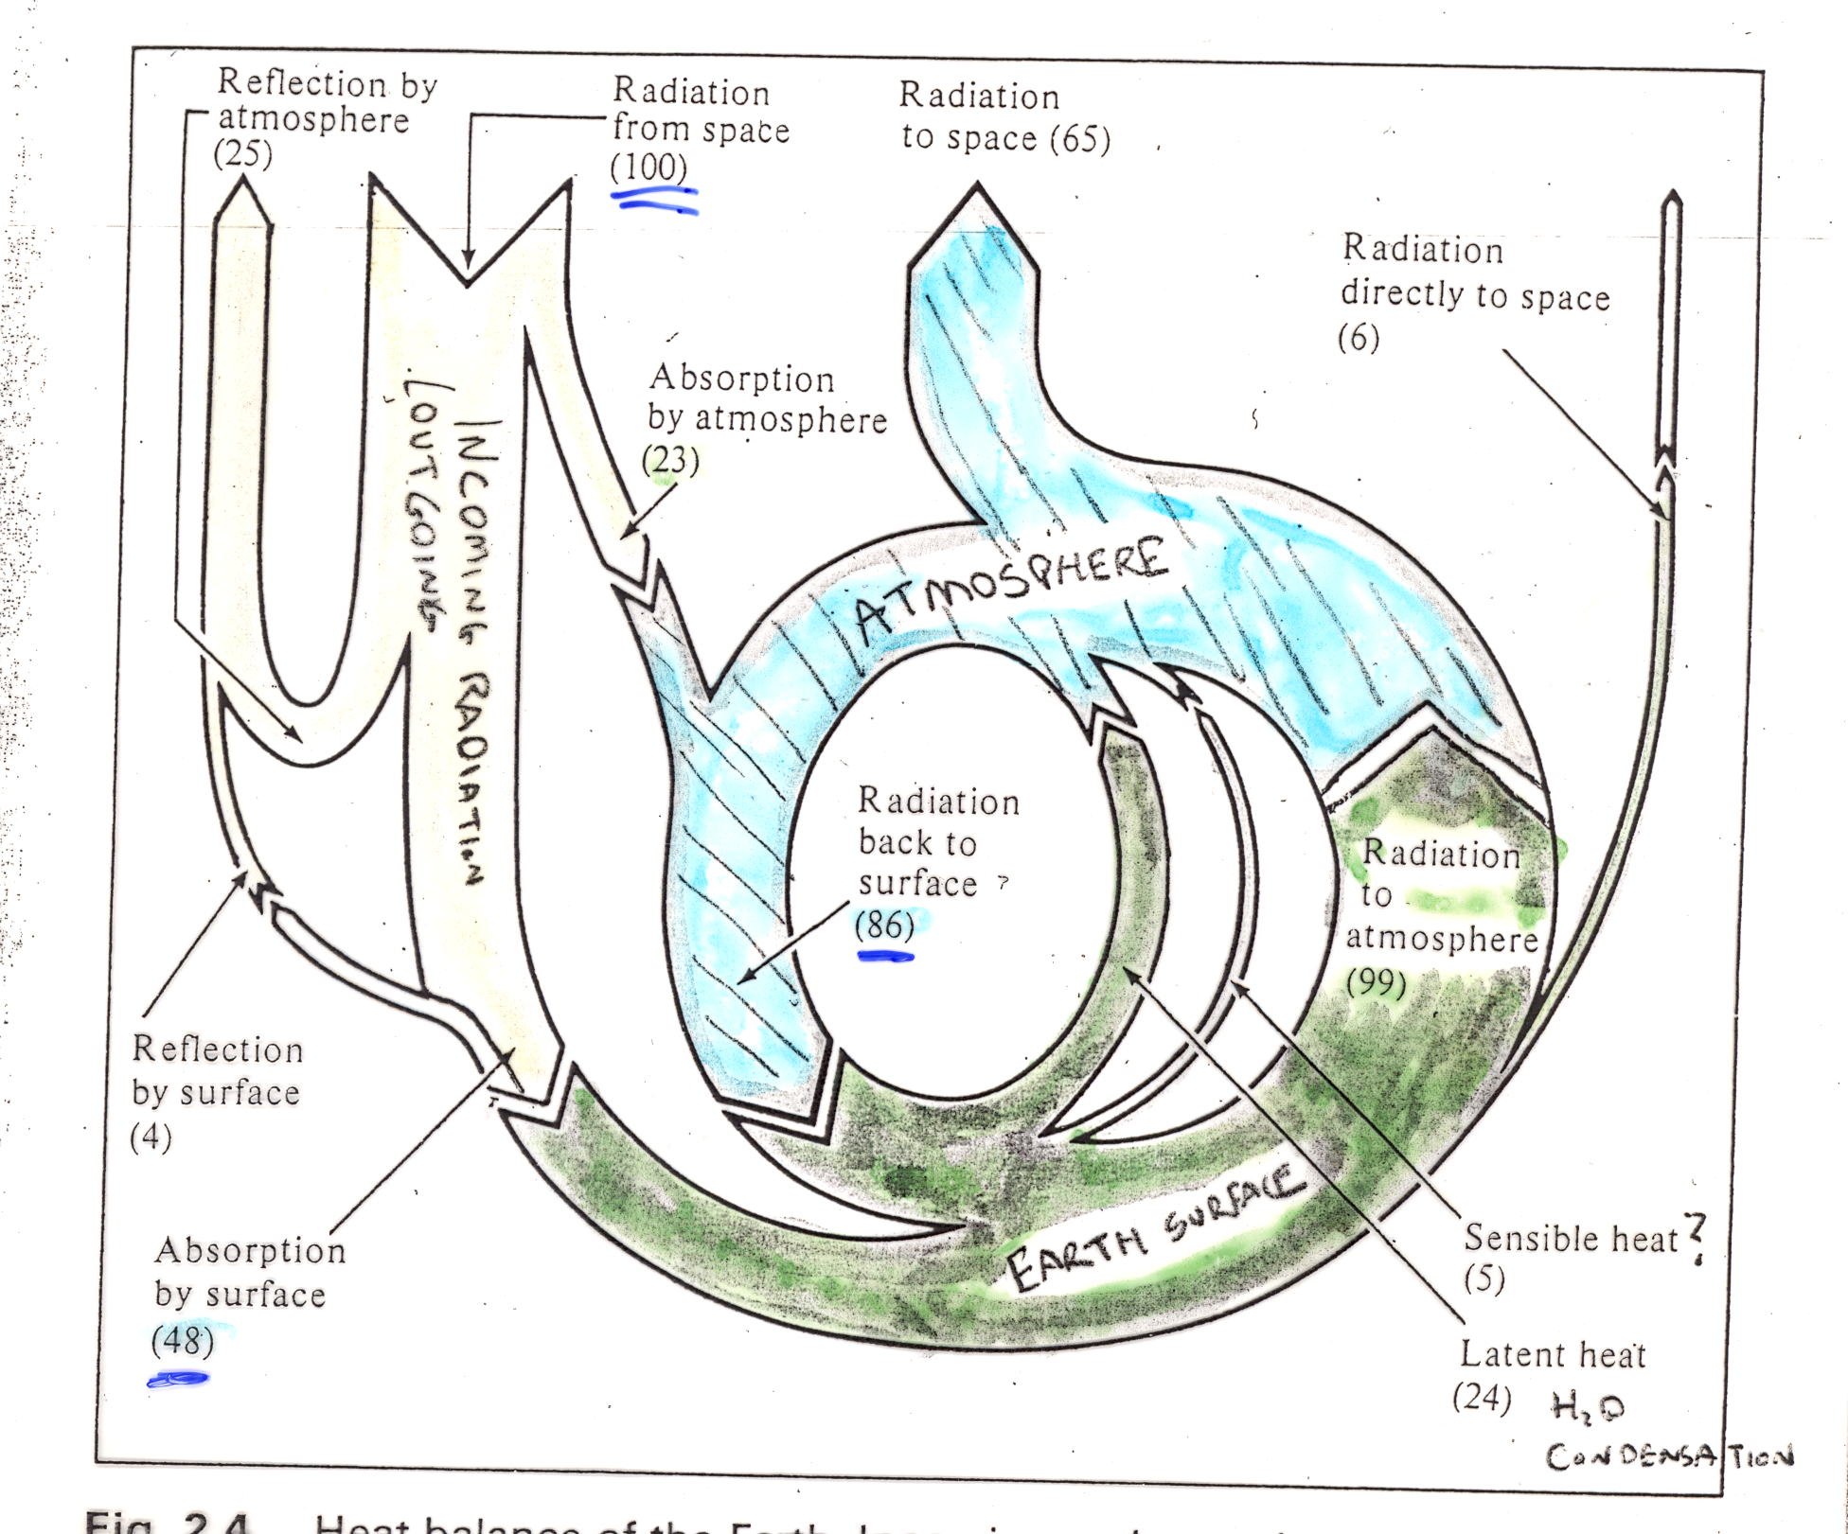

Slide 7
Mars has a very thin atmosphere – about 6 mbar CO2 is it!
http://www.youtube.com/watch?v=fpUVPvsIF5w

Slide 8
Does a substance absorb/emit IR?
Atoms or Molecules?
No
Diatomic or Polyatomic?
Yes
Homonuclear or Heteronuclear?
Yes
No

Slide 9
