Slide 1
CHEM 304 – 3/7/12
I.D. Climate Change:
• Overview/Commentary
• Matter & Radiation
• Flux/Steady State Radiation Balance
• “Effective”Temperature Calcs.
EXAM #1 WEDNESDAY - STUDY!
Review Session Monday in class
Find utility bill & your car’s mpg

Slide 2
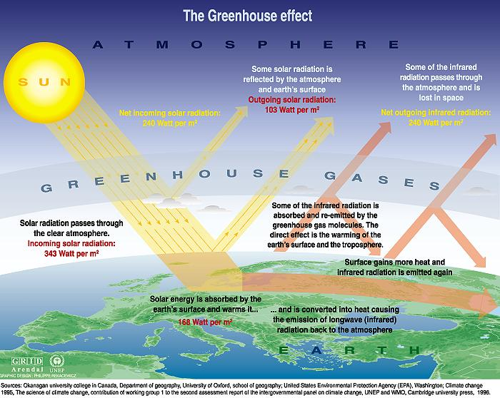
The global radiation balance —>
3 Main climate Influences

Slide 3
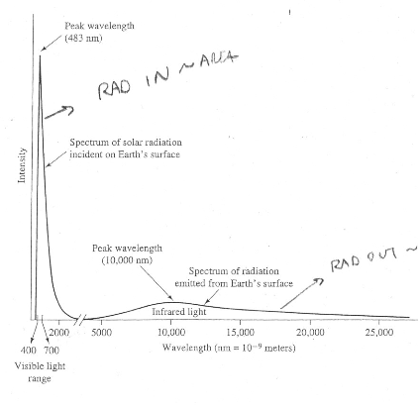

Slide 4
True or False:
Venus is hotter than Earth because it is closer to the sun?

Slide 5
