Slide 1
CHEM 304 – 3/5/12
I.C. Tropospheric chemistry:
- Overview / Synopsis
Observations: The Clean Air Act
READ Ch.3, Ch.5, appendix on orgo. Chem.
QUIZ TODAY!

Slide 2
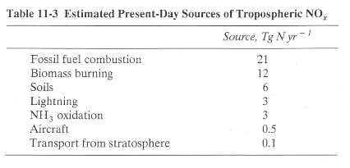
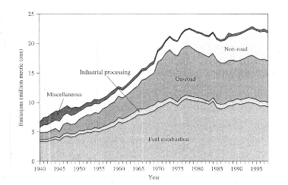
NOx Emissions

Slide 4
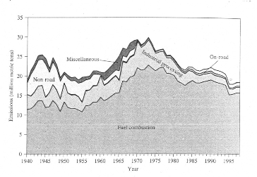
SOx Emissions

Slide 5
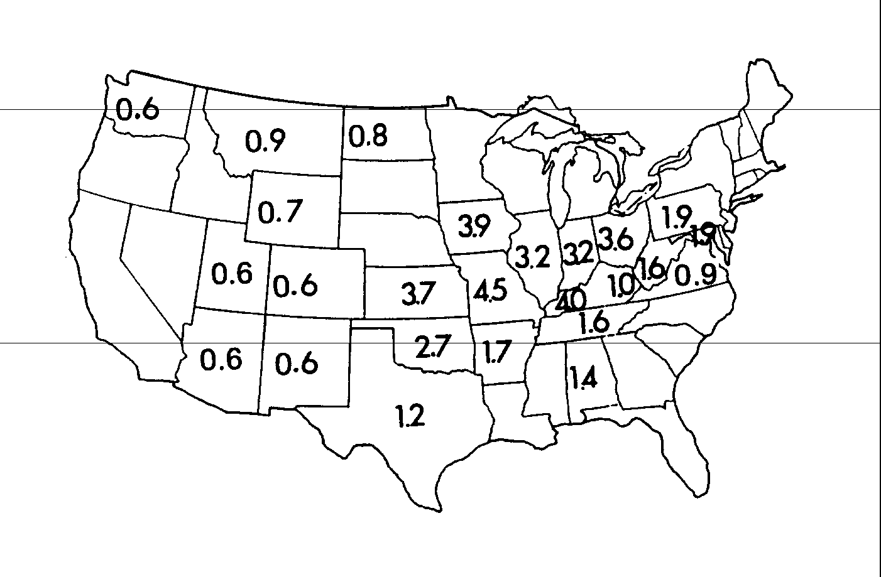
Sulfur Content of Coal (%)

Slide 6
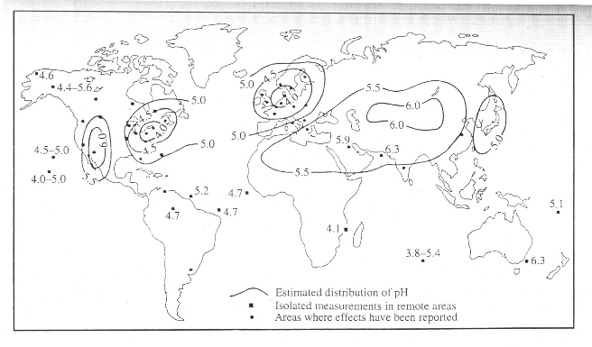
pH of Precipitation

Slide 7
Policy:
I) The Clean Air Act 1963 —> 1990 (Current Law)
SOx: 2 million tons/yr by 2012
NOx: 1.25 million tons/yr by 2010
Hg: 5 tons/yr. by 2008
II) The “Clear Skies” Initiative (2 steps) —> Proposed 2003
SOx: 4.5 million tons/yr by 2010 (3 by 2018)
NOx: 2.1 million tons/yr by 2008 (1.7 by 2018)
Hg: 26 tons/yr. by 2010 (15 tons/yr. by 2018)
(Source: NRDC web site… But I have see this elsewhere..)

Slide 8
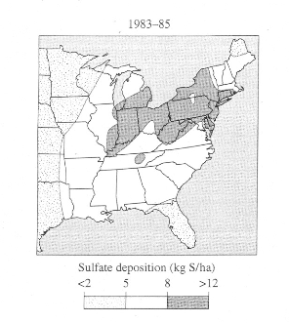
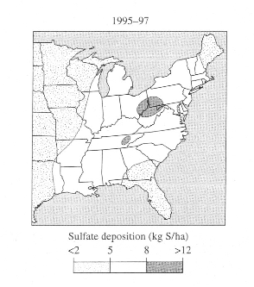
Sulfate Deposition: then and now

Slide 9
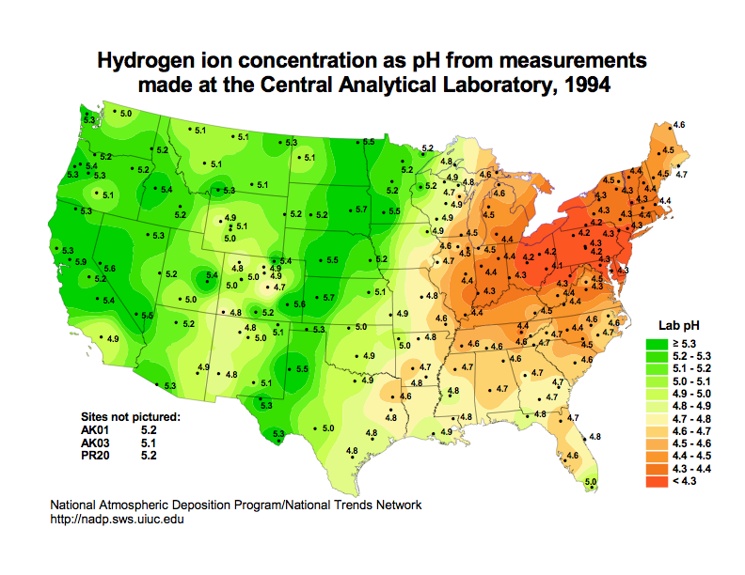
pH of Precipitation

Slide 10
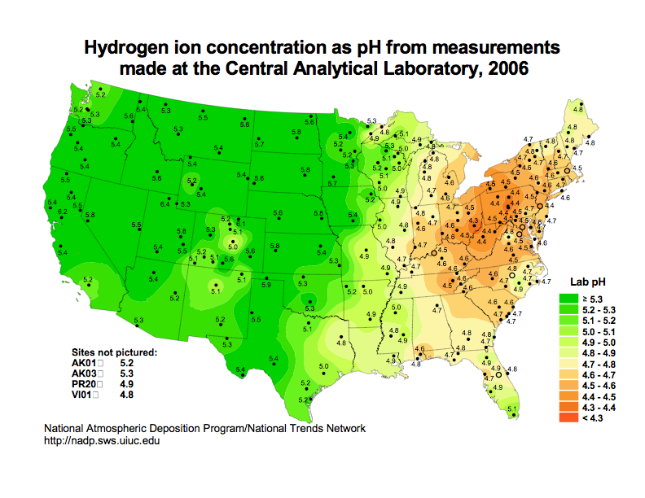
pH of Precipitation

Slide 11
The National Atmospheric Deposition program:
http://nadp.sws.uiuc.edu/
http://nadp.sws.uiuc.edu/data/animaps.aspx (animations index)
http://nadp.sws.uiuc.edu/data/amaps/so4/amaps.html (an awesome animation)

