Slide 1
CHEM 304 – 3/2/12
I.C. Tropospheric chemistry:
- NOx/SOx chemistry:
> Sources
> “Acid rain”/Aerosol Chem.
- pH of natural rainwater (CO₂ _{(aq)})
READ Ch.3, Ch.5, appendix on orgo. Chem.
HW #6 in your inbox – TEST NEXT F!

Slide 2
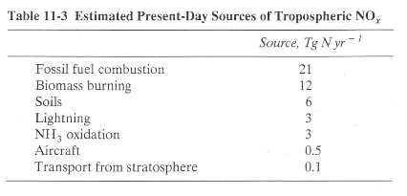
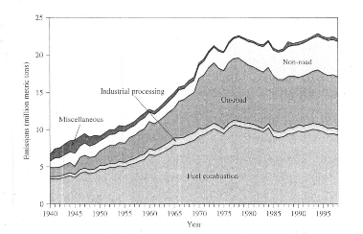
NOx Emissions

Slide 4
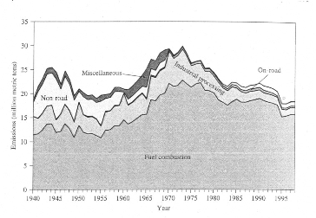
SOx Emissions

Slide 5
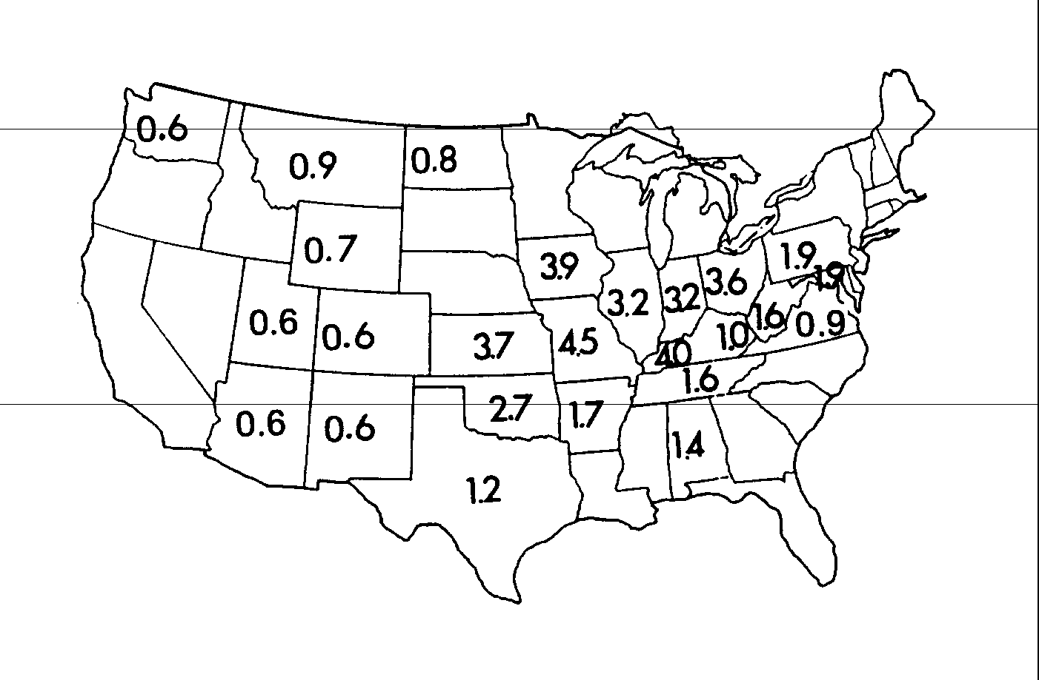
Sulfur Content of Coal (%)

Slide 6
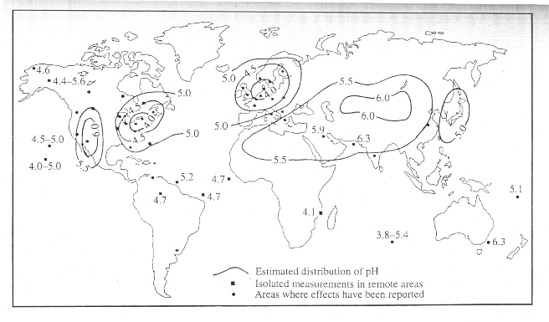
pH of Precipitation

