Slide 1
CHEM 304 – 2/29/12
I.D. Tropospheric chemistry: Air Pollution
- Review Natural Tropospheric Chem.
- Methane Oxidation
- Generalized Hydrocarbon Oxidation Mechanism —> Photochemical Smog
READ Ch.3, Ch.5, appendix on org. chem.
Quiz Monday: Ozone Hole, natural Trop. Chem, Methane oxidation, Photo. Smog; HW # 5 & #6 (1-3).

Slide 2
Pictorial view of Basic Tropospheric Chemistry …

Slide 3
Hydrocarbon Oxidation (As generalized from CH₄)
R–CH₃ + OH —> RCH₂ + H₂O
R–CH₂ + O₂ —> R–CH₂O₂
R–CH₂O₂ + NO —> NO₂ + R–CH₂O
NO₂ + hν —> NO + O
O₂ + O + M —> O₃ + M
R–CH₂O + O₂ —> R–CHO + HO₂
HO₂ + NO —> NO₂ + OH
NET: R–CH₃ + 4 O₂ —> R–CHO + 2 O₃ + H₂O

Slide 4
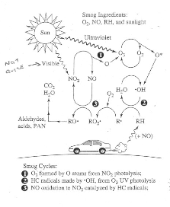
Primary Pollutants
Relative to “background”
More NO
- More NO –>NO₂
(From RO₂)
(More O₃)
- Increase demand for O (inc. production too!)
Secondary Pollutants

Slide 7
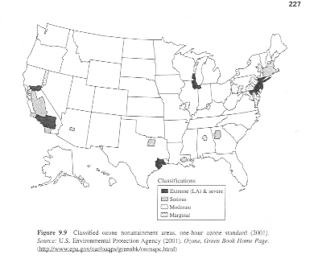

Slide 8
