Slide 1
CHEM 304 – 2/27/12
I.D. Tropospheric chemistry:
- biogenic compounds & sources
- anthropogenic compounds & their sources
- OH: NOx, O₃,CO
—> then the “big picture”
READ Ch. #3, Ch. #5, & appendix on org. chem.
The detailed stuff we covern next is in #5.

Slide 2
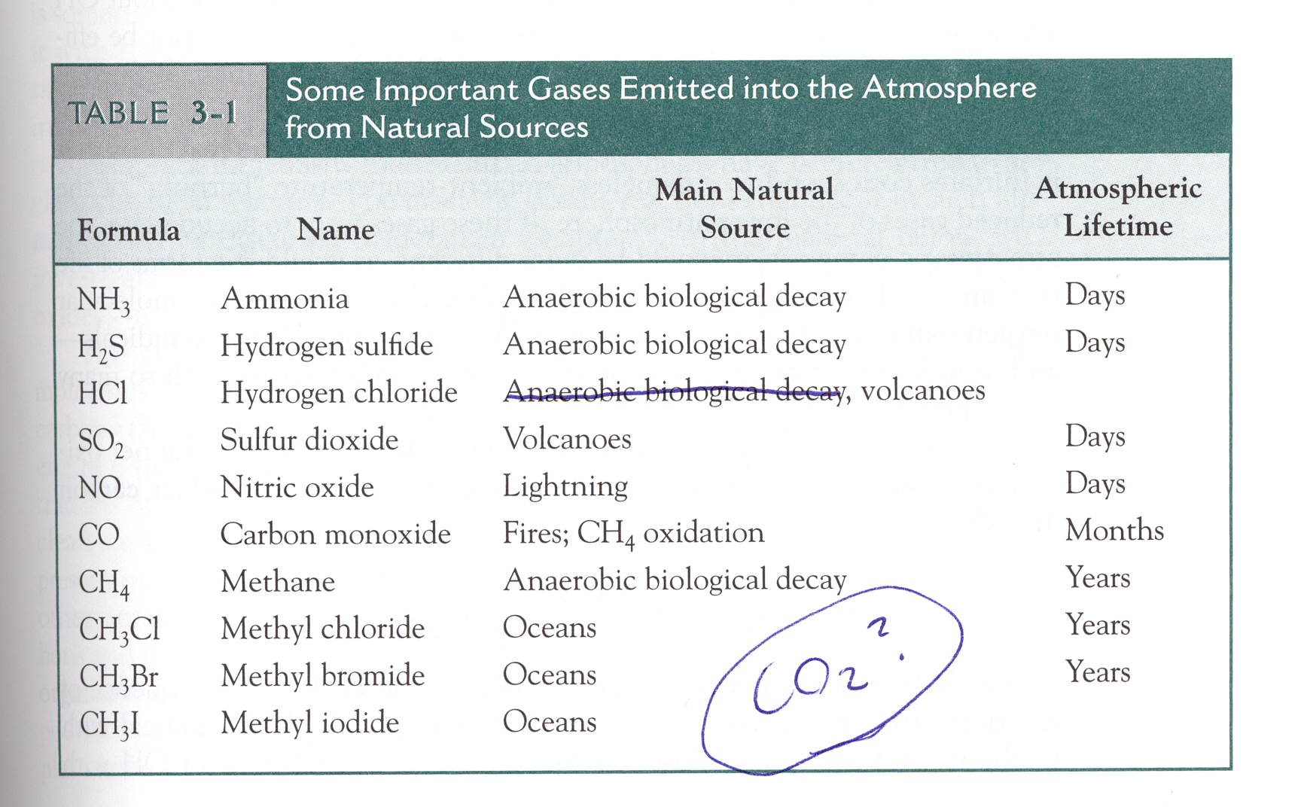
Trace gases - Natural Sources …
And LOTS of VOC’s from plants …

Slide 3
5 possible fates of a compound introduced into the troposphere:
Dry deposition: direct absorption on plants or in soils, etc.
Wet deposition or “rainout”: dissolve –> precip.
Transport to Stratosphere: Long lifetime!
Photochemistry: λ > 300 nm only (NO₂, O₃)
Reaction with OH: this is the primary chemical loss path (and the end result is ultimately oxidation)

Slide 4
Pictorial view of Basic Tropospheric Chemistry …

