Slide 1
CHEM 304 - 2/24/12
I.C. Stratospheric Chemistry:
• The Antarctic Ozone Hole:
- Observations
- Non-chemical factors - “The Set-up”
- Chemical Processes - “The Action”
- Some links and animations
FINISH READING CH 2
HW#5 out
Web update today

Slide 2
Ozone Hole links & animations … for starters
(What the ___ is this ?)
http://www.youtube.com/watch?v=LSuNPbT-uvo&NR=1
(2000 O3 hole animation)
http://svs.gsfc.nasa.gov/vis/a000000/a001100/a001167/a001167.mpg
(A history lesson)
http://ozonewatch.gsfc.nasa.gov/facts/history.html
(A good image of the O3 hole and a PSC)
http://ozonewatch.gsfc.nasa.gov/facts/hole.html

Slide 3
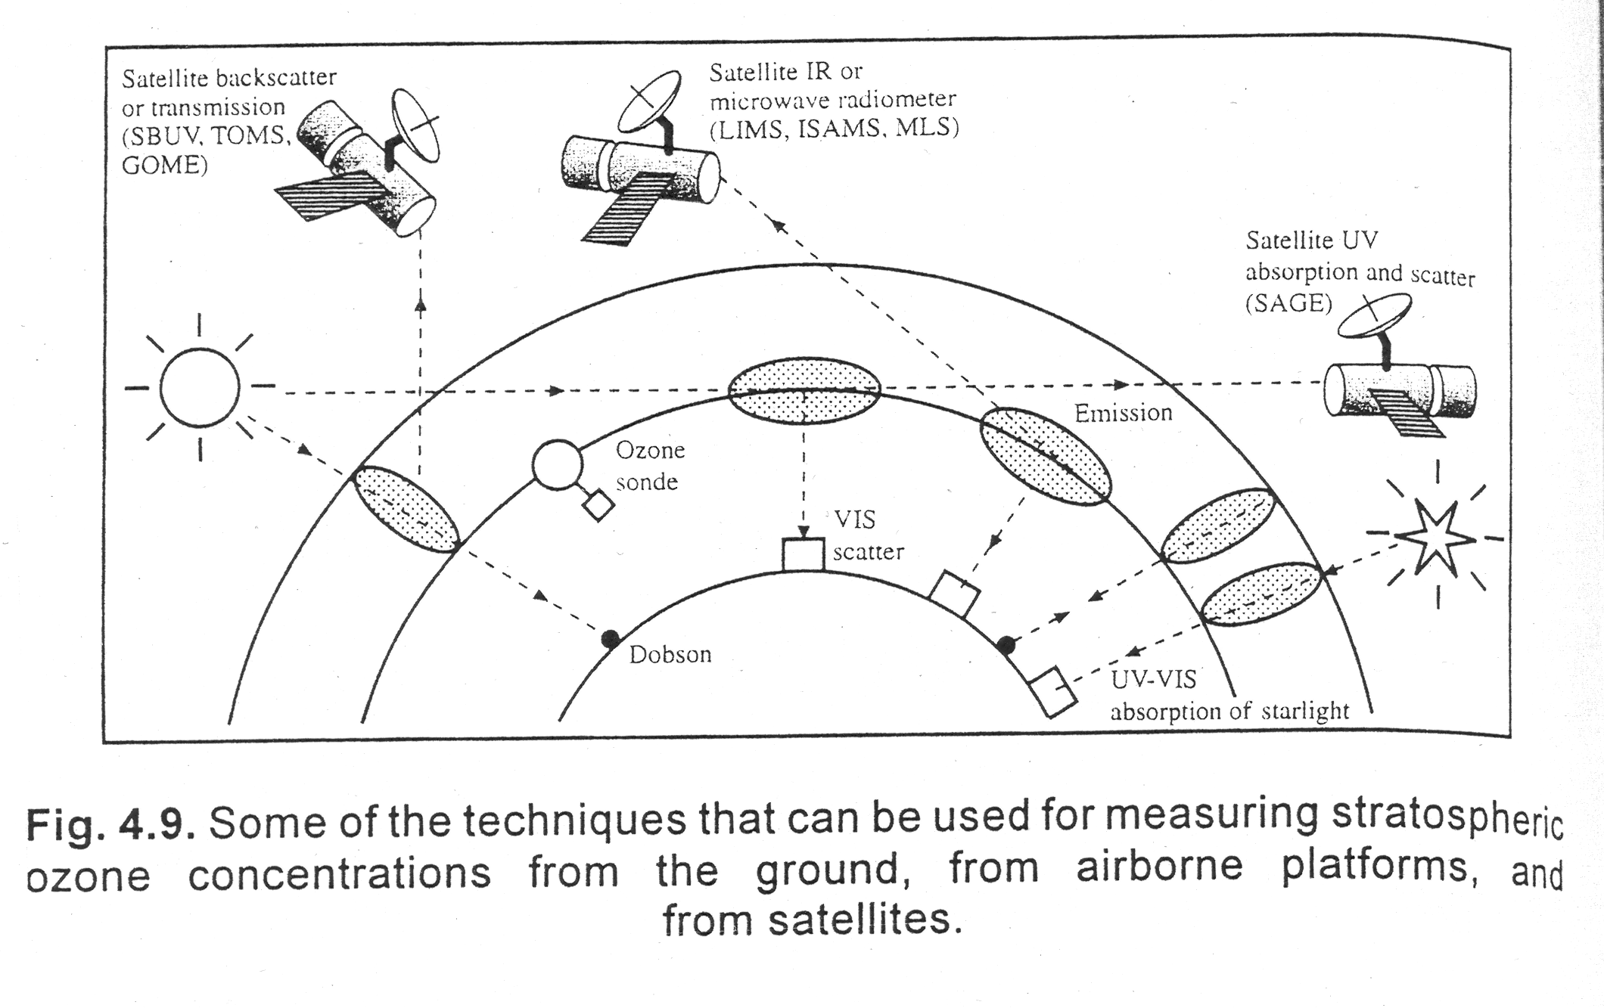
How do we measure Ozone?

Slide 4
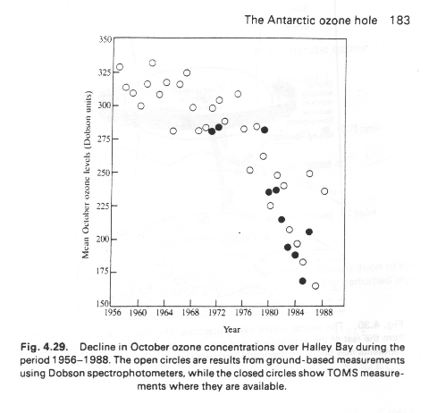
Data from Farman’s “Dobson” Measurements

Slide 5
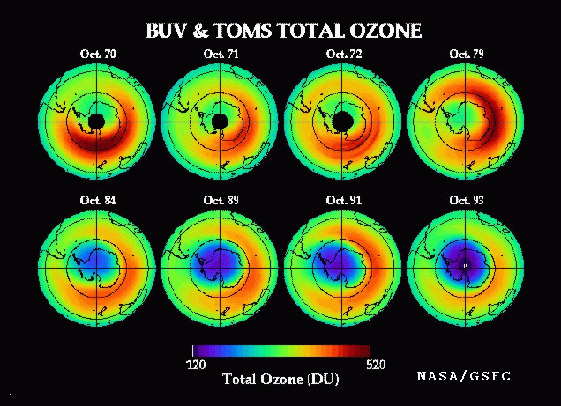

Slide 6
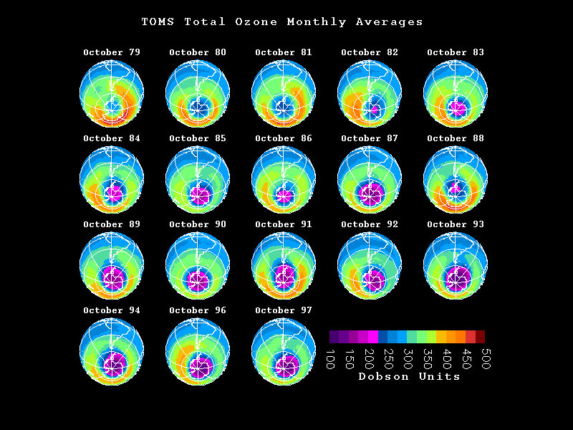

Slide 7
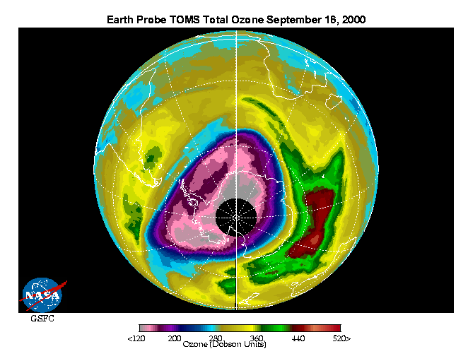

Slide 8
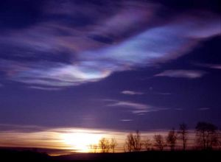
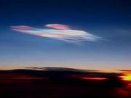
Polar Stratospheric Clouds

Slide 9
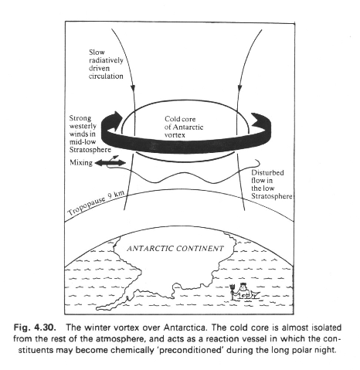
The polar Vortex ..

Slide 10
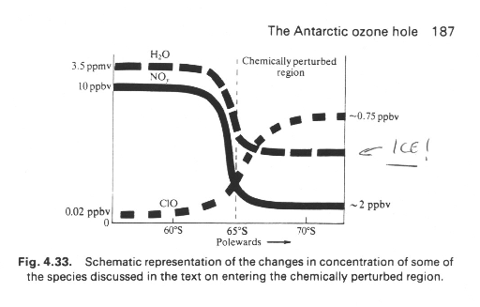
Priming the Chemistry…

Slide 11
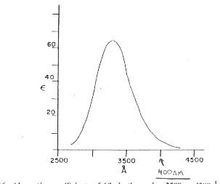
Cl₂ is a very “shallow” reservoir … why ?

Slide 12
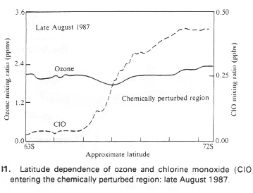
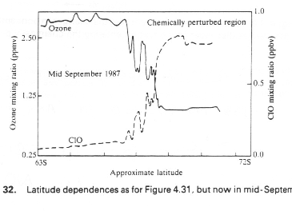
<— Anomalous Hi ClOx
Onset of “Dimer” Chemistry —>

Slide 13
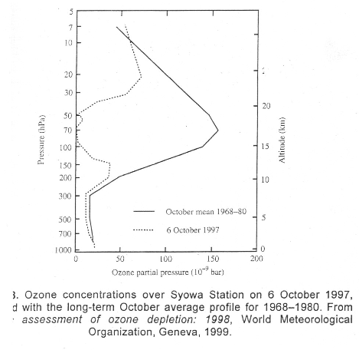
At some altitudes there is excess ClOx - the Ozone has been “titrated” out of the sky !

Slide 14
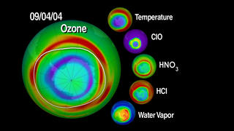

Slide 15
More Ozone Hole links & animations …
(2000 O3 hole animation)
http://svs.gsfc.nasa.gov/vis/a000000/a001100/a001167/a001167.mpg
(1997 O3 hole animation)
http://jwocky.gsfc.nasa.gov/multi/epanim97.html
(Annual Changes) http://www.youtube.com/watch?v=taTzqRHNIEc
(A short NASA Video info …)
http://www.youtube.com/watch?v=qUfVMogIdr8&NR=1
(Arctic O3 Hole ?) http://svs.gsfc.nasa.gov/vis/a000000/a001000/a001087/
(Other Links )
http://ozonewatch.gsfc.nasa.gov/facts/hole.html
http://ozonewatch.gsfc.nasa.gov/multimedia/index.html (Mucho multimedia !)

