Slide 1
CHEM 304 – 2/22/12
I.C. Stratospheric chemistry: Ozone Depletion
• Quantifying O₃ depletion chemistry:
- How much faster is Path #1?
- HOx cycles: Hi vs LO …
• Observations - how much O₃ depletion?
• Preview: Ozone hole chemistry
READ CH 2
QUIZ AVE = 18/20

Slide 2
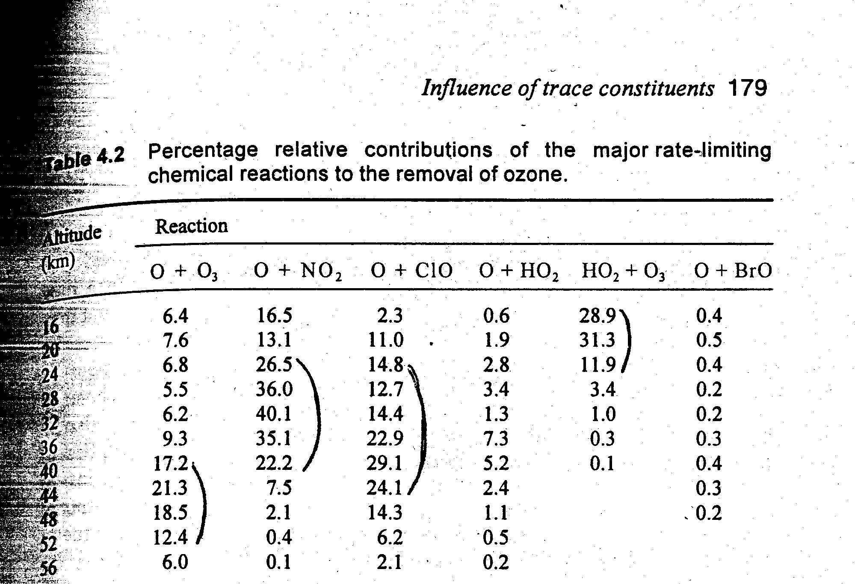
Which cycles deplete the most Ozone?

Slide 3
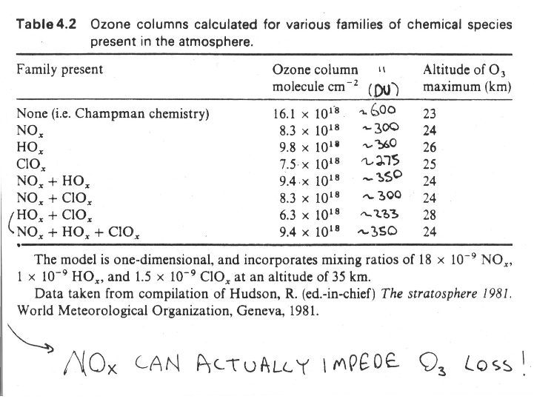

Slide 4
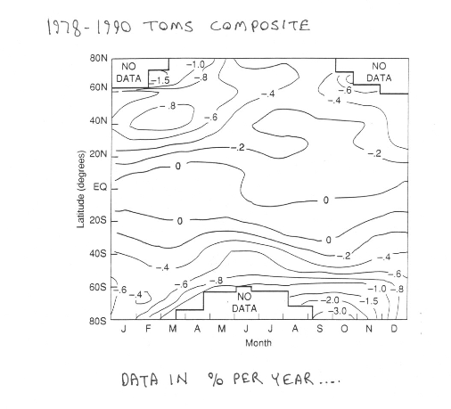

Slide 5
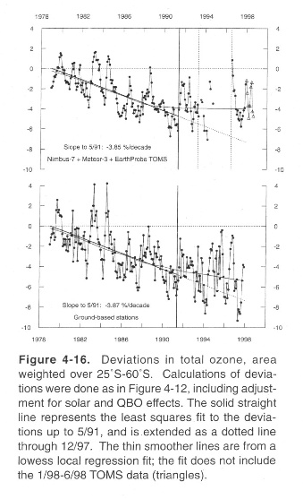

Slide 6
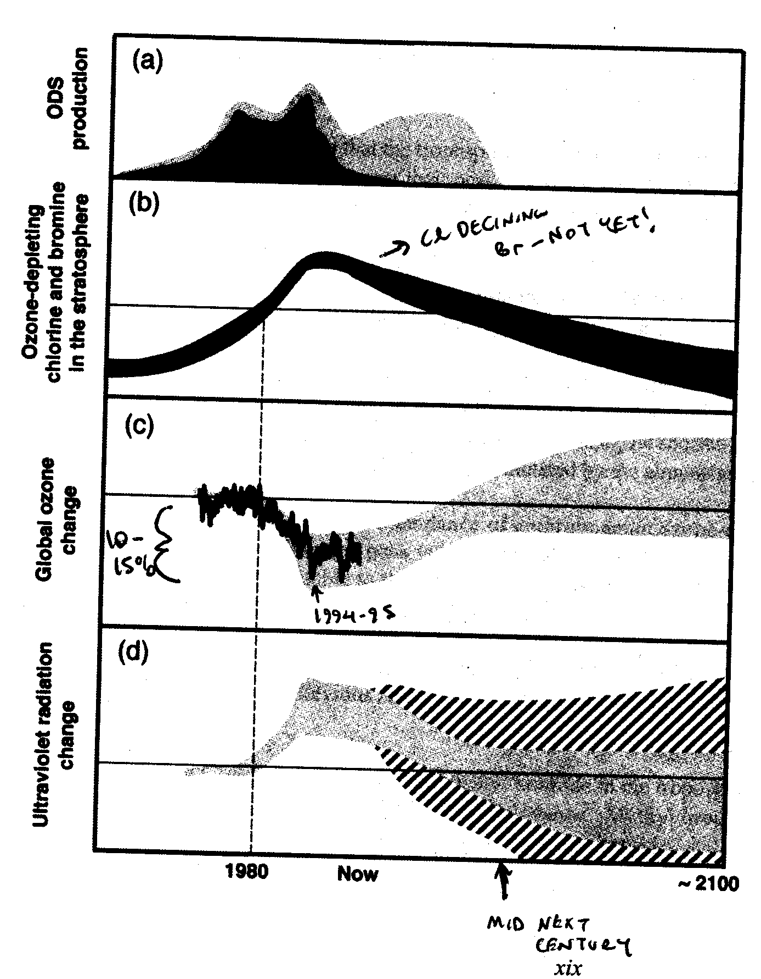
Phase-out of Ozone Depleting substances and its effect …

Slide 7
http://www.youtube.com/watch?v=LSuNPbT-uvo&NR=1
http://www.youtube.com/watch?v=YSZY8dihDXk&feature=fvw
http://www.youtube.com/watch?v=taTzqRHNIEc&feature=fvw
http://www.youtube.com/watch?v=qUfVMogIdr8&NR=1

