Slide 1
CHEM 304 - 1/25/12
0. Chemical Stability: The key issue…
I.A. Fundamentals of Atmospheric Chemistry
- Physical Structure of the Atm. (p.28-29)
- Chemical Composition of the Atm.
- Bulk considerations – stability?
- Free radicals…
Read: Baird Intro, start Chapter 1, and Ch. 3 (p.91-95)
FIELD TRIP MONDAY - DRESS WARM!

Slide 2
Key questions for Environmental Chemistry
What is out there? (i.e. what is the chemical composition of some natural entity, e.g. a lake, clean air, dirty air, etc.)
How, Why, and is it still changing? (i.e. what factors led to current composition?, what may be be driving changes?)
Is human activity a factor? (i.e. are we causing #2?)

Slide 3
The Key concept is Chemical Stability
How do we assess it ?
1) Quantitative Insight (i.e. thermochemical and/or rate data)
2) Intuitive Insight (i.e. structural considerations - “chemical intuition”)
3) Empirical Insight (i.e. what’s there?)
(i.e. what relative quantities are present?)

Slide 4
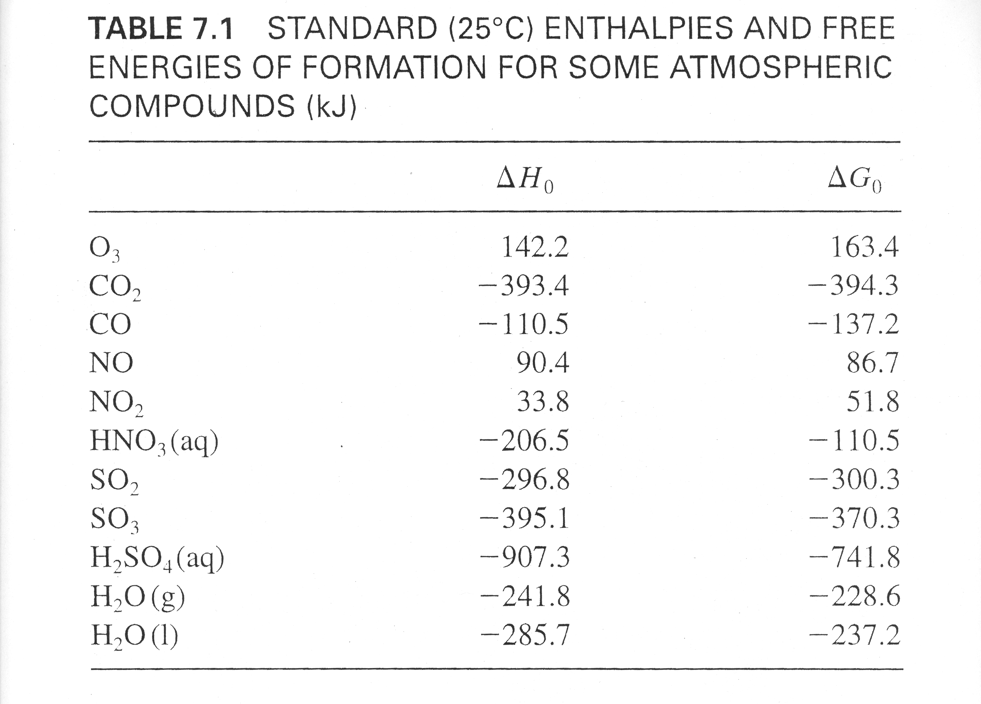
ΔH_{f} - Energy relative to Elements ( “–” means lower E)
ΔG_{f} - Overall Chemical Stability relative to Elements
(“–” means more stable/less reactive!)
http://webbook.nist.gov/chemistry

Slide 5
Where? Part I – The Atmosphere
Note: atm is smallest part of Earth System
atmosphere: 5.0 x 10¹⁸ kg
hydrosphere: 1.4 x 10²¹ kg
lithosphere: 6.0 x 10²⁴ kg

Slide 6
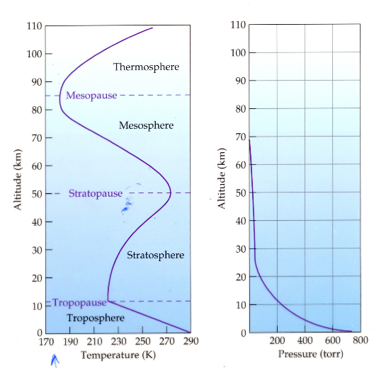

Slide 7
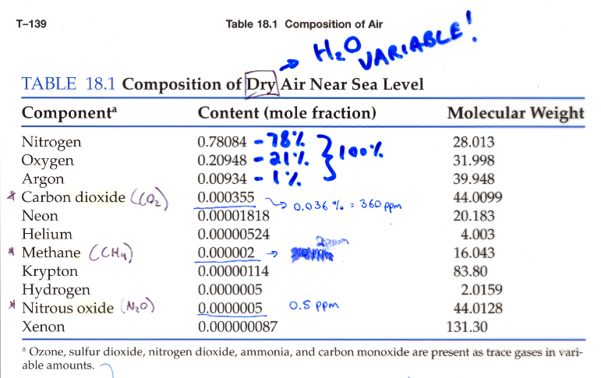

Slide 8
Some lingo regarding “Trace species” (e.g. pollutants, reactive substances, etc.)
Source: reaction or process that release trace compound.
Sink: Reaction or process that “permanently” removes trace compound.
Reservoir: An entity (process, substance, physical feature) that temporarily holds a trace substance

Slide 9
Which of the following are “free radicals”?
(all are neutral …)
CH₃, ClONO₂, NO₃, SO₃, HOSO₂, Cl₂O₂ CH₃, NO₃, & HOSO₂

Slide 10
A summary for free radical reaction types:
Initiation: X-Y —> X° + Y ° (often light-driven)
Propagation: X° + Y-Z —> XY + Z° or
X° + W —> XW°
Initiation: X° + Y ° —> X-Y

